Slide 1

Unit 4 Week 1

Slide 2

Welcome to
Children’s Church

Slide 3
Good Afternoon and What is your Good News today?

Slide 4
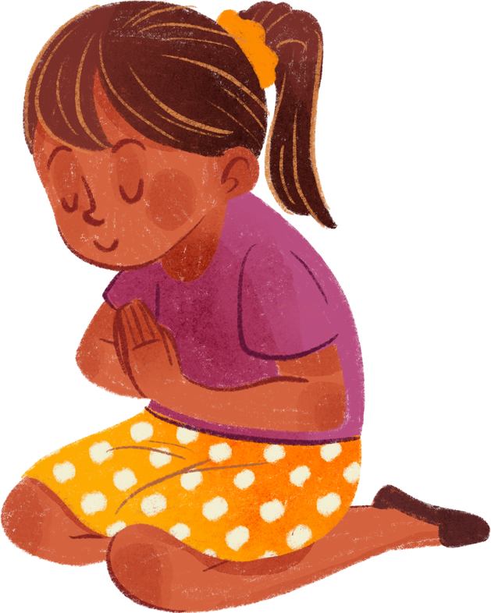
Let’s pray together!

Slide 5
Let’s sing together!
Jesus loves me

Slide 6
Do you know who Jesus is?

Slide 7
Jesus is the Son of God. He was born in Bethlehem over 2,000 years ago.

Slide 8
Memory Verse
“For God so loved the world, that he gave his only begotten Son, that whosoever believeth in him should not perish, but have everlasting life.”
‭‭John‬ ‭3‬:‭16‬ ‭KJV‬‬

Slide 9
Focus
We will learn about the birth of Jesus Christ and understand its significance in the Christian faith.

Slide 10
Focus Scripture
Luke 2:11 - "Today in the town of David a Savior has been born to you; he is the Messiah, the Lord."

Slide 11
Let’s Read Luke 2:1-20
EasyEnglish Bible Version
Jesus is born in Bethlehem
1 At that time, Caesar Augustus made a law. He told his men to count everyone who lived in the countries that he ruled. 2 This was the first time that the Romans had made a list of everyone's names. Quirinius was the Roman ruler of Syria when it happened.
3 Everyone went to his own home town for the Romans to count them. 4 So Joseph went to his home town, Bethlehem. He was living in the town of Nazareth, in Galilee. Bethlehem was in Judea. King David had been born there, so Bethlehem was called the town of David. Joseph belonged to the family of David. That is why he went to Bethlehem.

Slide 12
Pause to ask questions to check for comprehension.
  Why did Joseph go to Bethlehem?
  Where was Joseph living?
  What family did Joseph belong to?

Slide 13
5 Joseph took Mary with him so that the Romans could count them. She went because she had promised to marry Joseph. She was pregnant.
6 While they were in Bethlehem, the time came for her baby to be born. 7 This was her first baby, and it was a boy. She put cloths around him. Then she put him in an animal's food box. She did this because the rooms for visitors were full of people.
An angel sends some shepherds to see the baby Jesus
8 That night some shepherds were living out in the fields near Bethlehem. They were keeping their sheep safe. 9 Then an angel of the Lord appeared to them. A bright light from God shone all around them. That frightened them very much. 10 The angel said to them, ‘Do not be afraid. Listen! I bring you good news. This news will make everyone very happy.

Slide 14
Pause to ask questions to check for comprehension.
  Why did Mary put her son, Jesus, in an animal food basket?
  Who told the shepherds the good news?

Slide 15
11 Something happened today in the town of David. Someone special was born. He is the one who will save you. He is the Messiah. He is the Lord. 12 I will tell you how you will know this baby. You will find him with cloths around him. He is lying in an animal's food box.’
13 At that moment, a great crowd of angels appeared. They were praising God. They said:
14 ‘God is great! He lives in the highest place above.
He will bless the people on earth who please him.
They will have peace in their minds.’

Slide 16
Pause to ask questions to check for comprehension.
  How did the shepherds know that Jesus was the Messiah and the Lord?
  Who said “God is great. And He lives in the highest place above?”

Slide 17
15 After that, the angels went away and returned to heaven. Then the shepherds said to each other, ‘We should leave the sheep and go to Bethlehem immediately! The Lord God has sent his angels to tell us what has happened. We want to see this baby.’
16 So the shepherds went quickly to Bethlehem. When they got there, they found Mary and Joseph with the baby. The baby really was lying in a food box.
17 After they had seen the baby, they told everybody about him. They told them what the angel had said to them about him. 18 Many people heard what the shepherds said. The people were very surprised. 19 Mary remembered everything that the shepherds had said. She thought about it all for a long time. 20 The shepherds then went back to their sheep. As they went they praised God. They said, ‘How great you are! How good you are! Everything that the angel told us was true! We have heard good news. We have seen very special things!’

Slide 18
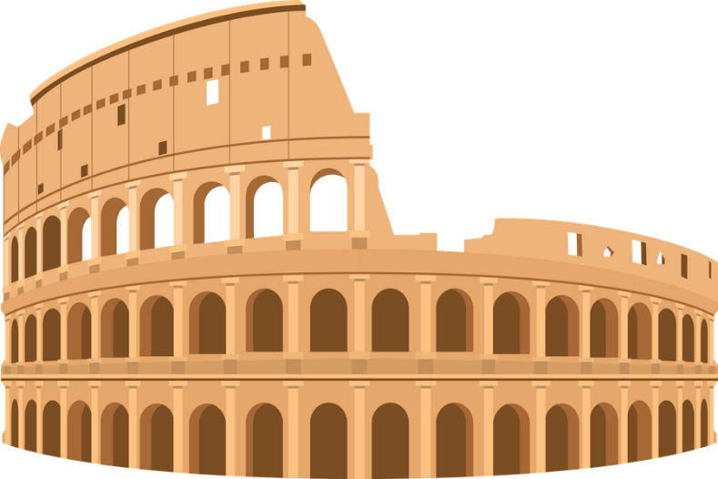
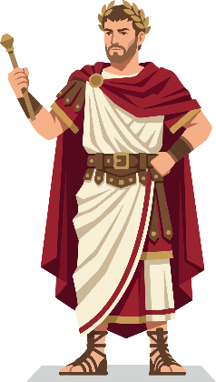


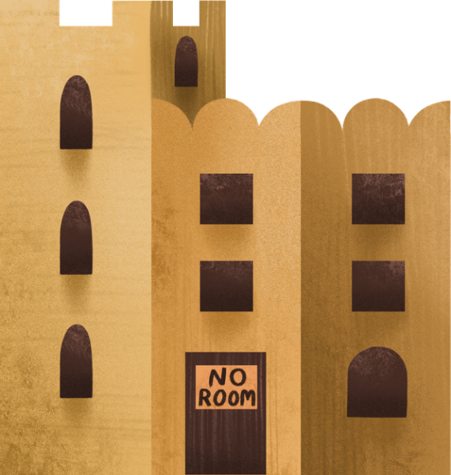

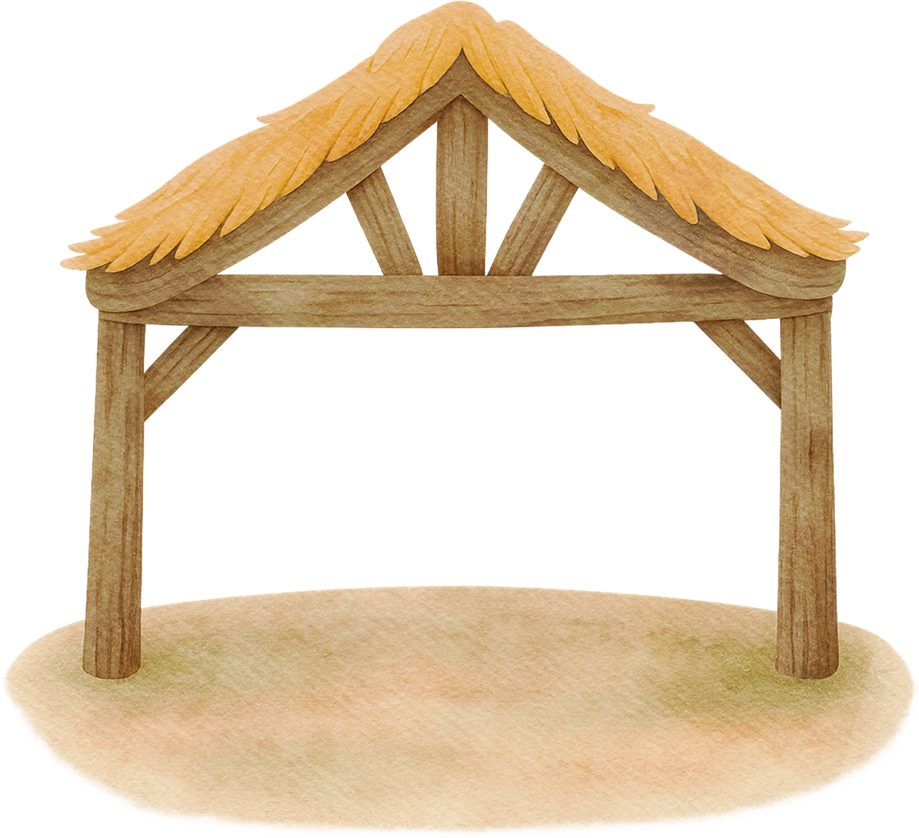
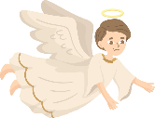
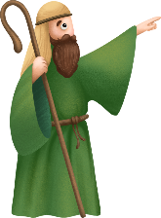


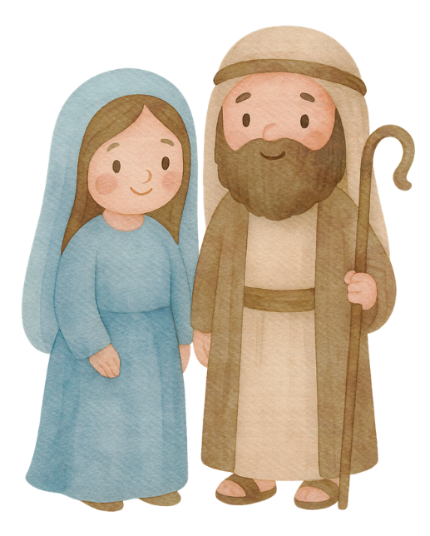
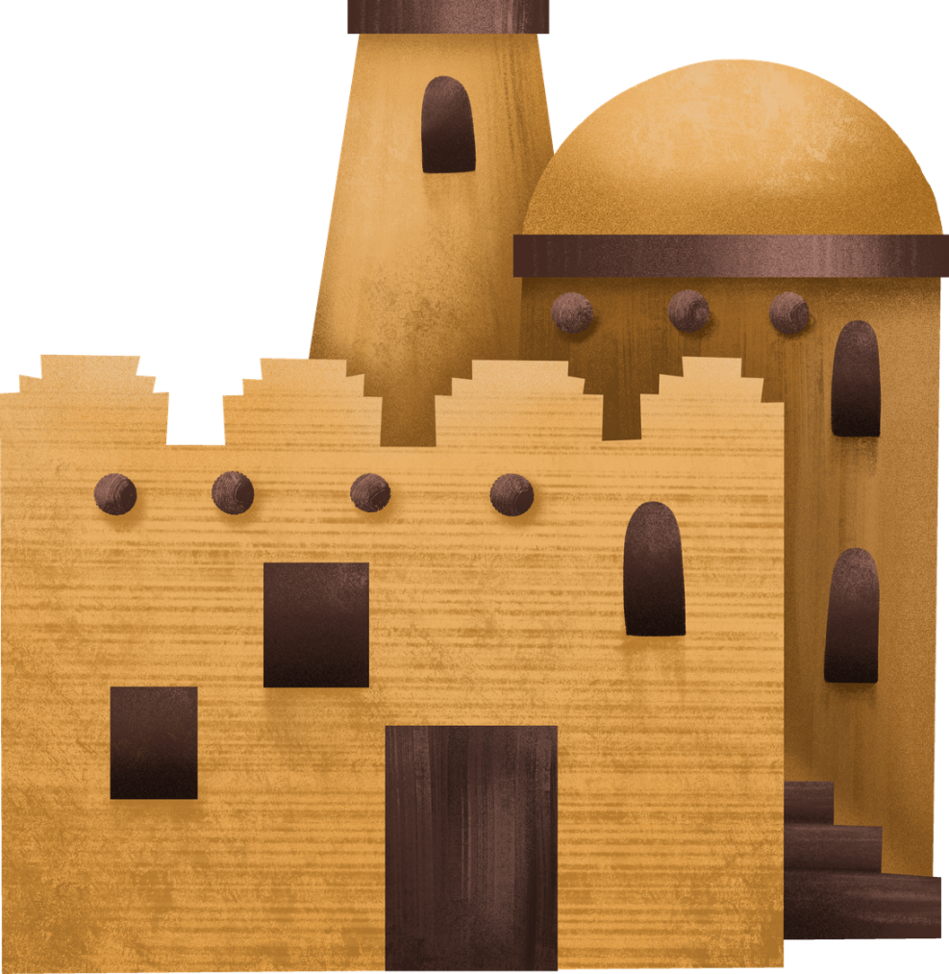

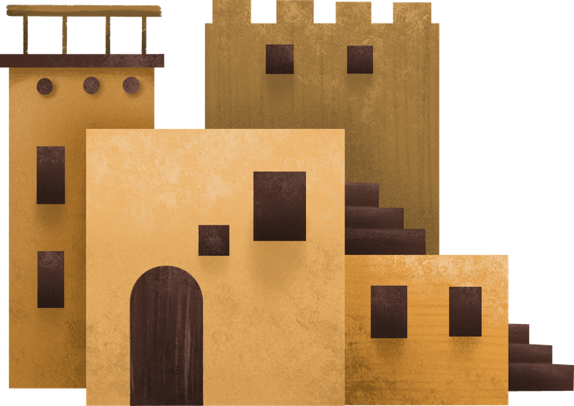


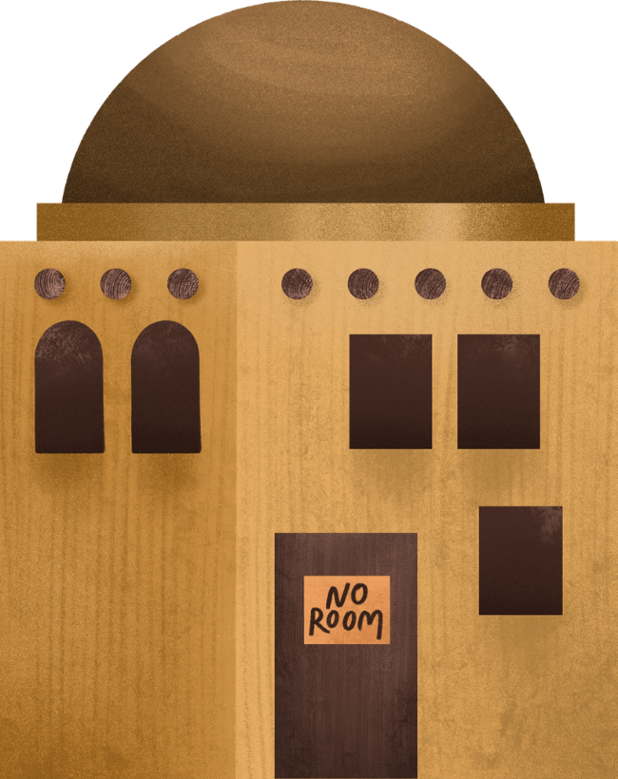
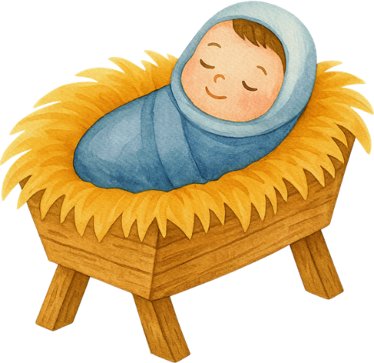
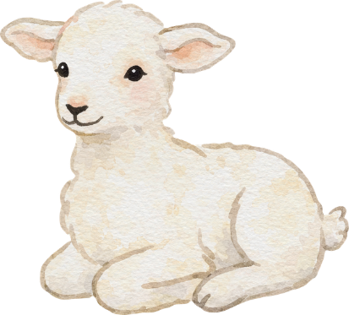
Activity: I-Spy
As you play I-spy ask the children about each character. Example what were the shepherds doing the night the angel spoke to them?
Bethlehem

Slide 19
Reflection Questions
  Why did Mary and Joseph travel to Bethlehem?
  How do you think Mary and Joseph felt when Jesus was born?
  What did the angels say to the shepherds?
  Why is Jesus' birth important for Christians?
  How can we celebrate Jesus' birth in our own lives?

Slide 20
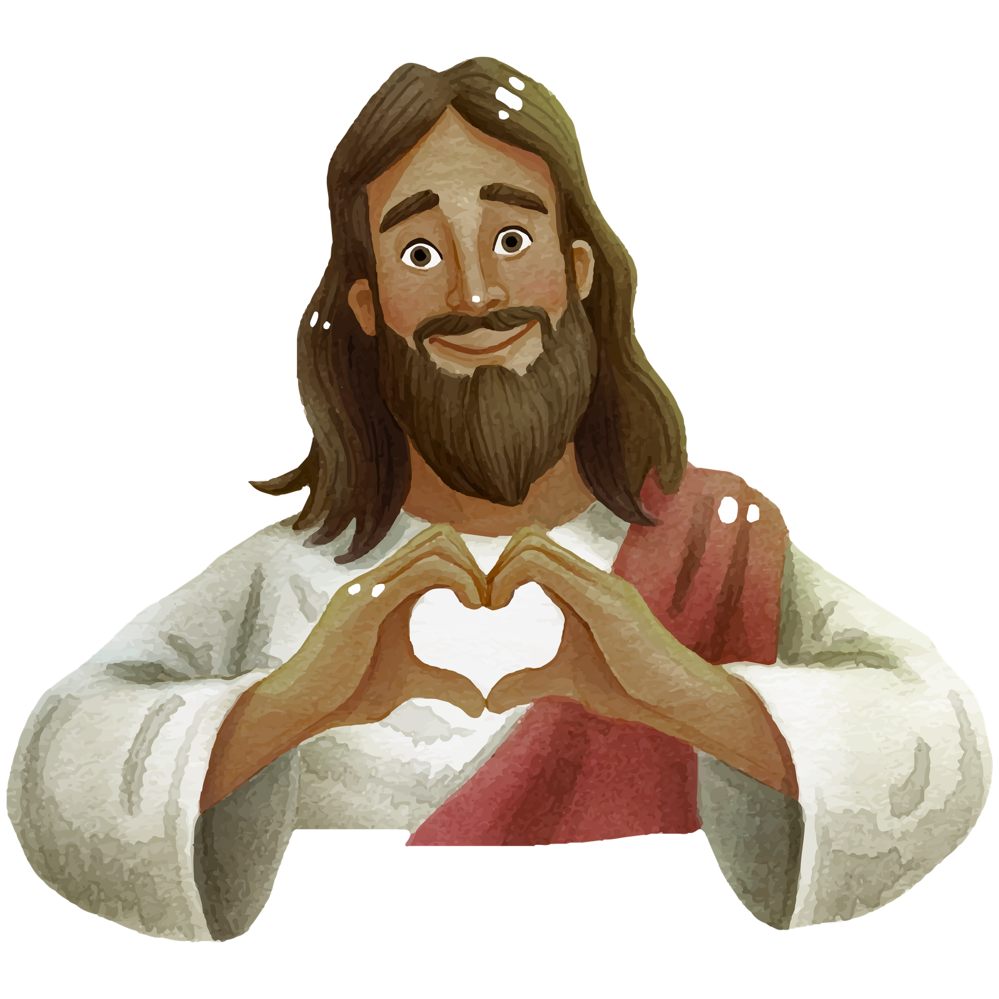
Conclusion: The Message of Jesus Today
Jesus came to teach us about love, peace and kindness.

Slide 21
Let’s pray together!

