Slide 1


God Love Us
Unit 4 Week 3

Slide 2
Welcome to
Children’s Church

Slide 3
Good Afternoon and What is your Good News today?

Slide 4
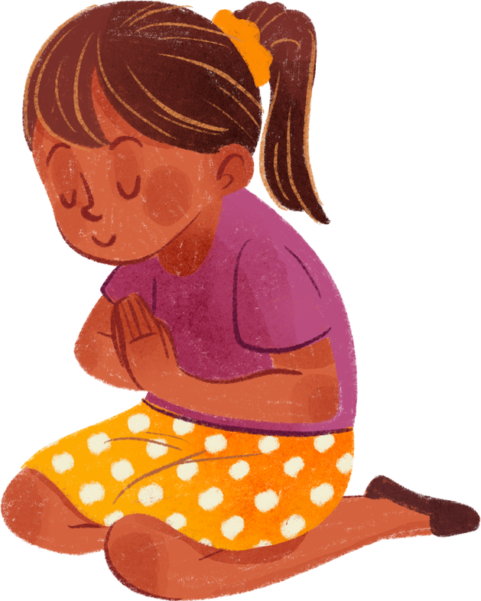
Let’s pray together!

Slide 5
Let’s sing together!
What A Mighty God

Slide 6
Do you know how much God loves you?

Slide 7
God loves you so much that even through our mistakes He does not give up on us.

Slide 8
Memory Verse
“For God so loved the world, that he gave his only begotten Son, that whosoever believeth in him should not perish, but have everlasting life.”
‭‭John‬ ‭3‬:‭16‬ ‭KJV‬‬

Slide 9
Focus
We will learn about the depths of God’s love and the sacrifice Jesus made for us.

Slide 10
Focus Scripture
Romans 5:8 NIV
“But God demonstrates his own love for us in this: While we were still sinners, Christ died for us.”

Slide 11
What Do You think the Focus Scripture Means?
Romans 5:8 NIV
“But God demonstrates his own love for us in this: While we were still sinners, Christ died for us.”

Slide 12


Activity: Story time
Rules:
  Everyone will get up to 2 minutes to tell the group about a time that they felt loved. I will set a timer.
  While the person is talking everyone else is to be quiet.
  If you have a question it will have to wait until the person is done talking.

Slide 13
In each one of your stories the love of God was present. No matter how big or small the act is, the love of God is always in the midst. Even when we aren’t aware of it.

Slide 14
Bible Story Time
A long, long time ago in a land called Israel. There was a man named Jesus. He was a gift from God. Some called Him the Son of man and others called Him the son of David, but God called Him “My Beloved Son.” While Jesus was on earth He would tell stories, teach the people, heal the sick, and cast out demons. After some time had passed He had a big sacrifice to make. His sacrifice was to die to save the world. The night before He was crucified He prayed to the Father and said “Not my will, but your will be done.” You see Jesus knew what was to come and the pain and suffering He was going to face, but He did it anyways because He loved us. So, He layed down His life for us so that we could be with the Father in heaven.

Slide 15


Slide 16
Let’s talk about the video

Slide 18

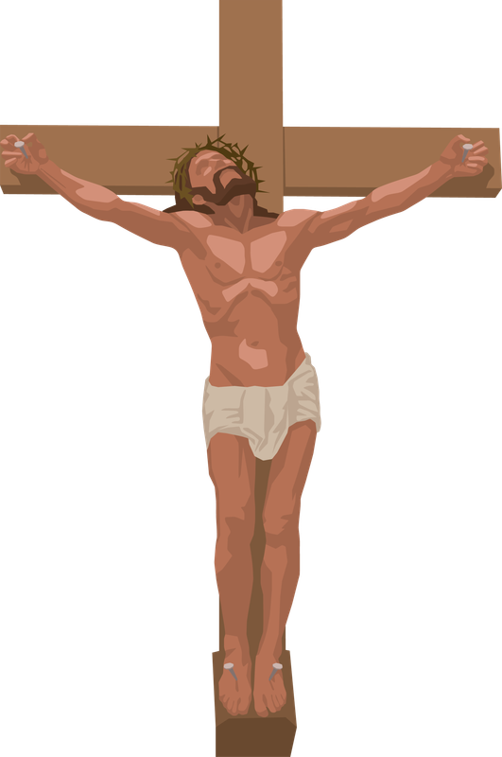
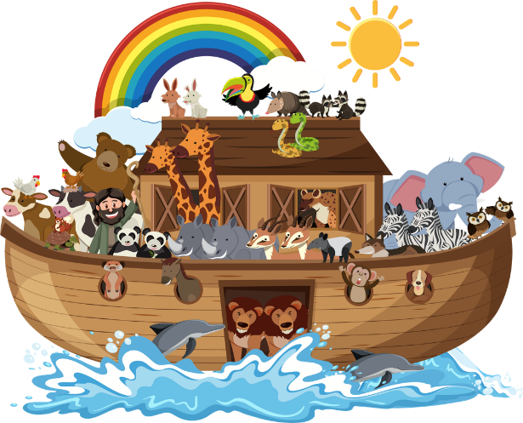
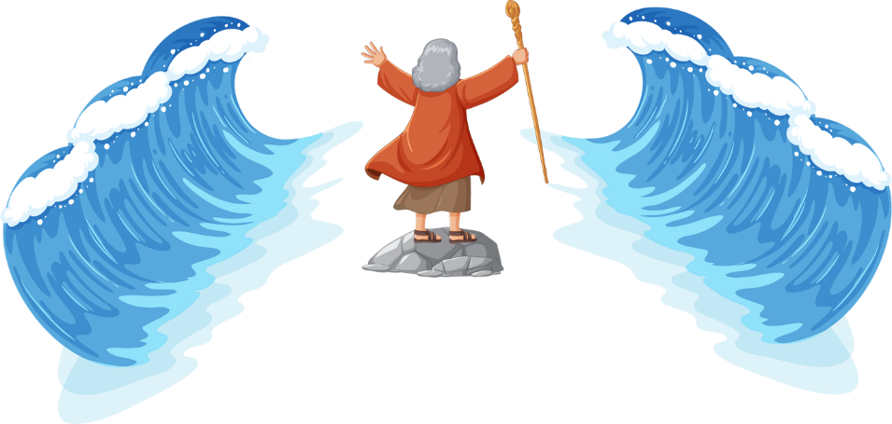
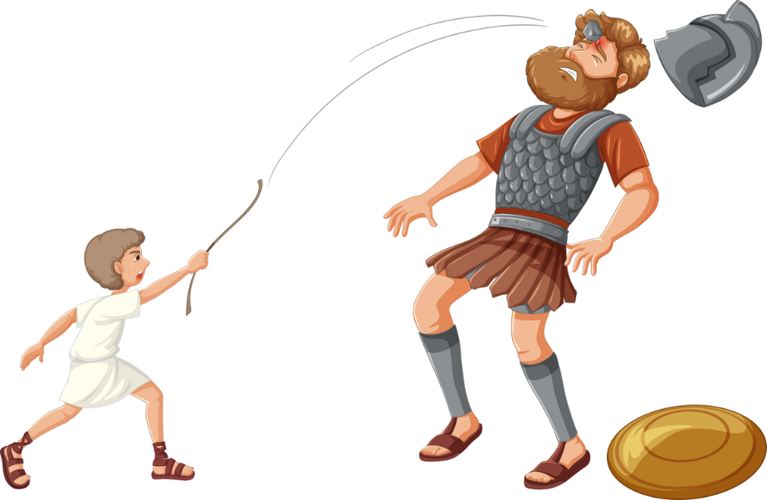
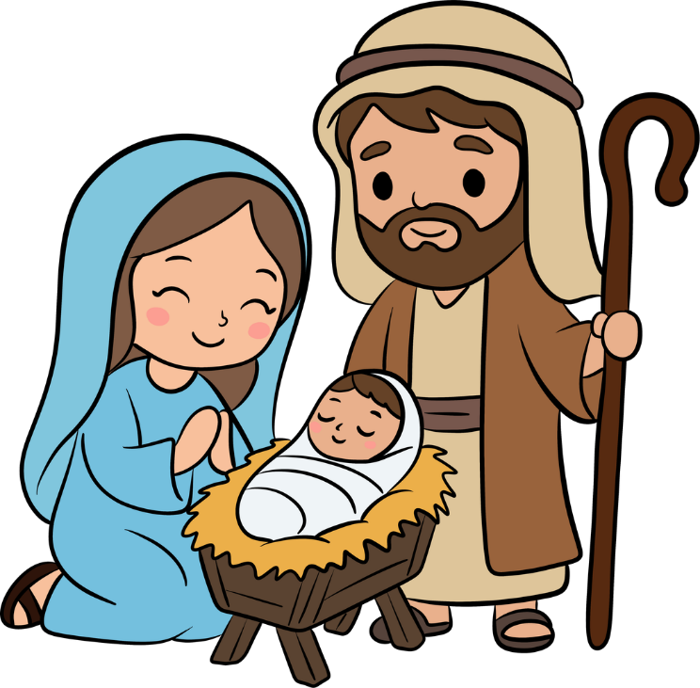
Activity:
Name the picture to the Bible story.

Slide 19
Reflection Questions
  What is something you learned today?
  What is one way God demonstrates His love for us?
  What did Christ do for us while we were sinners?

Slide 20
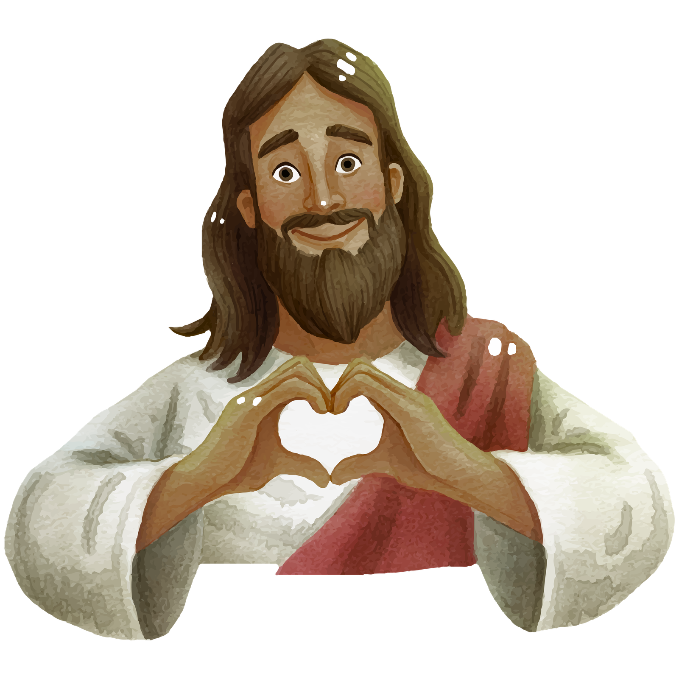
Conclusion: The Message of God’s love
Even though we make mistakes, God loves us so much that He sent Jesus to die for our sins.

Slide 21
Let’s pray together!

