Slide 1


Unit 4 Week 4

Slide 2

Welcome to
Children’s Church

Slide 3
Good Afternoon and What is your Good News today?

Slide 4
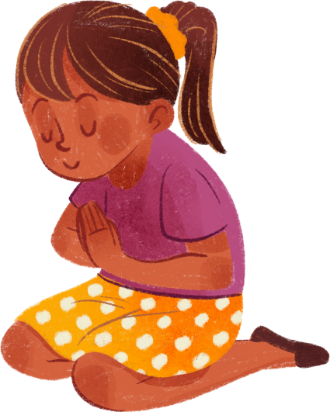
Let’s pray together!

Slide 5
Let’s sing together!
What A Mighty God

Slide 6
Do you know how much God loves you?

Slide 7
God loves everyone. No one person is more important to God He loves us all. We are all unique to Him.

Slide 8
  Have you ever lost something that you really loved?
  How did that make you feel when you couldn’t find it?
  How did it make you feel when you did find it?

Slide 9
Let’s Practice our Memory Verse
“For God so loved the world, that he gave his only begotten Son, that whosoever believeth in him should not perish, but have everlasting life.”
‭‭John‬ ‭3‬:‭16‬ ‭KJV‬‬

Slide 10
Focus
We will learn about the parable of the lost sheep and understand the importance of each individual to God.

Slide 11
Focus Scripture
“Rejoice with me; I have found my lost sheep.” -Luke 15:6

Slide 12
What Is A Parable?
A parable is a usually short fictitious story that illustrates a moral attitude or a religious principle.
Jesus used parables to teach important lessons about God’s love.

Slide 13
Words to look for:
  Sheep
  Shepherd
  Lost

Slide 14

Luke 15:1-3
Now the tax collectors and sinners were all gathering around to hear Jesus. 2 But the Pharisees and the teachers of the law muttered, “This man welcomes sinners and eats with them.”
3 Then Jesus told them this parable:

Slide 15
Luke 15:4
4 “Suppose one of you has a hundred sheep and loses one of them. Doesn’t he leave the ninety-nine in the open country and go after the lost sheep until he finds it?
  What would you do? Would you go and find your lost sheep?

Slide 16
Luke 15:5-7
5 And when he finds it, he joyfully puts it on his shoulders 6 and goes home. Then he calls his friends and neighbors together and says, ‘Rejoice with me; I have found my lost sheep.’ 7 I tell you that in the same way there will be more rejoicing in heaven over one sinner who repents than over ninety-nine righteous persons who do not need to repent.

Slide 17
Discussion Questions
  What did the shepherd do when he realized one sheep was missing?
  How did the shepherd feel when he found the lost sheep?
  What does ths parable teach us about God’s love for us?

Slide 18


Slide 19
Let’s Talk About the Video

Slide 20




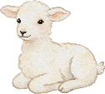



Activity:
Where is my lost sheep?
There are 4 lost sheep.
Can you find all 4 of my sheep?
I love my sheep!

Slide 21
Reflection Questions
  What is something you learned today?
  What is one way God demonstrates His love for us?
  What did Christ do for us while we were sinners?

Slide 22
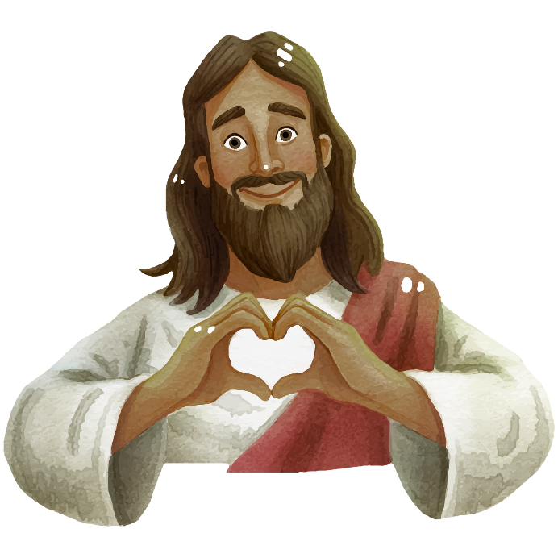
Conclusion: The Message of God’s love
God loves everyone. Whether they are a sinner or saved there is no depth that He won’t go to save you.

Slide 23
Let’s pray together!

