Slide 1


Unit 4 Week 7

Slide 2

Welcome to
Children’s Church

Slide 3
Good Afternoon and What is your Good News today?

Slide 4
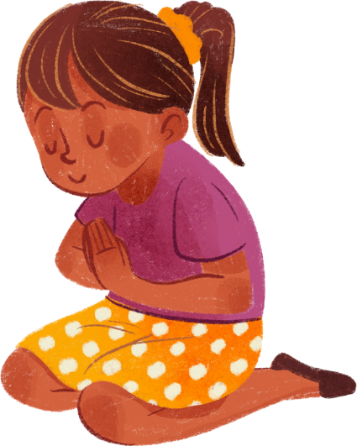
Let’s pray together!

Slide 5
Let’s sing together!
Jesus Loves Me

Slide 6
Do you know how much God loves you?

Slide 7
God’s love does not stop because we do something wrong. He continues to love us. It’s what we do after the wrong that counts.

Slide 8
  Have you ever did something wrong?
  What did you do to show that you were sorry?

Slide 9
Let’s Practice our Memory Verse
“For God so loved the world, that he gave his only begotten Son, that whosoever believeth in him should not perish, but have everlasting life.”
‭‭John‬ ‭3‬:‭16‬ ‭KJV‬‬

Slide 10
Focus
We will learn about the story of Zacchaeus and understand the importance of repentance and seeking Jesus.

Slide 11
Focus Scripture
Luke 19:10 - "For the Son of Man came to seek and to save the lost."

Slide 12
Words to look for:
  Save
  Seek
  Lost

Slide 13

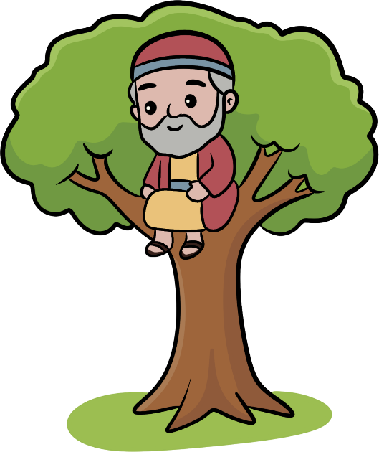
Luke 19:1-4
Jesus entered Jericho and was passing through. 2 A man was there by the name of Zacchaeus; he was a chief tax collector and was wealthy. 3 He wanted to see who Jesus was, but because he was short he could not see over the crowd. 4 So he ran ahead and climbed a sycamore-fig tree to see him, since Jesus was coming that way.
  Why did Zacchaeus climb the sycamore-fig tree?

Slide 14
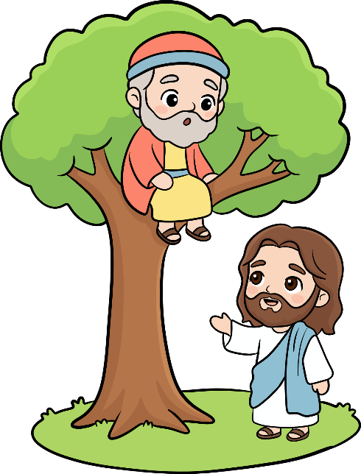
Luke 19:5-7
5 When Jesus reached the spot, he looked up and said to him, “Zacchaeus, come down immediately. I must stay at your house today.” 6 So he came down at once and welcomed him gladly.
7 All the people saw this and began to mutter, “He has gone to be the guest of a sinner.”
  How did Jesus reach when He seen Zacchaeus?

Slide 15
Luke 19:8-10
8 But Zacchaeus stood up and said to the Lord, “Look, Lord! Here and now I give half of my possessions to the poor, and if I have cheated anybody out of anything, I will pay back four times the amount.”
9 Jesus said to him, “Today salvation has come to this house, because this man, too, is a son of Abraham. 10 For the Son of Man came to seek and to save the lost.”
  What did Zacchaeus do to show he was sorry?

Slide 16
Discussion Questions
  What can we learn from Zacchaeus’ story about seeking forgiveness?
  How can we seek Jesus in our daily lives?
  How can we show we are sorry for our wrong doings?

Slide 17


Slide 18
Let’s Talk About the Video

Slide 19






Activity:
Find the Coins

Slide 20

Just like you found the coins, Zacchaeus collected taxes and later had to repay for all the wrong he had done.

Slide 21
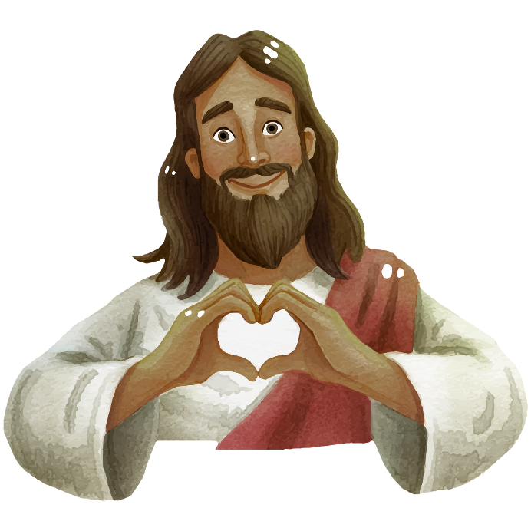
Conclusion: The Message of God’s love
Even when we do wrong the Lord will forgive us when we repent.

Slide 22
Let’s pray together!

