Slide 1



Unit 4 Week 8

Slide 2
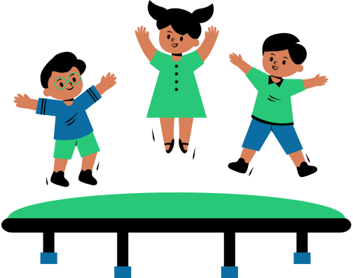
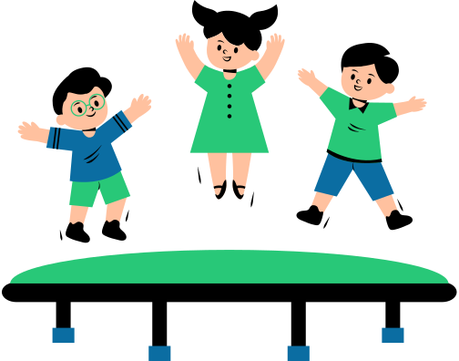
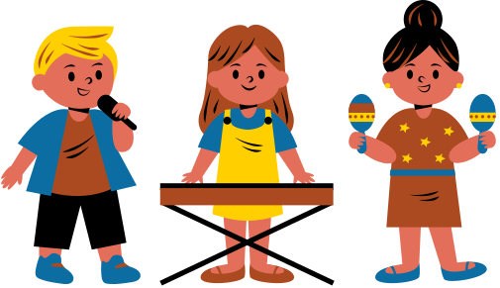
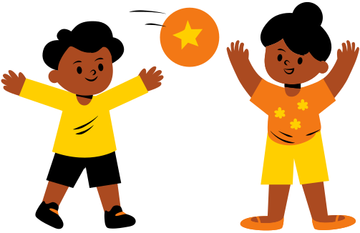

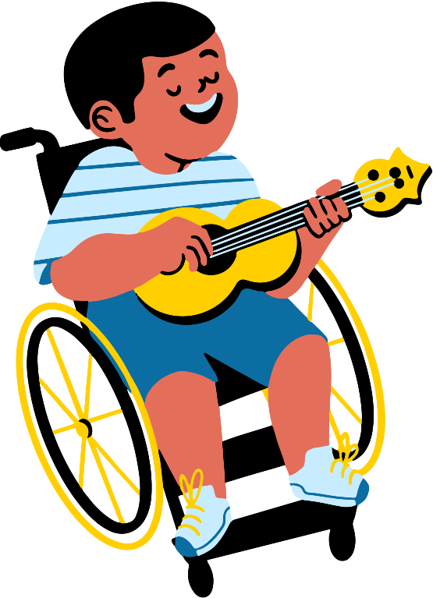
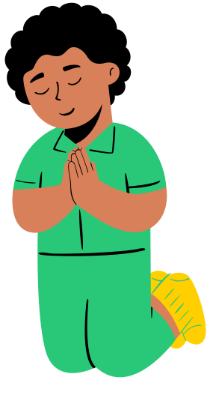
Welcome to
Children’s Church

Slide 3
Good Afternoon and What is your Good News today?

Slide 4

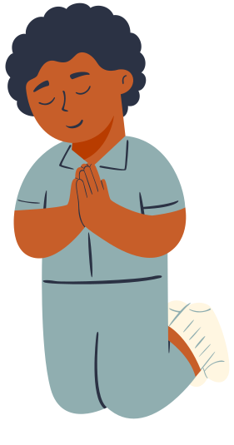
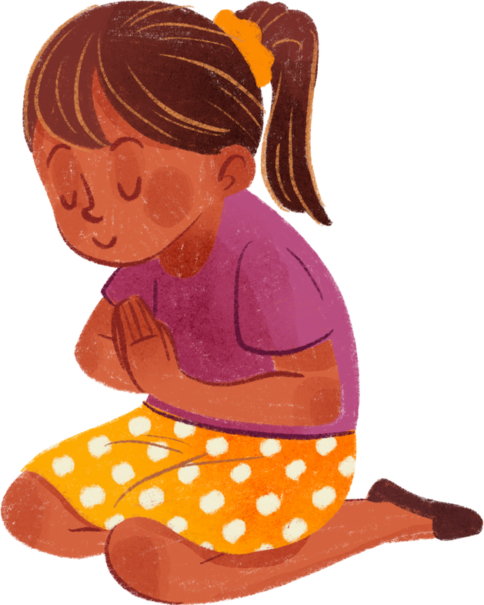
Let’s pray together!

Slide 5
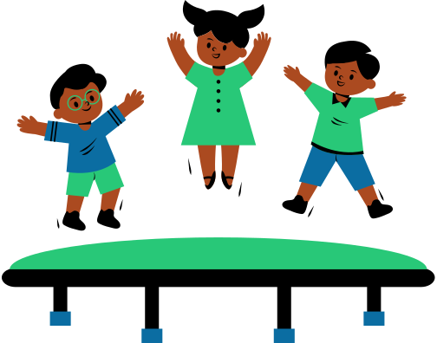
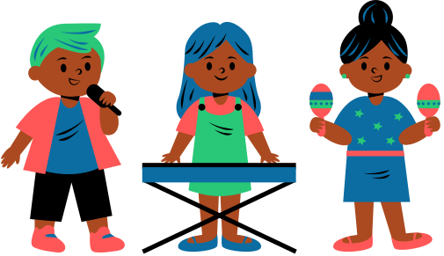

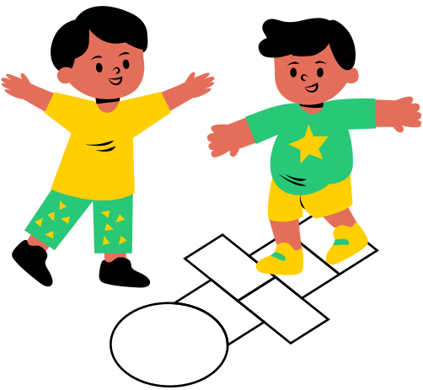

Let’s sing together!
This Little Light of Mine

Slide 6
Do you know how much God loves you?

Slide 7
Let’s Practice our Memory Verse
“For God so loved the world, that he gave his only begotten Son, that whosoever believeth in him should not perish, but have everlasting life.”
‭‭John‬ ‭3‬:‭16‬ ‭KJV‬‬

Slide 8
Focus
We will understand the significance of Baptism in the Christian faith and learn its meaning as a sacrament of initiation and purification.

Slide 9
Focus Scripture
Matthew 28:19 - "Therefore go and make disciples of all nations, baptizing them in the name of the Father and of the Son and of the Holy Spirit.”

Slide 10
Words to look for:
  Baptized
  Disciples
  Consented

Slide 11

Matthew 3:13-15
13 Then Jesus came from Galilee to the Jordan to be baptized by John. 14 But John tried to deter him, saying, “I need to be baptized by you, and do you come to me?”
15 Jesus replied, “Let it be so now; it is proper for us to do this to fulfill all righteousness.” Then John consented.
  Deter means to turn aside; discourage or prevent from happening
  Consented means to approve.

Slide 12
Matthew 3:16-17
16 As soon as Jesus was baptized, he went up out of the water. At that moment heaven was opened, and he saw the Spirit of God descending like a dove and alighting on him. 17 And a voice from heaven said, “This is my Son, whom I love; with him I am well pleased.”
  How do you think Jesus felt when the Lord said “This is my Son, whom I am well pleased.”?

Slide 13

Diving Deeper: Baptisim

Slide 14
Discussion Questions
  How does baptism change a persons life?
  What did Jesus baptism signify?

Slide 15
Activity:
Diving Deep

Slide 16
Lets Talk About The Video

Slide 17


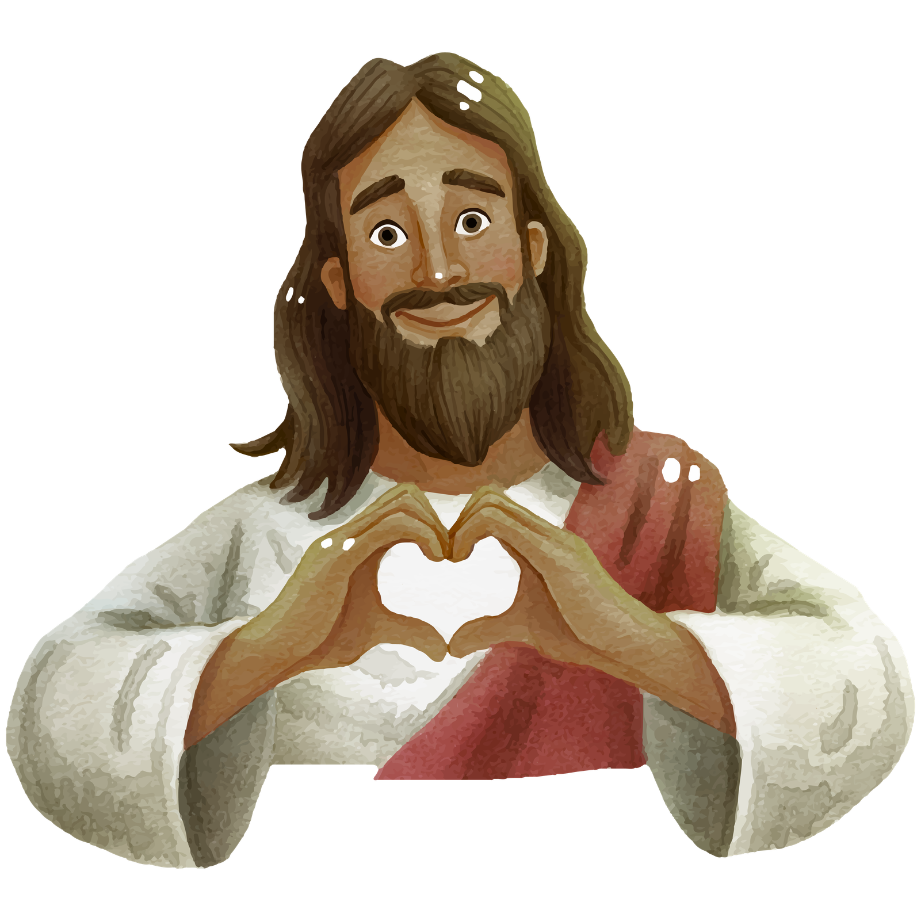


Conclusion: The Message of God’s love
Jesus did not need to be washed from sin, but he got baptized to show he loves and obeys God. When we get baptized, we follow his good example. Baptism is like wearing a team jersey. It is a public way to show everyone that you belong to God's family and love Jesus.

Slide 18
Let’s pray together!

