Slide 1


Unit 4 Week 9

Slide 2

Welcome to
Children’s Church

Slide 3
Good Afternoon and What is your Good News today?

Slide 4
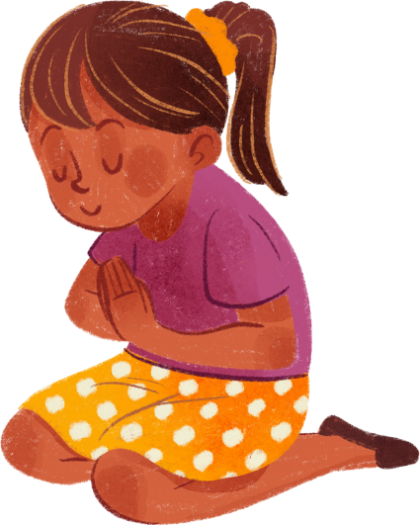
Let’s pray together!

Slide 5
Let’s sing together!
Jesus Loves Me

Slide 6
Do you know how much God loves you?

Slide 7
God’s love for us is beyond all measures. He gave us His Son to not only be a living sacrifice for us but as an example of how to love one another.

Slide 8
Let’s Practice our Memory Verse
“For God so loved the world, that he gave his only begotten Son, that whosoever believeth in him should not perish, but have everlasting life.”
‭‭John‬ ‭3‬:‭16‬ ‭KJV‬‬

Slide 9
Focus
We will learn about the Last Supper, its significance, and the importance of communion in the Christian faith.

Slide 10
Focus Scripture
Luke 22:19 “And he took bread, gave thanks and broke it, and gave it to them saying, ‘This is my body given for you; do this in rememberance of me.”

Slide 11
Words to look for:
  Passover
  Sacrafice
  Covenant

Slide 12

Luke 22:7-12
7 Then came the day of Unleavened Bread on which the Passover lamb had to be sacrificed. 8 Jesus sent Peter and John, saying, “Go and make preparations for us to eat the Passover.” 9 “Where do you want us to prepare for it?” they asked. 10 He replied, “As you enter the city, a man carrying a jar of water will meet you. Follow him to the house that he enters, 11 and say to the owner of the house, ‘The Teacher asks: Where is the guest room, where I may eat the Passover with my disciples?’ 12 He will show you a large room upstairs, all furnished. Make preparations there.”

Slide 13
Luke 22:13-16
13 They left and found things just as Jesus had told them. So they prepared the Passover.
14 When the hour came, Jesus and his apostles reclined at the table. 15 And he said to them, “I have eagerly desired to eat this Passover with you before I suffer. 16 For I tell you, I will not eat it again until it finds fulfillment in the kingdom of God.”

Slide 14
Luke 22:17-20
17 After taking the cup, he gave thanks and said, “Take this and divide it among you. 18 For I tell you I will not drink again from the fruit of the vine until the kingdom of God comes.”
19 And he took bread, gave thanks and broke it, and gave it to them, saying, “This is my body given for you; do this in remembrance of me.” 20 In the same way, after the supper he took the cup, saying, “This cup is the new covenant in my blood, which is poured out for you.[a]
  How can we remember Jesus’ sacrifice in our lives?

Slide 15
Discussion Questions
  What does the bread represent in the Last Supper?
  What does the wine represent in the Last Supper?

Slide 16


Slide 17
Let’s Talk About the Video

Slide 18
Activity:
Word Search
P
A
S
S
O
V
E
R
  Passover
  Jesus
  Save
  Covanent
  Bread
  Body
  Blood
Q
U
A
P
R
M
N
I
K
P
C
B
O
D
Y
H
L
X
R
P
R
F
G
P
C
O
V
A
N
E
N
T
J
E
S
U
S
Z
A
O
S
A
V
D
J
P
O
E
B
L
O
O
D
A
W
D

Slide 19
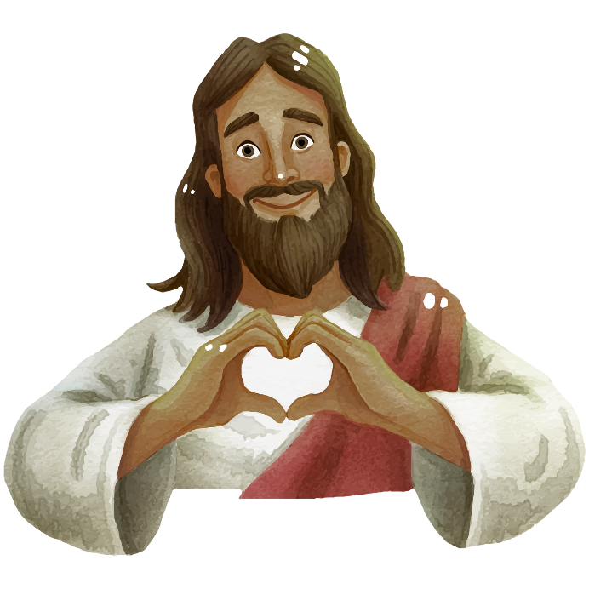
Conclusion: The Message of God’s love
The Lord sent His Son to be a living sacrifice for us. Everytime we take communion we can remember the greatest sacrifice that was given for us.

Slide 20
Let’s pray together!

