Slide 1
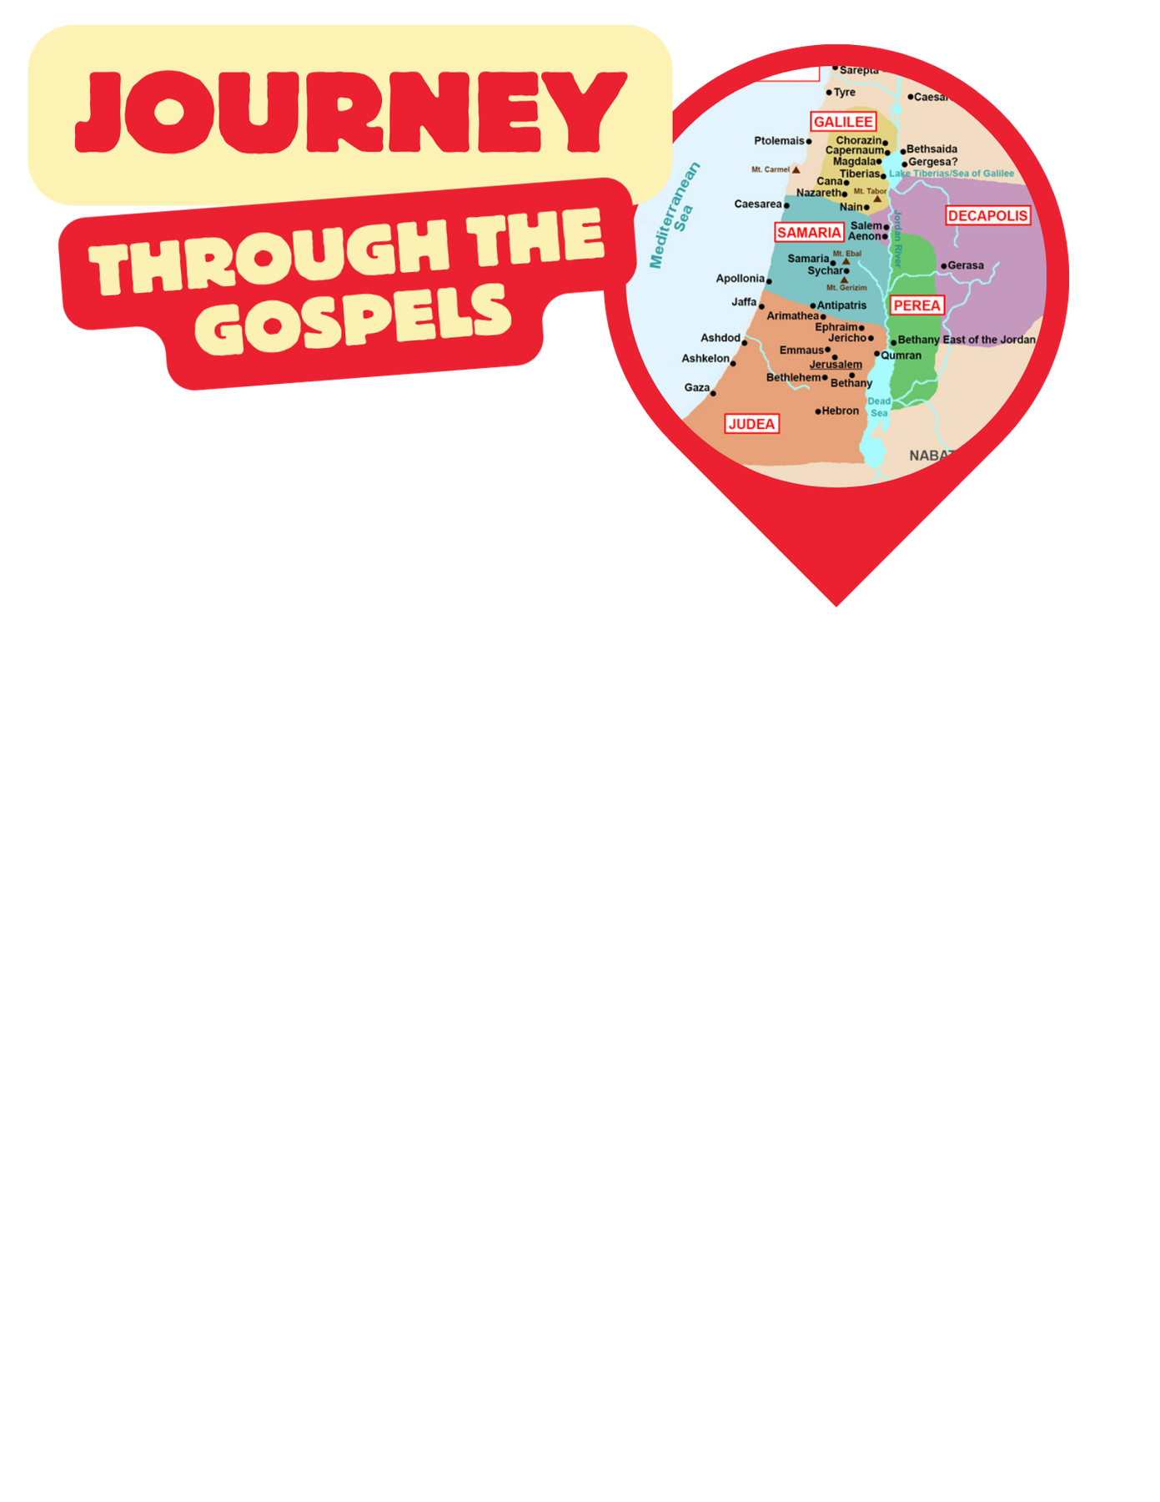
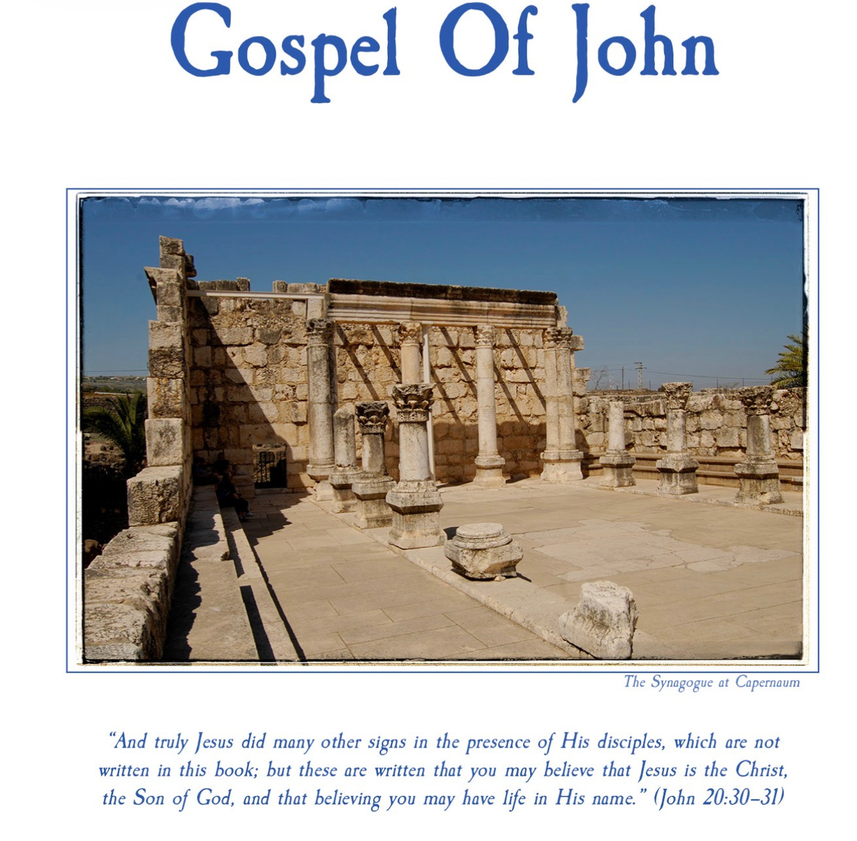
John 2: Jesus’ First Miracle, Jesus drives money changers from the Temple

Slide 2



Slide 3




Slide 4

Let us
PRAY

Slide 5



Class Expectations
Camera’s on
Actively Participate

Slide 6

Share your homework. What did you write about Chapter 1.

Slide 7



Open your Bibles to John 2
Get your notebooks and pencil

Slide 8
Jesus Changes Water Into Wine John 2:1-11
On the third day a wedding took place at Cana in Galilee. Jesus’ mother was there, 2 and Jesus and his disciples had also been invited to the wedding. 3 When the wine was gone, Jesus’ mother said to him, “They have no more wine.”
4 “Woman,[a] why do you involve me?” Jesus replied. “My hour has not yet come.”
5 His mother said to the servants, “Do whatever he tells you.”
6 Nearby stood six stone water jars, the kind used by the Jews for ceremonial washing, each holding from twenty to thirty gallons.[b]
7 Jesus said to the servants, “Fill the jars with water”; so they filled them to the brim.
8 Then he told them, “Now draw some out and take it to the master of the banquet.”
They did so, 9 and the master of the banquet tasted the water that had been turned into wine. He did not realize where it had come from, though the servants who had drawn the water knew. Then he called the bridegroom aside 10 and said, “Everyone brings out the choice wine first and then the cheaper wine after the guests have had too much to drink; but you have saved the best till now.” 11 What Jesus did here in Cana of Galilee was the first of the signs through which he revealed his glory; and his disciples believed in him.

Slide 9
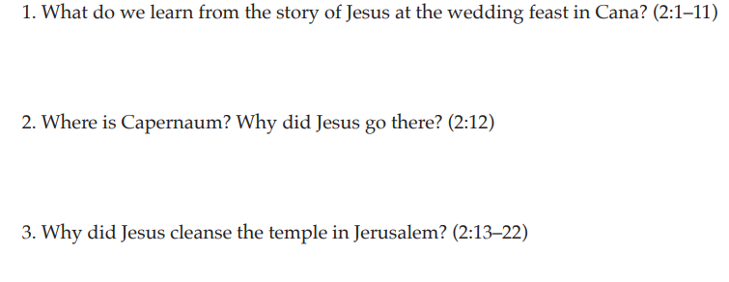
In your notebook copy the question down and write what your answer. You have about 3-5 minutes. Then we will go over the answer as a group.

Slide 10
12 After this he went down to Capernaum with his mother and brothers and his disciples. There they stayed for a few days.
Jesus Clears the Temple Courts
13 When it was almost time for the Jewish Passover, Jesus went up to Jerusalem. 14 In the temple courts he found people selling cattle, sheep and doves, and others sitting at tables exchanging money. 15 So he made a whip out of cords, and drove all from the temple courts, both sheep and cattle; he scattered the coins of the money changers and overturned their tables. 16 To those who sold doves he said, “Get these out of here! Stop turning my Father’s house into a market!” 17 His disciples remembered that it is written: “Zeal for your house will consume me.”[c]
18 The Jews then responded to him, “What sign can you show us to prove your authority to do all this?”
19 Jesus answered them, “Destroy this temple, and I will raise it again in three days.”
20 They replied, “It has taken forty-six years to build this temple, and you are going to raise it in three days?” 21 But the temple he had spoken of was his body. 22 After he was raised from the dead, his disciples recalled what he had said. Then they believed the scripture and the words that Jesus had spoken.

Slide 11
In your notebook copy the question down and write what your answer. You have about 3-5 minutes. Then we will go over the answer as a group.
  Why did Jesus cleanse the temple in Jerusalem? (2:13-22)

Slide 12
23 Now while he was in Jerusalem at the Passover Festival, many people saw the signs he was performing and believed in his name.[d] 24 But Jesus would not entrust himself to them, for he knew all people. 25 He did not need any testimony about mankind, for he knew what was in each person.

Slide 13
In your notebook copy the question down and write what your answer. You have about 3-5 minutes. Then we will go over the answer as a group.
  Why did Jesus “not commit Himself” to those who believed in Him? (2:23-25)

Slide 14
Discussion Quessions
  If you were one of the merchants in the temple, how would you have reacted to Jesus?
  What does Jesus' body being the "new temple" mean for how we treat our own bodies today?

Slide 15
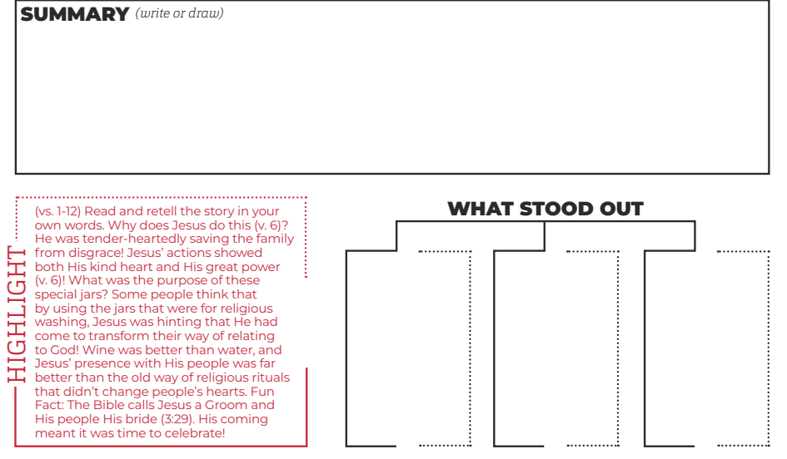
Homework: In your notebook

Slide 16
THE BOOK OF JOHN PURPOSE:
“THESE ARE WRITTEN THAT YOU MAY BELIEVE THAT JESUS IS THE CHRIST, THE SON OF GOD, AND THAT BY BELIEVING YOU MAY HAVE LIFE IN HIS NAME” (JOHN 20:31).

Slide 17
Let us
PRAY

