Slide 1


John 5: The Healing at the Pool, The Authority of the Son, Testimonies About Jesus

Slide 2


Slide 4

Let us
PRAY

Slide 5

Class Expectations
Camera’s on
Actively Participate

Slide 6
Share your homework. What did you write about Chapter 4.
What did you write for you summary and what stood out to you from chapter 4?

Slide 7


Open your Bibles to John 5
Get your notebooks and pencil

Slide 8
The Healing at the Pool
5 Some time later, Jesus went up to Jerusalem for one of the Jewish festivals. ² Now there is in Jerusalem near the Sheep Gate a pool, which in Aramaic is called Bethesda^{[a]} and which is surrounded by five covered colonnades. ³ Here a great number of disabled people used to lie—the blind, the lame, the paralyzed. ^{[4] [b]} ⁵ One who was there had been an invalid for thirty-eight years. ⁶ When Jesus saw him lying there and learned that he had been in this condition for a long time, he asked him, “Do you want to get well?”
⁷ “Sir,” the invalid replied, “I have no one to help me into the pool when the water is stirred. While I am trying to get in, someone else goes down ahead of me.”
⁸ Then Jesus said to him, “Get up! Pick up your mat and walk.” ⁹ At once the man was cured; he picked up his mat and walked.
John 5:1-9a

Slide 9
In your notebook copy the question down and write your answer. You have about 3-5 minutes. Then we will go over the answer as a group.
  What happened at the pool of Bethesda? (5:1-9)

Slide 10
The day on which this took place was a Sabbath, ¹⁰ and so the Jewish leaders said to the man who had been healed, “It is the Sabbath; the law forbids you to carry your mat.”
¹¹ But he replied, “The man who made me well said to me, ‘Pick up your mat and walk.’ ”
¹² So they asked him, “Who is this fellow who told you to pick it up and walk?”
¹³ The man who was healed had no idea who it was, for Jesus had slipped away into the crowd that was there.
¹⁴ Later Jesus found him at the temple and said to him, “See, you are well again. Stop sinning or something worse may happen to you.” ¹⁵ The man went away and told the Jewish leaders that it was Jesus who had made him well. ¹⁶ So, because Jesus was doing these things on the Sabbath, the Jewish leaders began to persecute him. ¹⁷ In his defense Jesus said to them, “My Father is always at his work to this very day, and I too am working.”
John 5: 9b-17

Slide 11
In your notebook copy the question down and write your answer. You have about 3-5 minutes. Then we will go over the answer as a group.
  2. Why did some people think that Jesus had violated the Sabbath? (5:9b-17)

Slide 12
¹⁸ For this reason they tried all the more to kill him; not only was he breaking the Sabbath, but he was even calling God his own Father, making himself equal with God.
¹⁹ Jesus gave them this answer: “Very truly I tell you, the Son can do nothing by himself; he can do only what he sees his Father doing, because whatever the Father does the Son also does. ²⁰ For the Father loves the Son and shows him all he does. Yes, and he will show him even greater works than these, so that you will be amazed. ²¹ For just as the Father raises the dead and gives them life, even so the Son gives life to whom he is pleased to give it. ²² Moreover, the Father judges no one, but has entrusted all judgment to the Son, ²³ that all may honor the Son just as they honor the Father. Whoever does not honor the Son does not honor the Father, who sent him.
²⁴ “Very truly I tell you, whoever hears my word and believes him who sent me has eternal life and will not be judged but has crossed over from death to life. ²⁵ Very truly I tell you, a time is coming and has now come when the dead will hear the voice of the Son of God and those who hear will live. ²⁶ For as the Father has life in himself, so he has granted the Son also to have life in himself. ²⁷ And he has given him authority to judge because he is the Son of Man.
²⁸ “Do not be amazed at this, for a time is coming when all who are in their graves will hear his voice ²⁹ and come out—those who have done what is good will rise to live, and those who have done what is evil will rise to be condemned. ³⁰ By myself I can do nothing; I judge only as I hear, and my judgment is just, for I seek not to please myself but him who sent me.
John 5:18-30

Slide 13
In your notebook copy the question down and write your answer. You have about 3-5 minutes. Then we will go over the answer as a group.
  3. How does Jesus describe His relationship with the Father? (5:19-30)

Slide 14
Testimonies About Jesus
³¹ “If I testify about myself, my testimony is not true. ³² There is another who testifies in my favor, and I know that his testimony about me is true.
³³ “You have sent to John and he has testified to the truth. ³⁴ Not that I accept human testimony; but I mention it that you may be saved. ³⁵ John was a lamp that burned and gave light, and you chose for a time to enjoy his light.
³⁶ “I have testimony weightier than that of John. For the works that the Father has given me to finish—the very works that I am doing—testify that the Father has sent me. ³⁷ And the Father who sent me has himself testified concerning me. You have never heard his voice nor seen his form, ³⁸ nor does his word dwell in you, for you do not believe the one he sent. ³⁹ You study^{[c]} the Scriptures diligently because you think that in them you have eternal life. These are the very Scriptures that testify about me, ⁴⁰ yet you refuse to come to me to have life.
⁴¹ “I do not accept glory from human beings, ⁴² but I know you. I know that you do not have the love of God in your hearts. ⁴³ I have come in my Father’s name, and you do not accept me; but if someone else comes in his own name, you will accept him. ⁴⁴ How can you believe since you accept glory from one another but do not seek the glory that comes from the only God^{[d]}?
⁴⁵ “But do not think I will accuse you before the Father. Your accuser is Moses, on whom your hopes are set. ⁴⁶ If you believed Moses, you would believe me, for he wrote about me. ⁴⁷ But since you do not believe what he wrote, how are you going to believe what I say?”
John 5:31-47

Slide 15
Discussion
"If someone made a fake social media account using your name and photos, how would you prove to your friends that the real you is actually you?“
The Connection: "In John 5, religious leaders accused Jesus of making fake claims about being God's Son. Jesus didn't just say 'trust me.' He brought forward four massive pieces of evidence(John the Baptist, Miracles, God the Father and Moses) —like character witnesses in a courtroom—to prove exactly who He was.“
Discussion Question:
If someone questioned whether you really follow Jesus, what would your actions, words, and character show them about your faith?

Slide 16
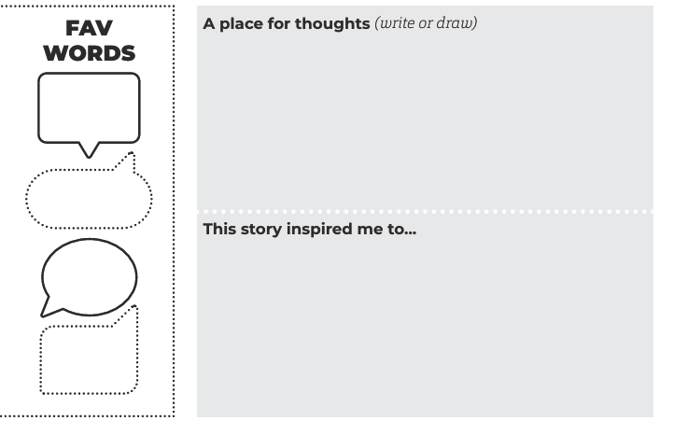
Chp 5 Homework: Write the task in your notebook
and complete at home this week.

Slide 17
THE BOOK OF JOHN PURPOSE:
“THESE ARE WRITTEN THAT YOU MAY BELIEVE THAT JESUS IS THE CHRIST, THE SON OF GOD, AND THAT BY BELIEVING YOU MAY HAVE LIFE IN HIS NAME” (JOHN 20:31).

Slide 18
Let us
PRAY

