Slide 1


Slide 2

“We are to believe and follow Christ in all things, including His words about Scripture. And this means that Scripture is to be for us what it was to Him: the unique, authoritative, and inerrant Word of God, and not merely a human testimony to Christ, however carefully guided and preserved by God. If the Bible is less than this to us, we are not fully Christ’s disciples.”
The Preacher and God’s Word
James Montgomery Boice

Slide 4
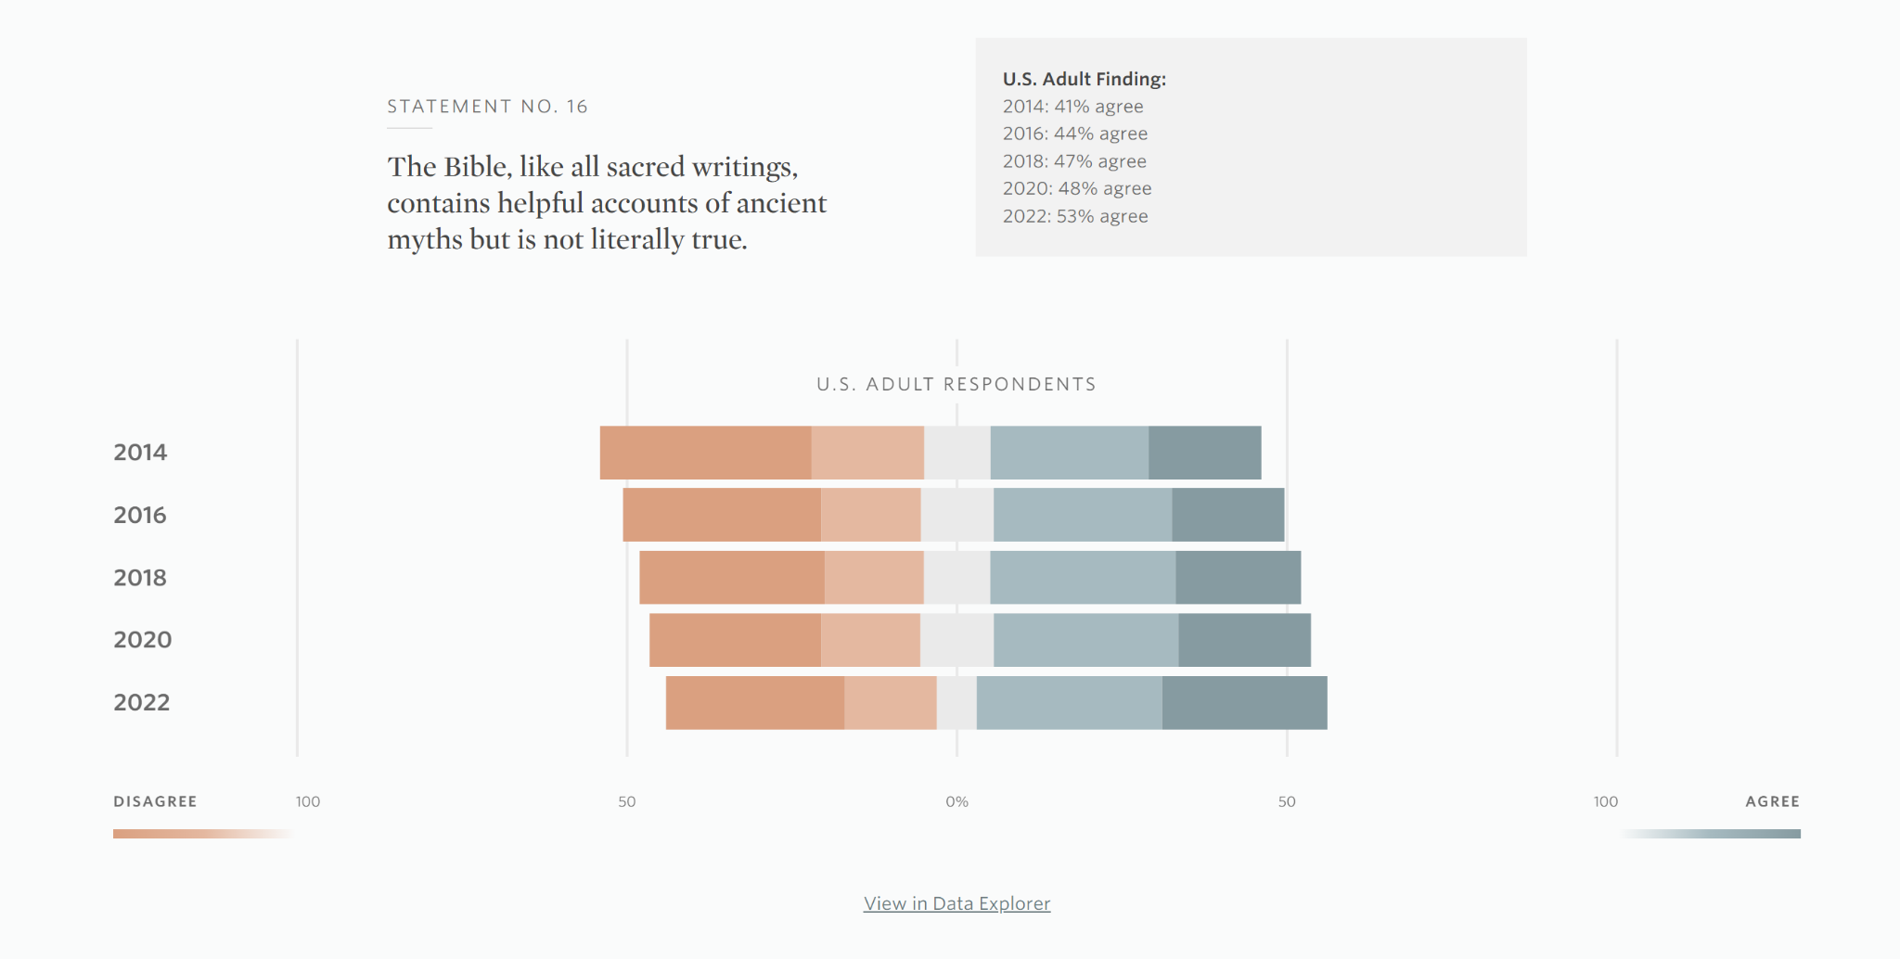

Slide 5
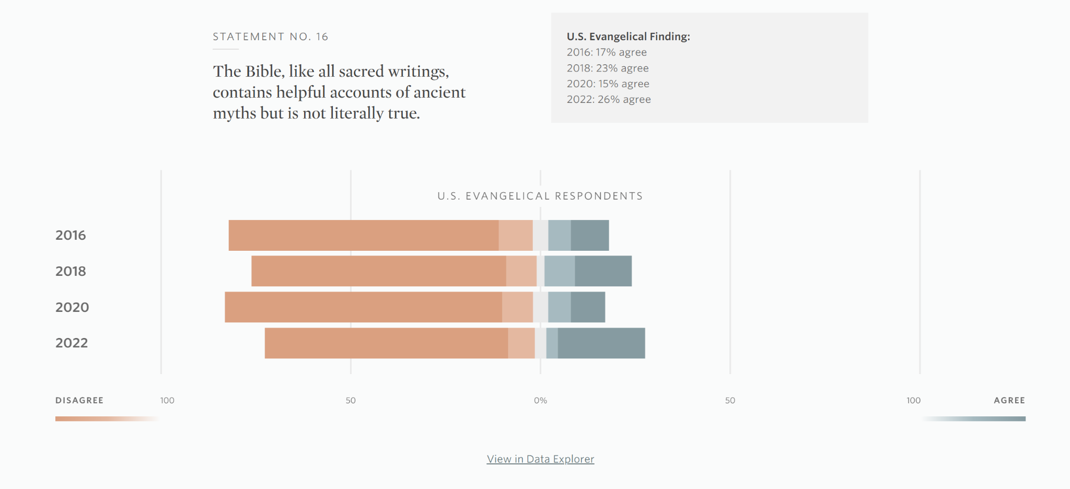

Slide 6
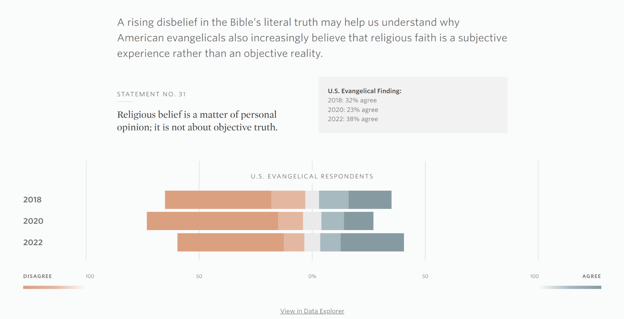

Slide 7
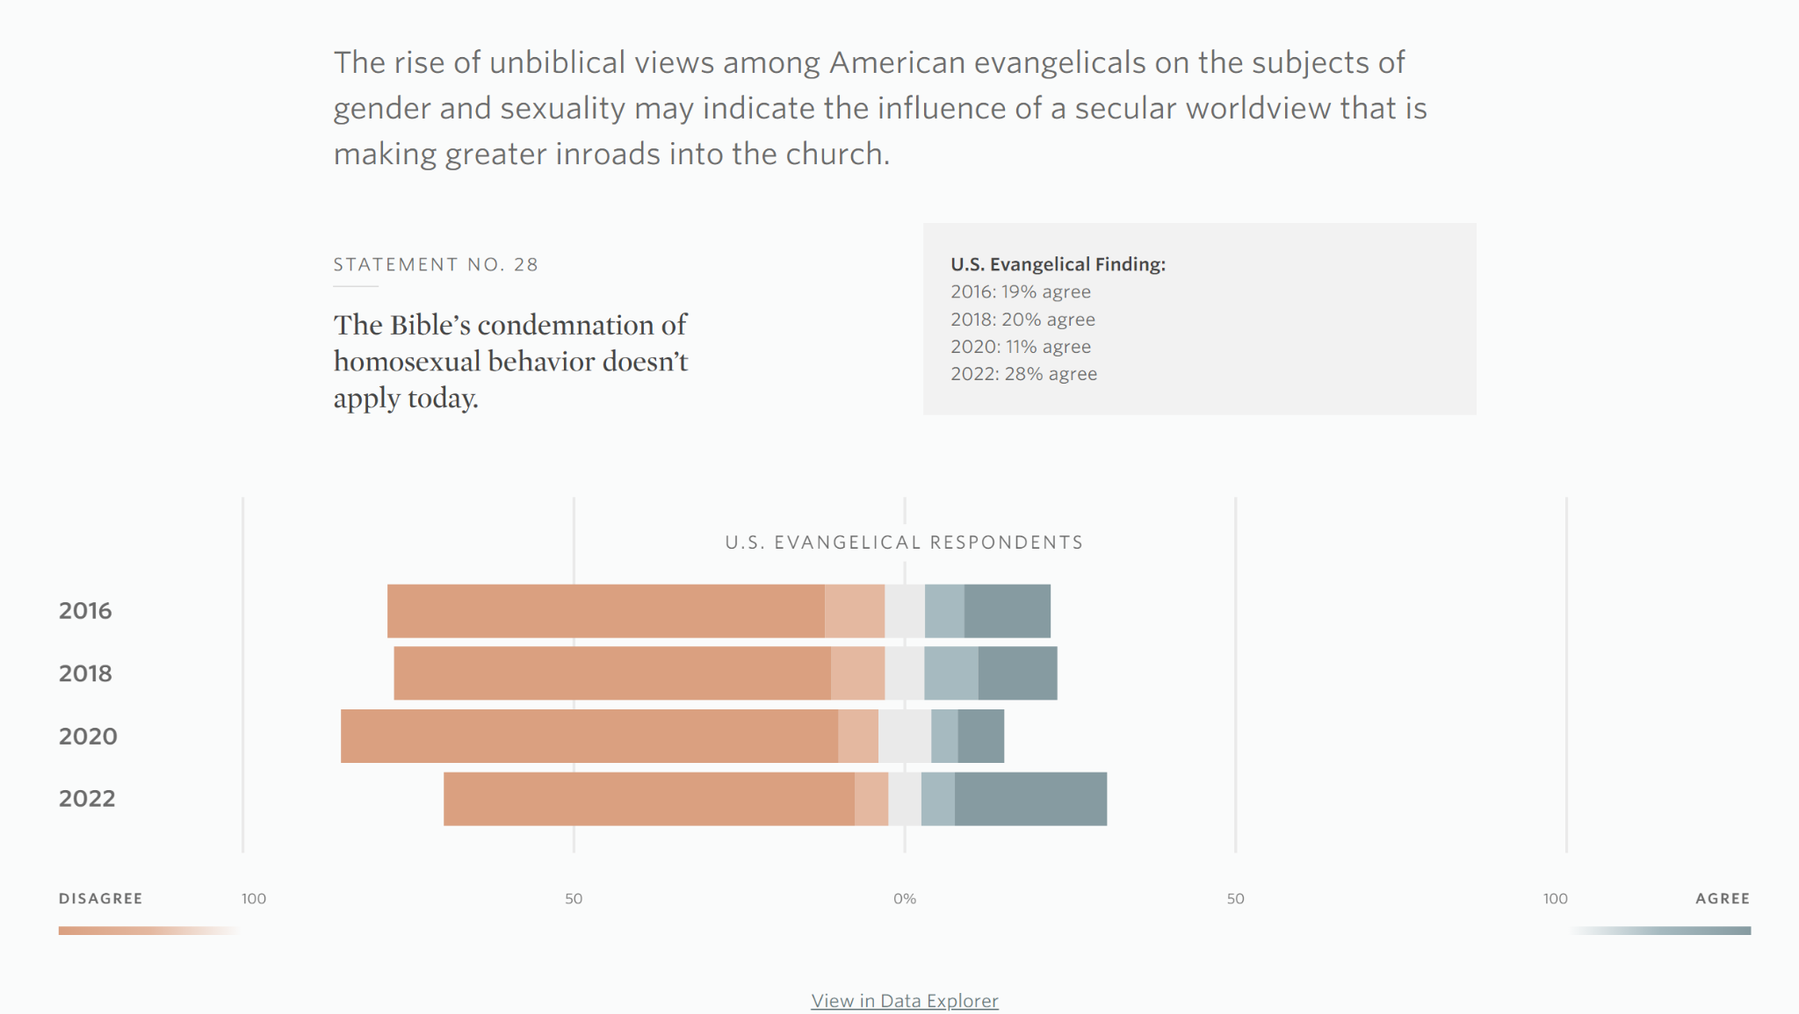

Slide 9
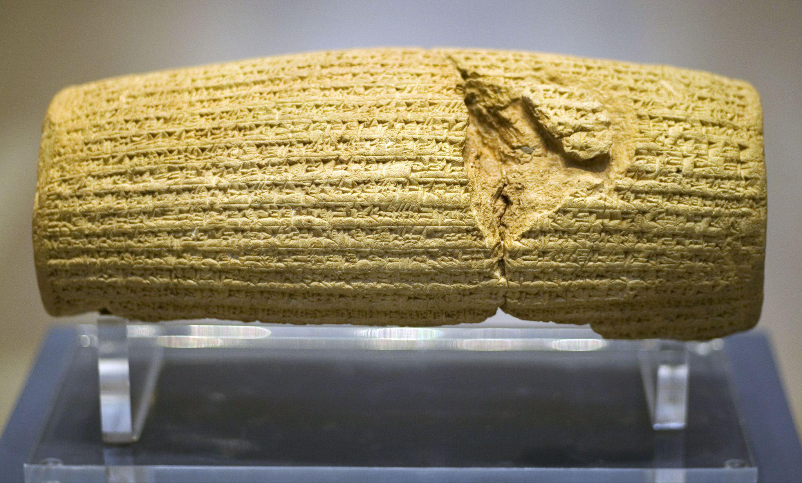

Slide 10
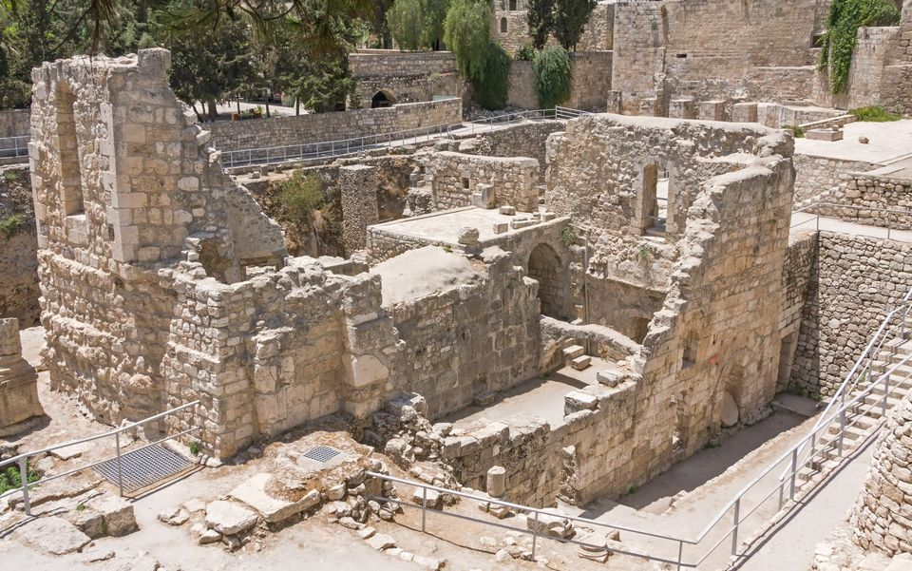

Slide 11
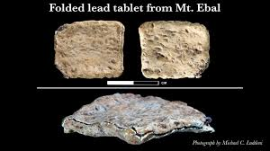

Slide 12
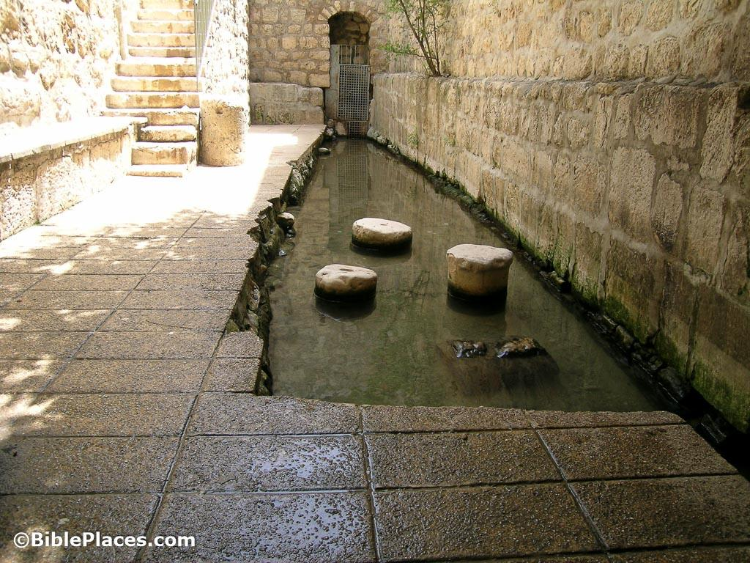

Slide 13
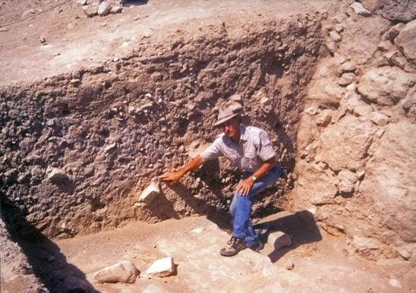
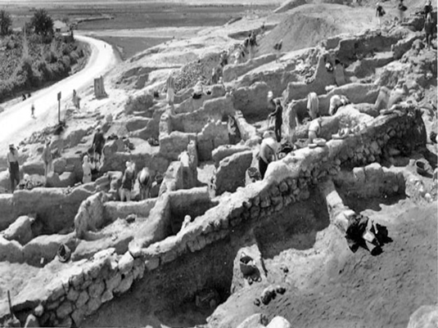

Slide 15
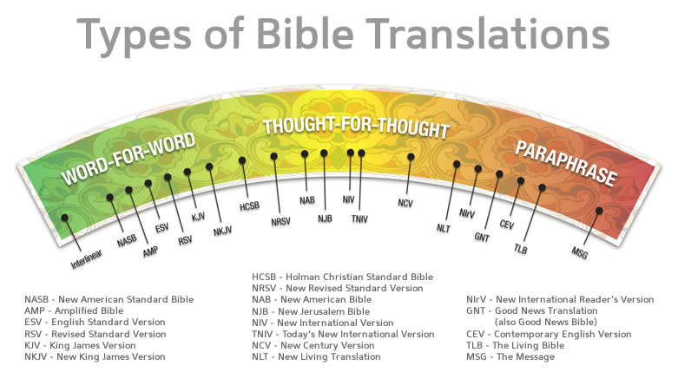

Slide 17
