Slide 1


Bible Study with Hill Chapel Athens
New Zoom Location
https://us02web.zoom.us/j/88909951335
Meeting ID: 889 0995 1335
One tap mobile
+13126266799,,88909951335# US
Meeting ID: 889 0995 1335

Slide 2

Bible Study
With Pastor Benjamin E.V. Lett

Slide 3

You should be able to find us on:
YouTube
Facebook
Through the church app

Slide 4
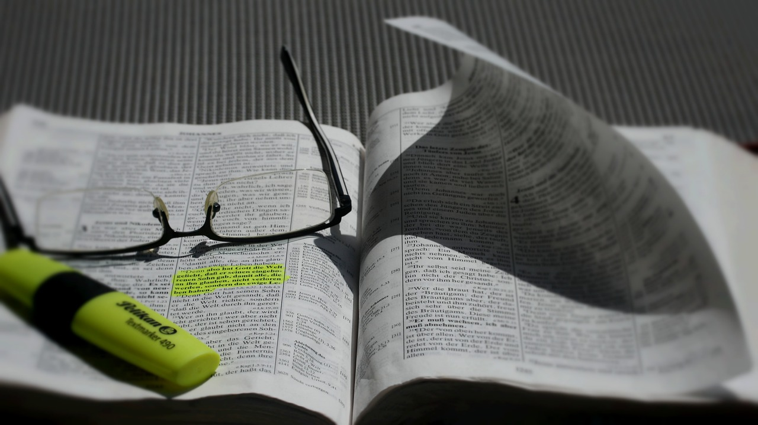
Prepare for our time of study by finding and reading:
^{September 20, 2023}
Exodus 13 & 14

Slide 5
On the road to becoming an overcomer
1. Why God permits Problems
2. Chasing Out Worry
3. Getting rid of Guilt
4. Putting away People Hurt
5. Taking on Your Anger
6. Alleviating Fear

Slide 6
living as an Overcomer by Alleviating Fear
^{Lesson 6}
Exodus 13 & 14

Slide 7
Fear

Slide 8


Fear
What is it?
How does being afraid impact you?

Slide 9
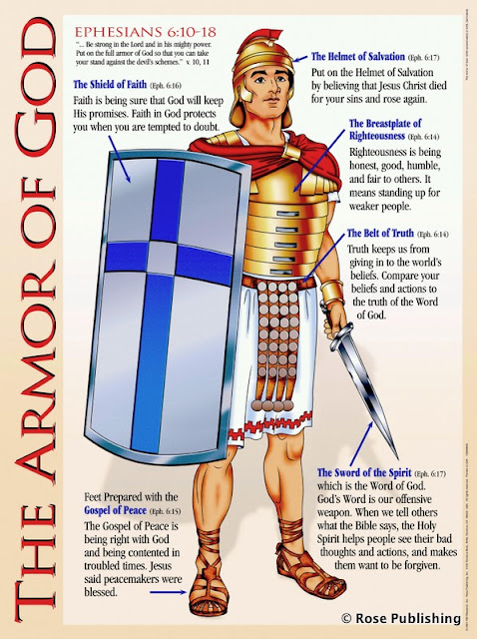
In order to defeat the enemy you must know the enemy Fear
Put on the full armor of God, so that you can take your stand against the devil’s schemes. For our struggle is not against flesh and blood, but against the rulers, against the authorities, against the powers of this dark world and against the spiritual forces of evil in the heavenly realms. Ephesians 6:11-12

Slide 10

What you should Know and do to Alleviate fear
Know the Affects of Fear
Know How to Alleviate Fear

Slide 11
Fear
Apostle Paul
I came to you in weakness with great fear and trembling. 1 Corinthians 2:3
One of Satan’s weapons against us fulfilling God’s purpose in our lives.
All of us, even the most effective Christian, have or battle fears.

Slide 12

^{How does fear affect us?}
.

Slide 13
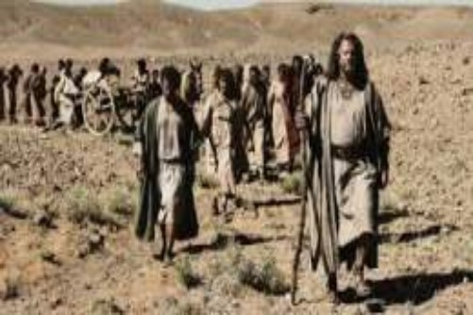
two ways that fear can Affect you
1. Cripple your faith.
2. Change your focus.

Slide 14
The Israelites when trapped by Pharaoh
Then the Lord said to Moses “Tell the Israelites to turn back and encamp near Pi Hahiroth, between Migdol and the sea. They are to encamp by the sea, directly opposite Baal Zephon. Pharaoh will think, ‘The Israelites are wandering around the land in confusion, hemmed in by the desert.’ Exodus 14:1-3
The reaction of the Israelites
¹⁰ As Pharaoh approached, the Israelites looked up, and there were the Egyptians, marching after them. They were terrified and cried out to the Lord. Exodus14:10

Slide 15
1. Fear can cripple your faith
2. Fear change your focus
¹¹ They said to Moses, “Was it because there were no graves in Egypt that you brought us to the desert to die? What have you done to us by bringing us out of Egypt? Exodus 14:11
¹² Didn’t we say to you in Egypt, ‘Leave us alone; let us serve the Egyptians’? It would have been better for us to serve the Egyptians than to die in the desert!” Exodus 14:12

Slide 16
^{Fear}
^{False}
^{Evidence}
^{Appearing Real}
!

Slide 17

^{How can we alleviate fear?}
.

Slide 18
1. Remember God’s power
2. Remember God’s promises
The Lord will fight for you; you need only to be still. Exodus 14:14
The Lord is my light and my salvation, whom shall I fear? The Lord is the stronghold of my life, of whom shall I be afraid? Psalm 27:1
God assures us that He Loves us
^{God can regulate our minds}

Slide 19


