Slide 1


Bible Study with Hill Chapel Athens
New Zoom Location
https://us02web.zoom.us/j/88909951335
Meeting ID: 889 0995 1335
One tap mobile
+13126266799,,88909951335# US
Meeting ID: 889 0995 1335

Slide 2
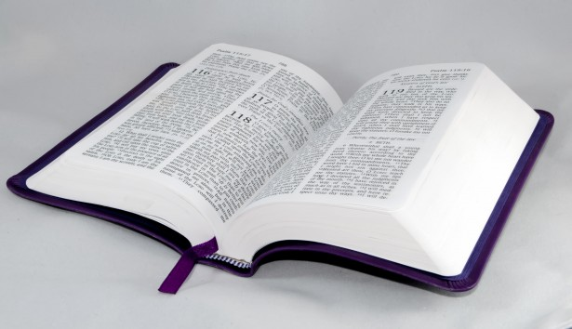
Bible Study
Hill Chapel
Baptist Church Athens

Slide 3

Bible Study
With Pastor Benjamin E.V. Lett

Slide 4
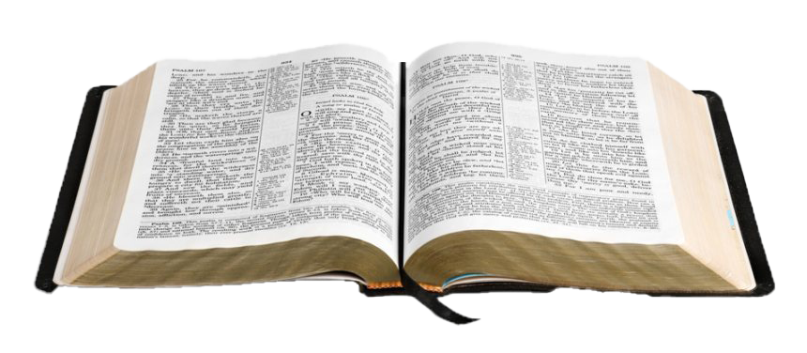
Bible Study with Hill Chapel Athens
Study Topic
On the Road to becoming an overcomer
A 12 Lesson study

Slide 5
Why God permits us to Have Problems
Why God permits Problems
Chasing Out Worry
No More Guilt
When People Hurt You
When You're Afraid
Taking on Your Anger
Turning Down Temptation
done with Loneliness
done with Discouragement
Done with feeling like a Failure
Strangling Stress
Finding Financial Freedom
Burnout be gone

Slide 6
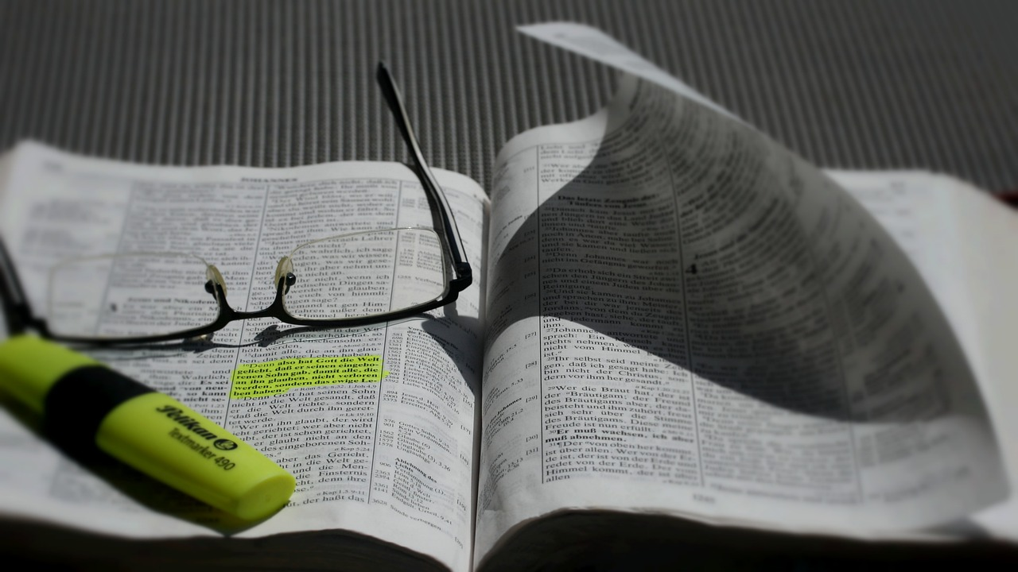
Why God Permits Us to Have Problems:
^{Lesson 1}
Romans 8

Slide 7
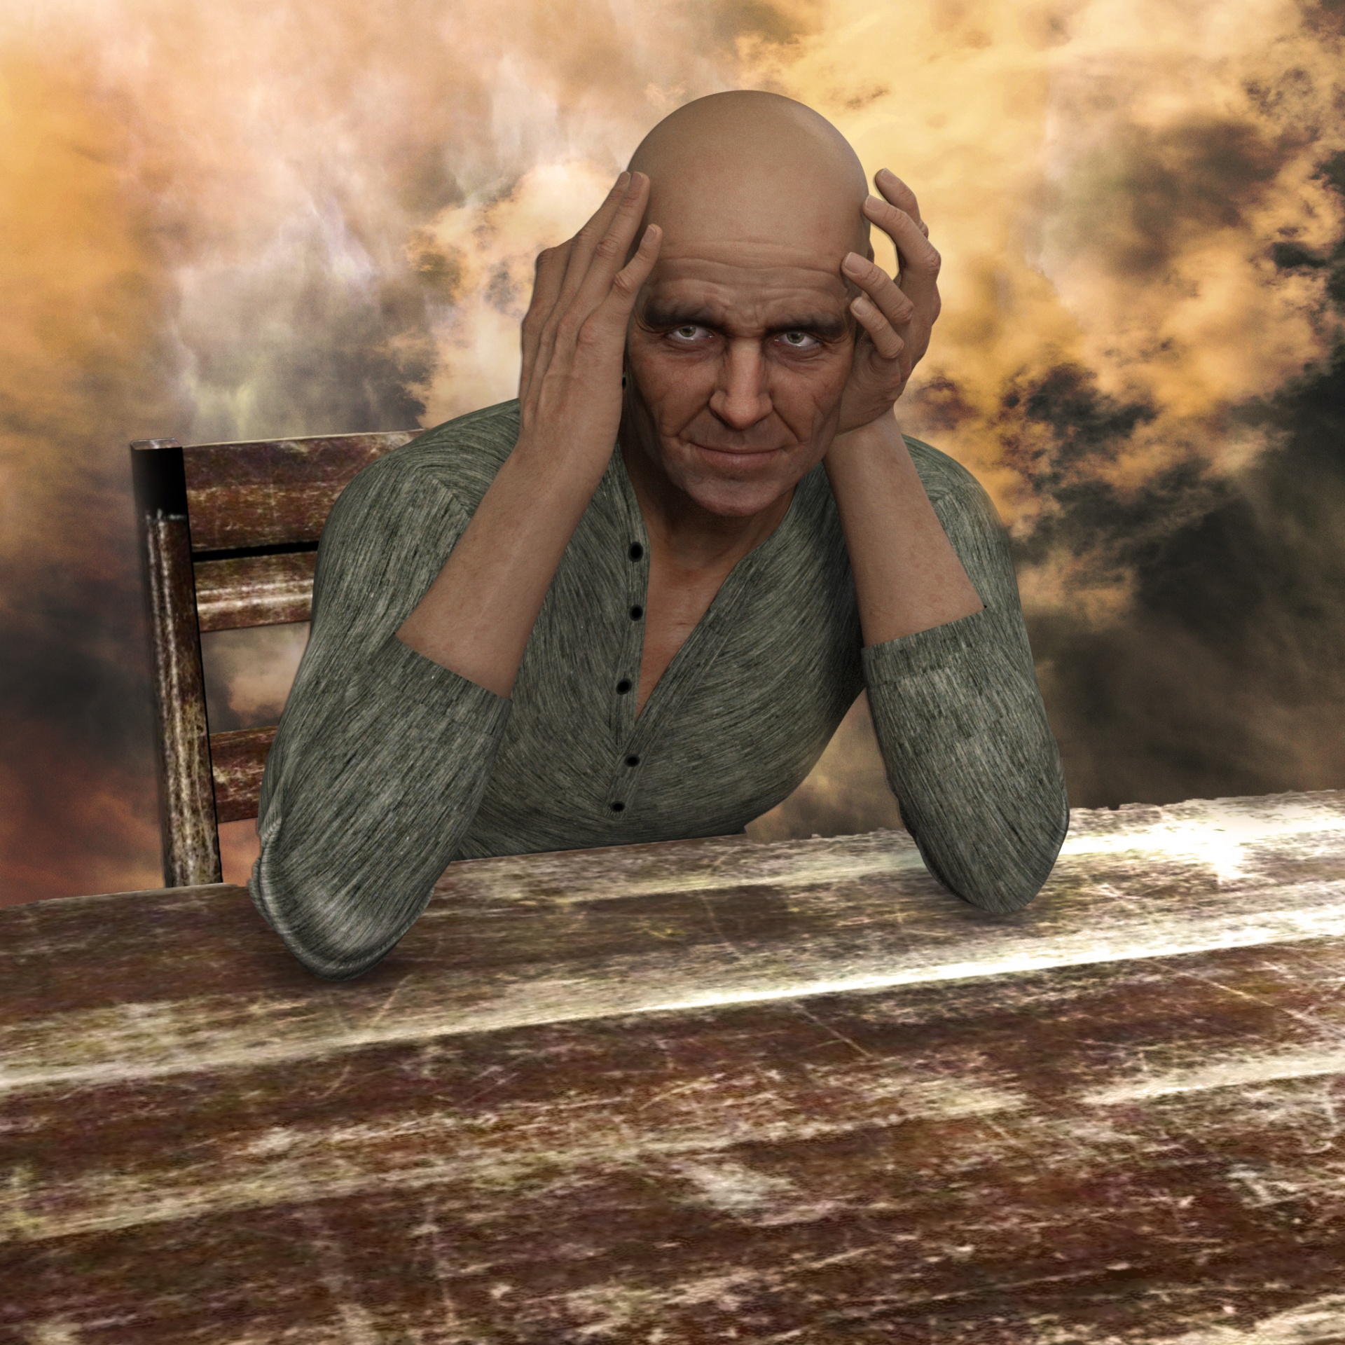
Lesson 1
Why God Permits Us to Have Problems

Slide 8

The Question
Everybody has problems

Slide 9
Our Problems Vary by type and severity
There are financial problems, health problems, and relationship problems, as well as problems of guilt, depression, temptation, failure, stress, burnout, etc.
We will look at each of these in detail during this study.

Slide 10

Your Thoughts
“We as Christians are not exempt from painful problems and often have more problems than non-Christians.”

Slide 11
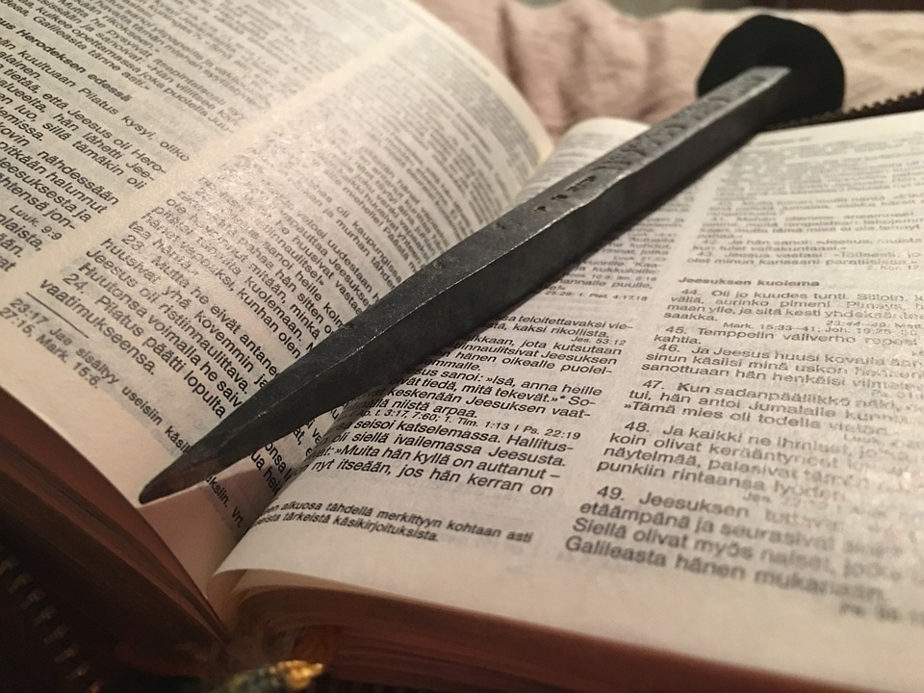
John 16:33
Jesus says:
³³ “I have told you these things, so that in me you may have peace. In this world you will have trouble. But take heart! I have overcome the world.”

Slide 12

Greek word translated trouble (THLIPSIS, th-lip´-sis), or “tribulation” in the KJV, means “pressing or pressure that burdens our spirits.” severe affliction or anguish
Trouble

Slide 13
In Romans 8, Paul writes about all kinds of problems: trouble . . . hardship . . . persecution . . . famine . . . nakedness . . . danger . . . sword and death
Romans 8:35-36

Slide 14

Paul on
PROBLEMS
What does he write concerning these problems?
See Romans 8:37

Slide 15
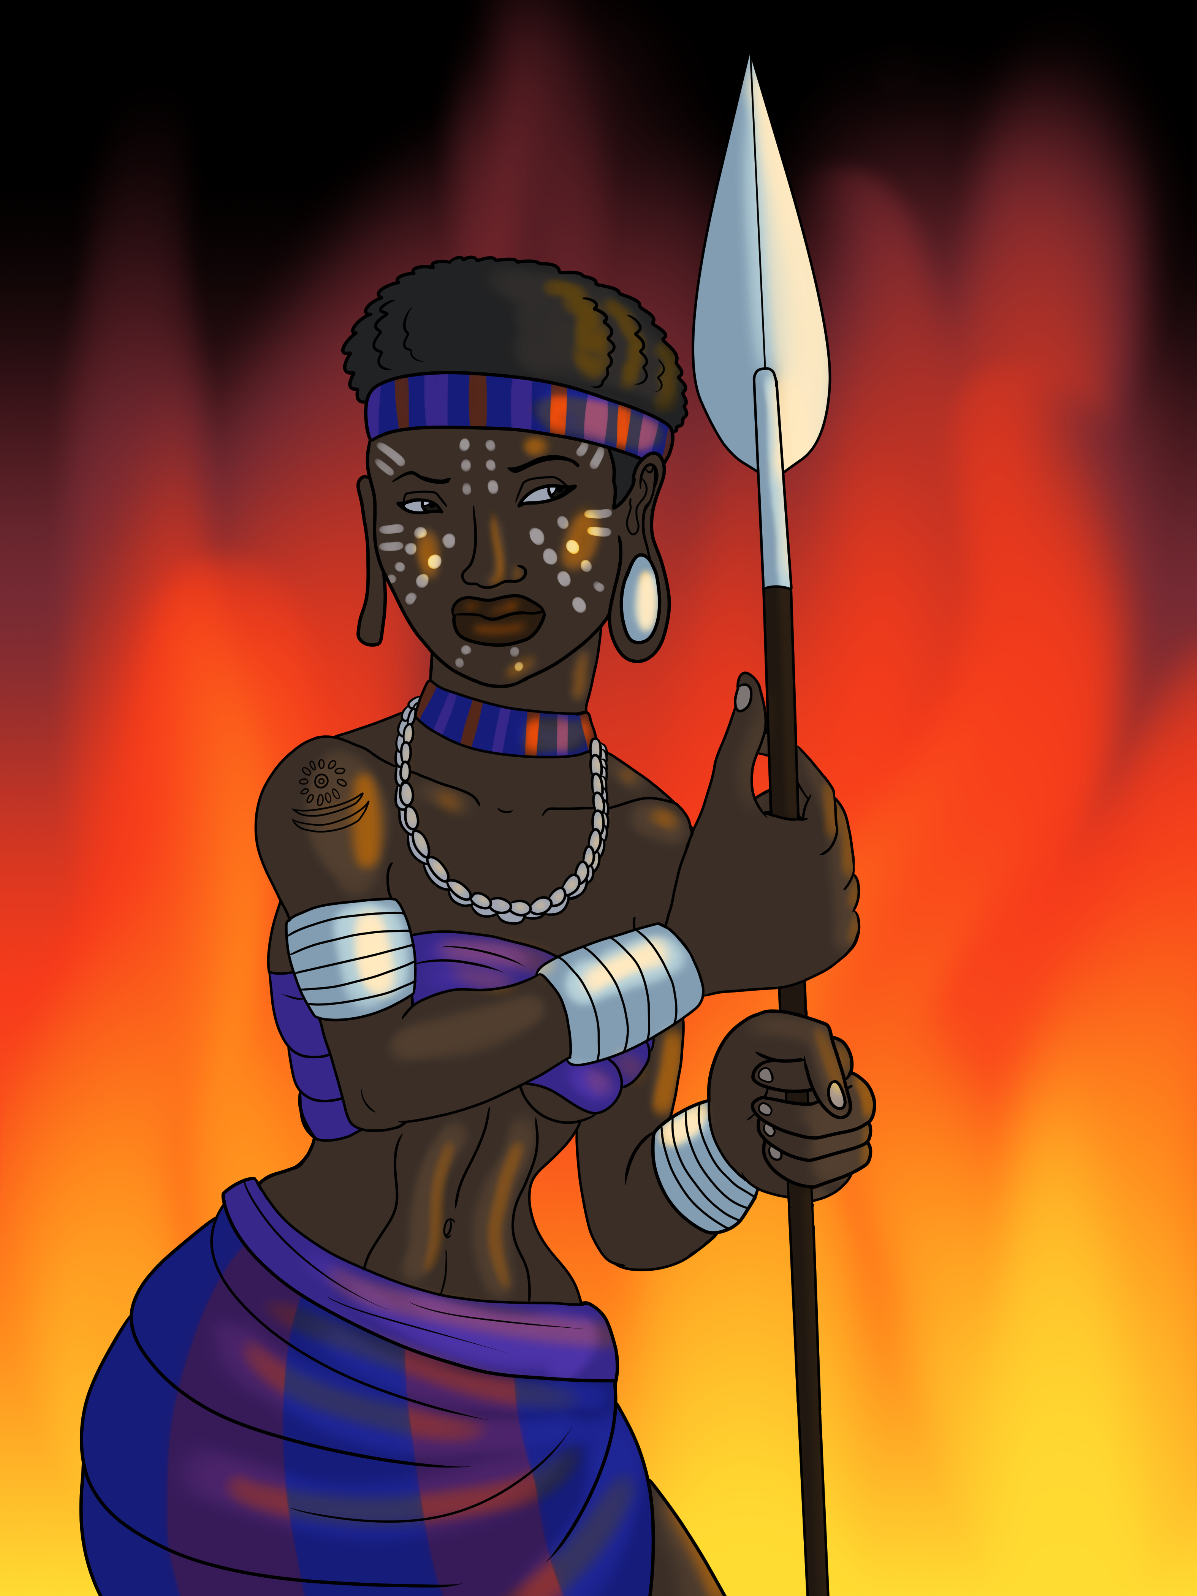
What does it mean to be more than a conqueror?

Slide 16

How does God do that?
Directs us
Inspects us
Corrects us
Perfects us

Slide 17
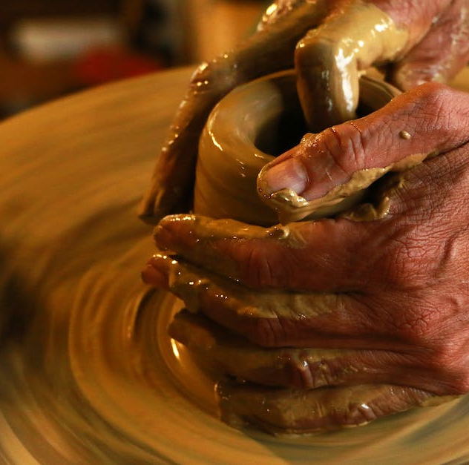
Directs us
Before I was afflicted I went astray, but now I obey your word. Psalm 119:67
…Therefore, in order to keep me from becoming conceited, I was given a thorn in my flesh, a messenger of Satan, to torment me.
2 Corinthians 12:7

Slide 18

God uses problems to direct us away from……..?

Slide 19
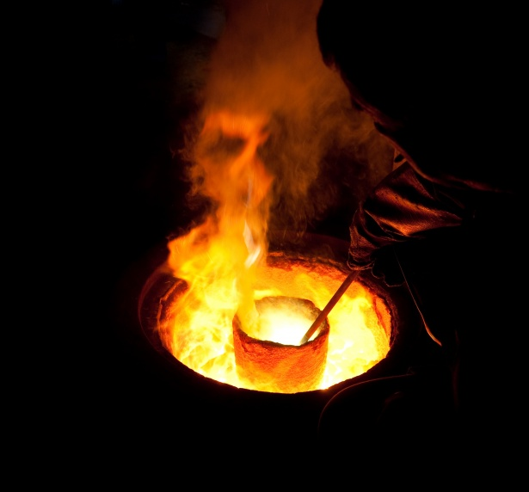
Inspect us
Trials or temptations
The word translated trials/ temptations (PEIROSMOS, pie-ros-mos´) means “a putting to the test.”
These have come so that the proven genuineness of your faith—of greater worth than gold, which perishes even though refined by fire—may result in praise, glory and honor when Jesus Christ is revealed. 1 Peter1:7

Slide 20
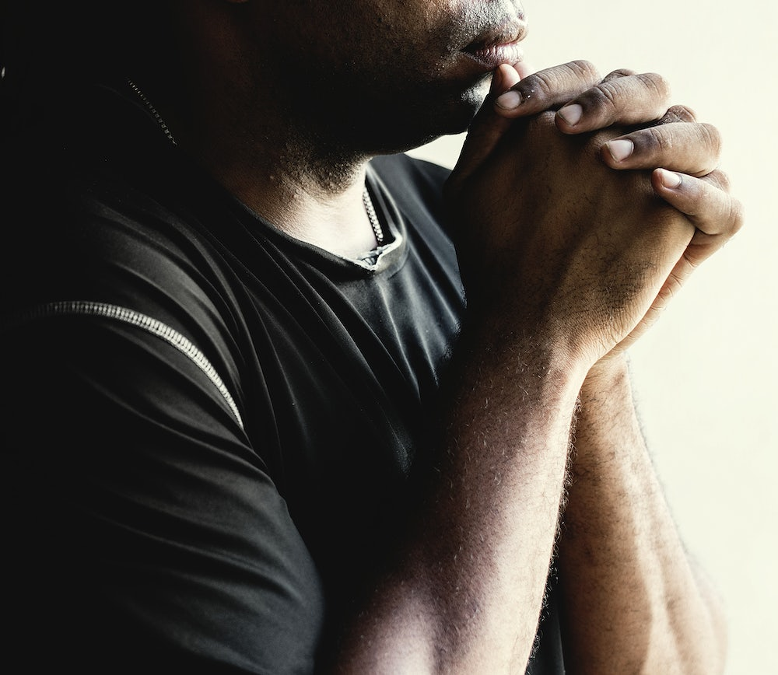
See if there is any offensive way in me, and lead me in the way everlasting.
Psalm 139:24

Slide 21

Corrects us
The word of the Lord came to Jonah son of Amittai: “Go to the great city of Nineveh and preach against it, because its wickedness has come up before me.” But Jonah ran away from the Lord and headed for Tarshish. He went down to Joppa, where he found a ship bound for that port… Then the Lord sent a great wind on the sea, and such a violent storm arose that the ship threatened to break up. Jonah 1:1-5

Slide 22
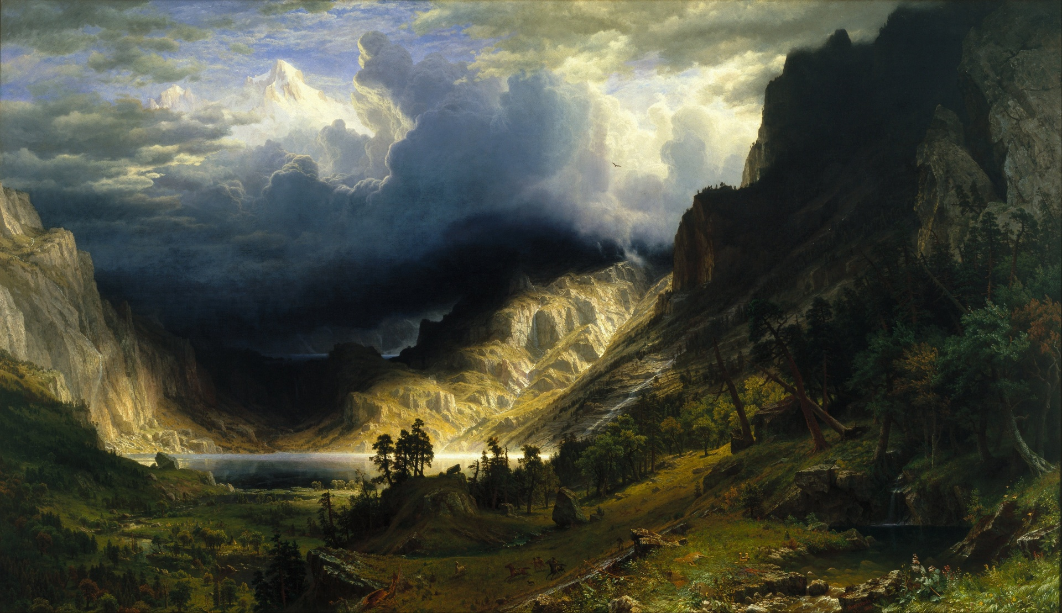

Give examples of how might God permit a storm in the life of His child?

Slide 23
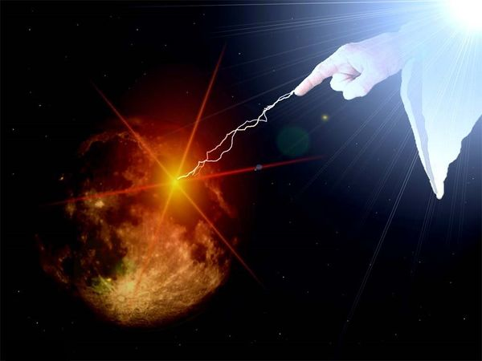

As a child of God, if you know you are out of God’s will and you see no storm what could that indicate?

Slide 24

Perfects us
Consider it pure joy, my brothers and sisters, whenever you face trials of many kinds, because you know that the testing of your faith produces perseverance. Let perseverance finish its work so that you may be mature and complete, not lacking anything.
James 1:1-4

Slide 25

Does God expect us to be perfect?
If He does, why?
If He does not, why not?
Does God want us perfect?
If He does, why?
If He does not, why not?
Big Questions

Slide 26

Q

