Slide 1
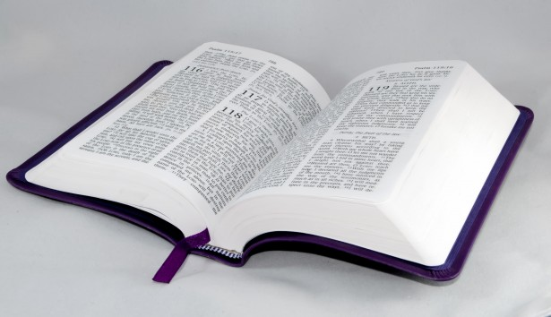
Bible Study
Hill Chapel
Baptist Church Athens

Slide 2


Bible Study with Hill Chapel Athens
New Zoom Location
https://us02web.zoom.us/j/88909951335
Meeting ID: 889 0995 1335
One tap mobile
+13126266799,,88909951335# US
Meeting ID: 889 0995 1335

Slide 3

Bible Study
With Pastor Benjamin E.V. Lett

Slide 4
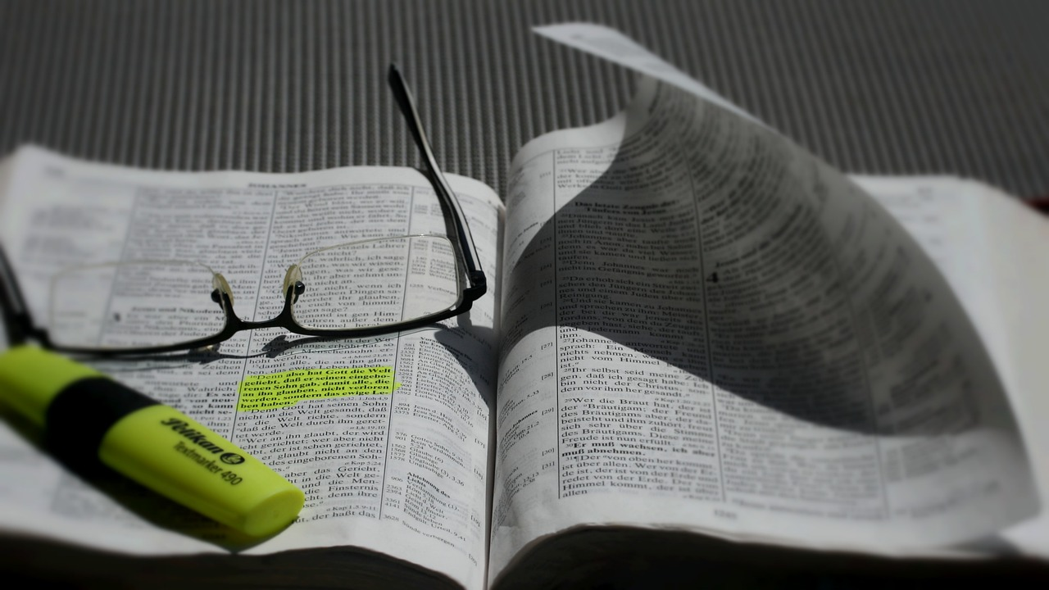
Prepare for our time of study by finding and reading:
^{August 30, 2023}
Psalm 51

Slide 5
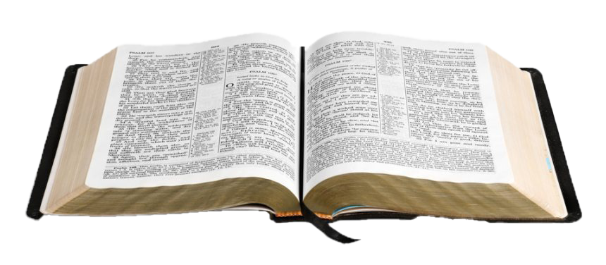
Bible Study with Hill Chapel Athens
Fall 2023 Study Topic
On the Road to becoming an Overcomer
On Line Only until further notice

Slide 6
living as an Overcomer by Getting Rid of Guilt
^{Lesson 3}
Psalm 51

Slide 7

Regret mistakes Guilt

Slide 8
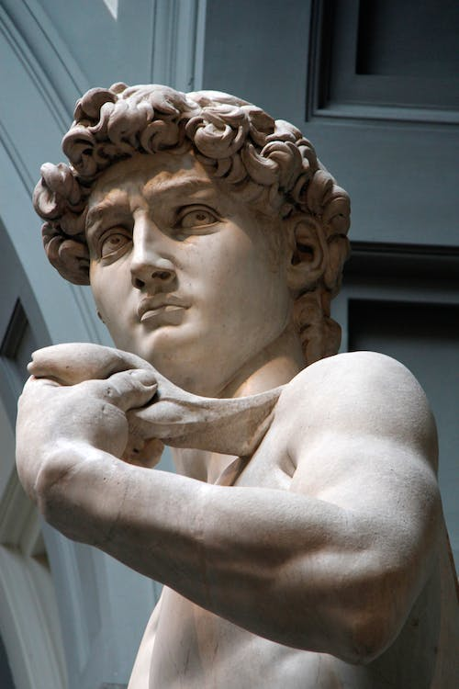
King Writer Warrior Poet Father Musician Husband Sheppard Murder Adulterer
David

Slide 9
My guilt has overwhelmed me like a burden too heavy to bear. Psalm 38:4
David

Slide 10

Guilt / Shame
Scripture – Psalm 32:1
Blessed is the one whose transgressions are forgiven, whose sins are covered.
God doesn't want guilt to rob you of your happiness.

Slide 11

Blessed means happy.

Slide 12
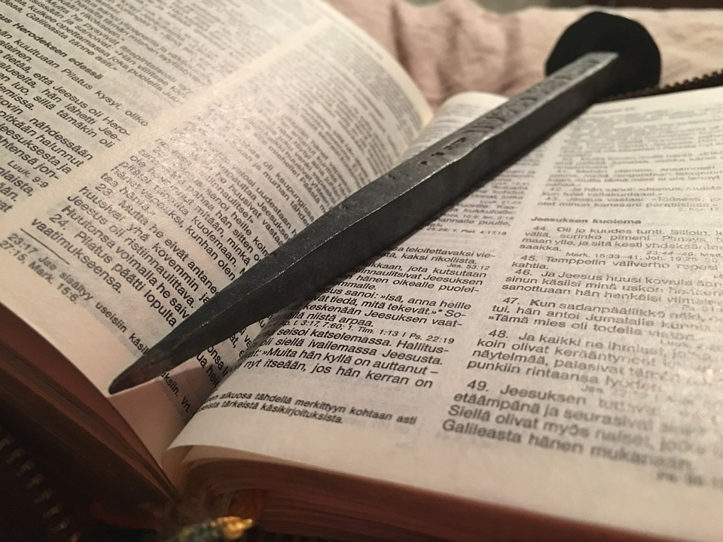
Things to do to get rid of guilt
Accept God’s love
Assume responsibility
Admit our sin is against God
Ask God for cleansing
Appeal to God for renewal
Avoid further sin

Slide 13
1. Accept God’s Love
Have mercy on me, O God, according to your unfailing love; Psalm 51:1
Unfailing Love
The Lord appeared to us in the past, saying: “I have loved you with an everlasting love; I have drawn you with unfailing kindness.
Jeremiah 31:3

Slide 14

2. Assume the responsibility
2 Wash away all my iniquity and cleanse me from my sin. 3 For I know my transgressions, and my sin is always before me. Psalm 51:2, 3
“I” “ME” “MY”
Wash - Cleans
Do you not know that your bodies are temples of the Holy Spirit, who is in you, whom you have received from God? You are not your own; 1 Corinthians 6:19

Slide 15
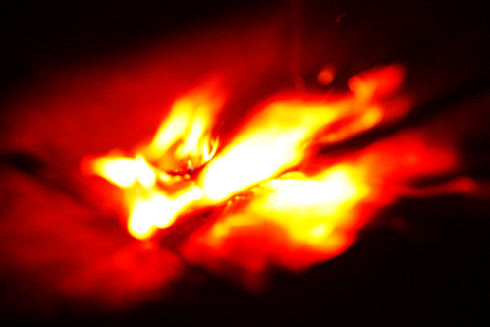
Conviction vs Condemnation
When he comes, he will prove the world to be in the wrong about sin and righteousness and judgment:
John 16:8

Slide 16
3. Admit our sin is against God
⁴ Against you, you only, have I sinned and done what is evil in your sight; Psalm 51:4
¹⁵ “If you love me, keep my commands. John 14:15

Slide 17
4. Ask God for clensing
7 Cleanse me with hyssop, and I will be clean; wash me, and I will be whiter than snow. Psalm 51:7 Hyssop: a small shrub used as a brush
As used in the time of the original Passover – Exodus 12:22
Cleans: to make clean from impurity or blemish
⁹ If we confess our sins, he is faithful and just and will forgive us our sins and purify us from all unrighteousness. 1John 1:9

Slide 18

5. Appeal to God for renewal
⁸ Let me hear joy and gladness; let the bones you have crushed rejoice. Psalm 51:8
¹⁸ “Forget the former things; do not dwell on the past Isaiah 43:18

Slide 19
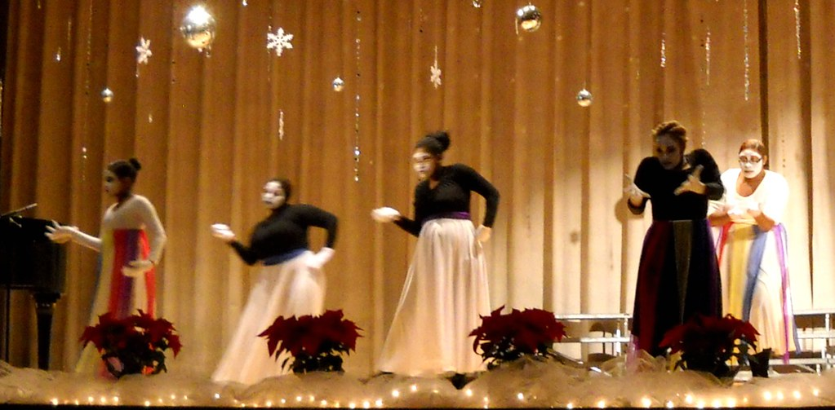
6. Avoid future sin
12 Restore to me the joy of your salvation and grant me a willing spirit, to sustain me. Psalm 51:12
Blessed are those who fear the Lord, who find great delight in his commands Isaiah 43:18

Slide 20

Q

Slide 21

Add a funny Quote
“QUOTES…

Slide 22


Slide 23

Weekly Prayer Meeting
Mondays at 5:30 pm
via teleconference
Dial: 1-267-807-9495
Access code: 505-087-623

Slide 24

10th Year
Save The Date
Pastor’s Appreciation
Mother Daughter Luncheon
September 30, 2023
12 - Noon
Celebration Sunday
October 1, 2023

Slide 25
Bible Study
With Pastor Benjamin E.V. Lett

