Slide 1

Bible Study
With Pastor Benjamin E.V. Lett

Slide 2


Bible Study with Hill Chapel Athens
New Zoom Location
https://us02web.zoom.us/j/88909951335
Meeting ID: 889 0995 1335
One tap mobile
+13126266799,,88909951335# US
Meeting ID: 889 0995 1335

Slide 3

Prepare for our time of study by finding and reading:
^{October 11, 2023}
Nehemiah 4

Slide 4
living as an Overcomer by Done with Discouragement
^{Lesson 9}
Nehemiah 3

Slide 5
Discouragement

Slide 6

discouragement
Events that may cause the feelings of discouragement
Actions that are the result of discouragement
Feelings that go along with discouragement

Slide 7

Feelings as a result of discouragement
Abandonment
Isolated
Deserted
Alone
Lost
Removed
Unwanted
Rejected
Undesired

Slide 8
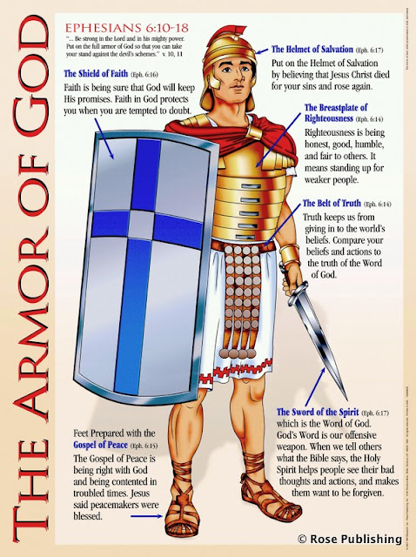
In order to defeat the enemy you must know the enemy Loneliness
Put on the full armor of God, so that you can take your stand against the devil’s schemes. For our struggle is not against flesh and blood, but against the rulers, against the authorities, against the powers of this dark world and against the spiritual forces of evil in the heavenly realms. Ephesians 6:11-12

Slide 9
Discouragement
“Don’t be discouraged”
⁹ And let us not lose heart and grow weary and faint in acting nobly and doing right, for in due time and at the appointed season we shall reap, if we do not loosen and relax our courage and faint. Galatians 6:9 AMP

Slide 10

Principles for defeating discouragement as found in Nehemiah 3
Reasons for Discouragement
Remedy for Discouragement

Slide 11

Reasons for Discouragement #1- Fatigue causes discouragement
¹⁰ Meanwhile, the people in Judah said, “The strength of the laborers is giving out, and there is so much rubble that we cannot rebuild the wall.” Nehemiah 4:10
What did their frustration cause them to do?

Slide 12
Reasons for Discouragement #2- Frustration causes discouragement
¹⁰ Meanwhile, the people in Judah said, “The strength of the laborers is giving out, and there is so much rubble that we cannot rebuild the wall.” Nehemiah 4:10
They were focusing on the problem rather than the purpose.

Slide 13
Reasons for Discouragement #2- Frustration causes discouragement
¹⁰ Meanwhile, the people in Judah said, “The strength of the laborers is giving out, and there is so much rubble that we cannot rebuild the wall.” Nehemiah 4:10
They were focusing on the problem rather than the purpose.

Slide 14
Don’t focus on the rubble

Slide 15
Reasons for Discouragement #2- Fear causes discouragement
¹¹ Also our enemies said, “Before they know it or see us, we will be right there among them and will kill them and put an end to the work.”¹² Then the Jews who lived near them came and told us ten times over, “Wherever you turn, they will attack us.” Nehemiah 4:11-12

Slide 16

fear causes discouragement
³ March around the city once with all the armed men. Do this for six days. ⁴ Have seven priests carry trumpets of rams’ horns in front of the ark. On the seventh day, march around the city seven times, with the priests blowing the trumpets. ¹⁰ But Joshua had commanded the army, “Do not give a war cry, do not raise your voices, do not say a word until the day I tell you to shout. Then shout!” Joshua 6:3,4, 10

Slide 17
Remedy for Discouragement #1- Continue with a new approach
If you want different results try a new approach.
¹³ Therefore I stationed some of the people behind the lowest points of the wall at the exposed places, posting them by families, with their swords, spears and bows. Nehemiah 4:13
²⁵ not giving up meeting together, as some are in the habit of doing, but encouraging one another—and all the more as you see the Day approaching. Hebrews 10:25

Slide 18
remedy for Discouragement #2- Concentrate on the Lord
¹⁴ After I looked things over, I stood up and said to the nobles, the officials and the rest of the people, “Don’t be afraid of them. Remember the Lord, who is great and awesome, and fight for your families, your sons and your daughters, your wives and your homes.” Nehemiah 4:14
Remember His
Promises
Presence
Power

Slide 19

remedy for Discouragement #3- Help carry someone else’s burden
²¹ So we continued the work with half the men holding spears, from the first light of dawn till the stars came out. ²² At that time I also said to the people, “Have every man and his helper stay inside Jerusalem at night, so they can serve us as guards by night and as workers by day.” Nehemiah 4:21-22
What does that look like?

Slide 20
Principles for defeating discouragement as found in Nehemiah 3
To be done with discouragement know:
The reasons for discouragement
Fatigue
Frustration
Fear
The remedy for
discouragement
Continue with a new approach
Concentrate on the Lord
Help carry someone else’s burden

Slide 21


