Slide 1


Bible Study with Hill Chapel Athens
New Zoom Location
https://us02web.zoom.us/j/88909951335
Meeting ID: 889 0995 1335
One tap mobile
+13126266799,,88909951335# US
Meeting ID: 889 0995 1335

Slide 2
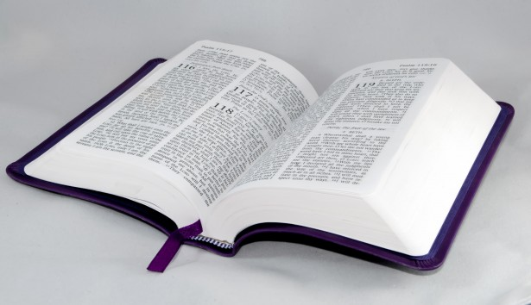
Bible Study
Hill Chapel
Baptist Church Athens

Slide 3

Bible Study
With Pastor Benjamin E.V. Lett

Slide 4

Prepare for our time of study by finding and reading:
^{September 6, 2023}
Genesis 41:50-52
Luke 6:28

Slide 5
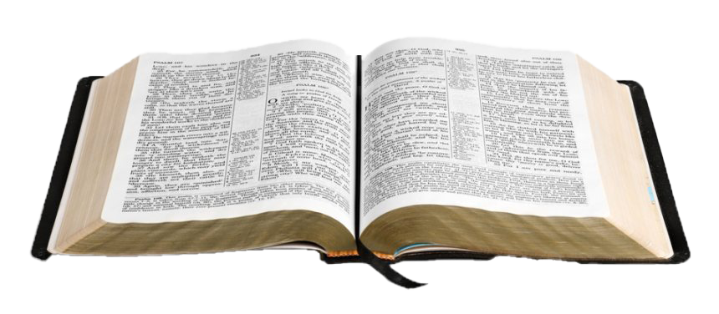
Bible Study with Hill Chapel Athens
Fall 2023 Study Topic
On the Road to becoming an Overcomer
On Line Only until further notice

Slide 6
On the road to becoming an overcomer
Why God permits Problems
Chasing Out Worry
Getting rid of Guilt
Putting away People Hurt
When You're Afraid
Taking on Your Anger
Turning Down Temptation
done with Loneliness
done with Discouragement
Done with feeling like a Failure
Strangling Stress
Finding Financial Freedom
Burnout be gone

Slide 7
living as an Overcomer by putting away people hurt
^{Lesson 4}
Genesis 41:50-52
Luke 6:28

Slide 8
Hurt

Slide 9
Hurt
Unless we know what to do when people hurt us, the memory of these hurts scars our past, saddens the present, and shackles us in the future

Slide 10
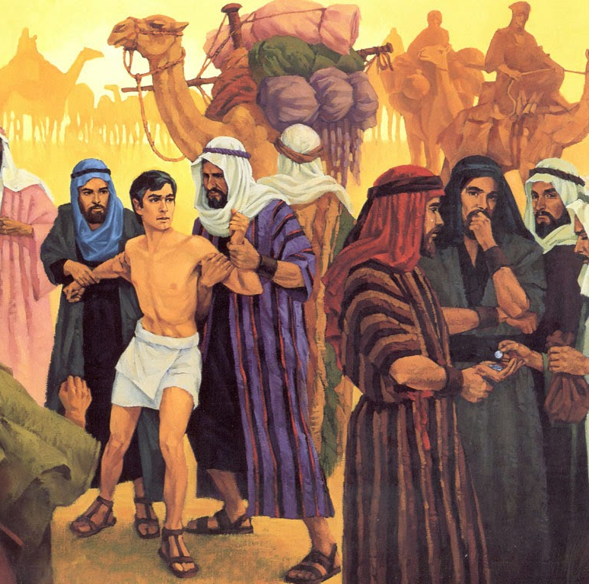
Story of Joseph
Loved by his father Hated by his brothers Sold into slavery Found in favor Placed in jail betrayed Trusted by The Pharaoh

Slide 11
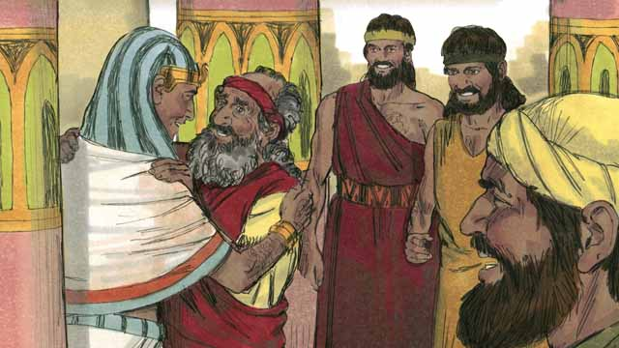
Joseph has two sons
⁵⁰ Before the years of famine came, two sons were born to Joseph by Asenath daughter of Potiphera, priest of On. ⁵¹ Joseph named his firstborn Manasseh and said, “It is because God has made me forget all my trouble and all my father’s household.” ⁵² The second son he named Ephraim and said, “It is because God has made me fruitful in the land of my suffering.” Genesis 41:50-52

Slide 12
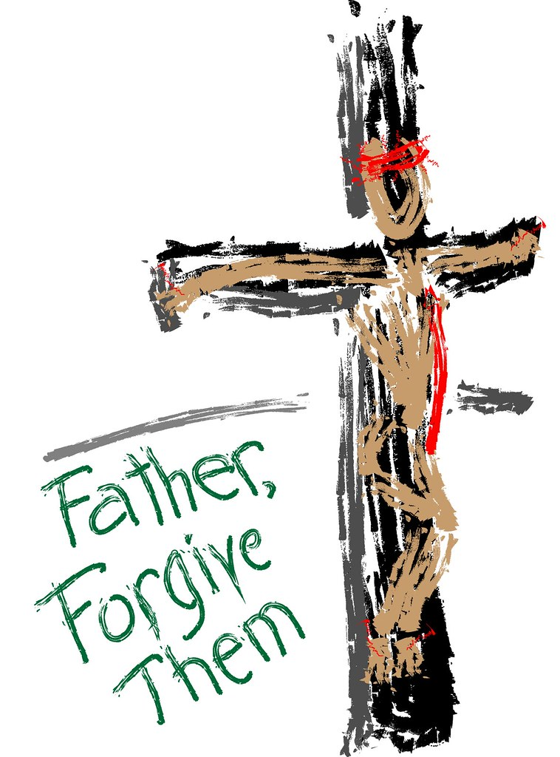
Two things we must do to be able to forgive the person who hut us
Free the person
Focus on the purpose of pain

Slide 13
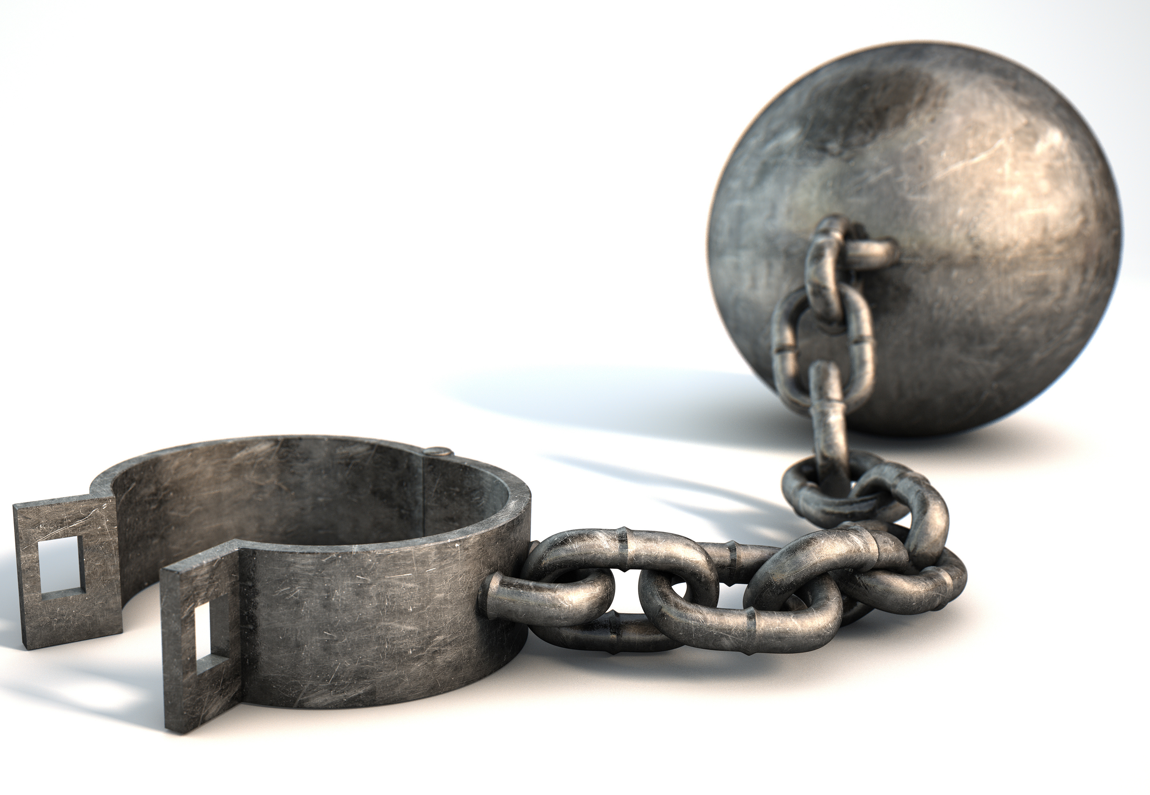
First, free the person
When people hurt us and we refuse to forgive them, we put them into the prisons of our hearts.

Slide 14

If we are to enjoy our blessings after being deeply hurt by people, we must make a moral decision to forgive them.
When did Joseph’s hurt end?

Slide 15
Jesus says there are two things we must do to release people who hurt us
#1
28 bless those who curse you, pray for those who mistreat you. Luke 6:28
Bless then - Greek for eulogeo “speak well of” or “to praise”

Slide 16
Jesus says there are two things we must do to release people who hurt us
#2
28 bless those who curse you, pray for those who mistreat you. Luke 6:28
Pray – We can’t resent someone and pray for them at the same time.

Slide 17
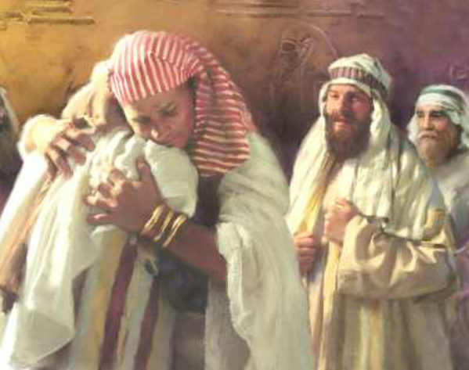
Second, focus on the purpose of the pain
²⁰ You intended to harm me, but God intended it for good to accomplish what is now being done, the saving of many lives. Genesis 50:20
Jacob believed God had a purpose

Slide 18

Is it important that we know the purpose?
What is it to be a good steward of your pain?
Slavery
Segregation
Jim Crow Laws
Lynchings

Slide 19

Other
Reasons…
Your thoughts

Slide 20
Other ways
To put away people hurt…

Slide 21

Q

