Slide 1
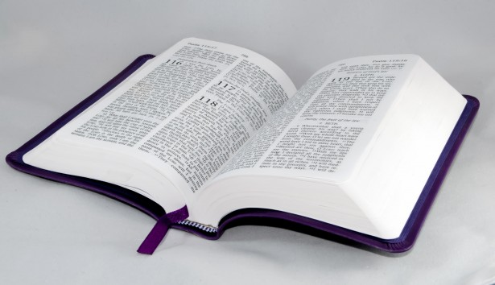
Bible Study
Hill Chapel
Baptist Church Athens

Slide 2

Bible Study
With Pastor Benjamin E.V. Lett

Slide 3

Prepare for our time of study by finding and reading:
^{August 23, 2023}
Matthew 6:25-34

Slide 4
living as an Overcomer by
Chasing out Worry
^{Lesson 2}
Matthew 6:25-34

Slide 5
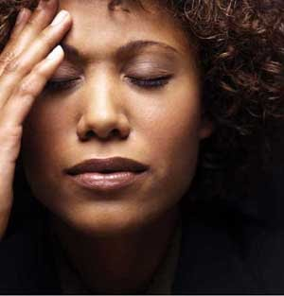
Worry
What is it?

Slide 6
Worry:
“to choke or strangle

Slide 7

Concern
What is it?

Slide 8
What’s the difference between worry & concern?

Slide 9
God plans for the future
5 The plans of the diligent lead to profit as surely as haste leads to poverty.
Proverbs 21:5
We plan for the future, but we don’t worry about it.

Slide 10

Let’s examine…
Why shouldn't we worry and how to wipe out worry.

Slide 11
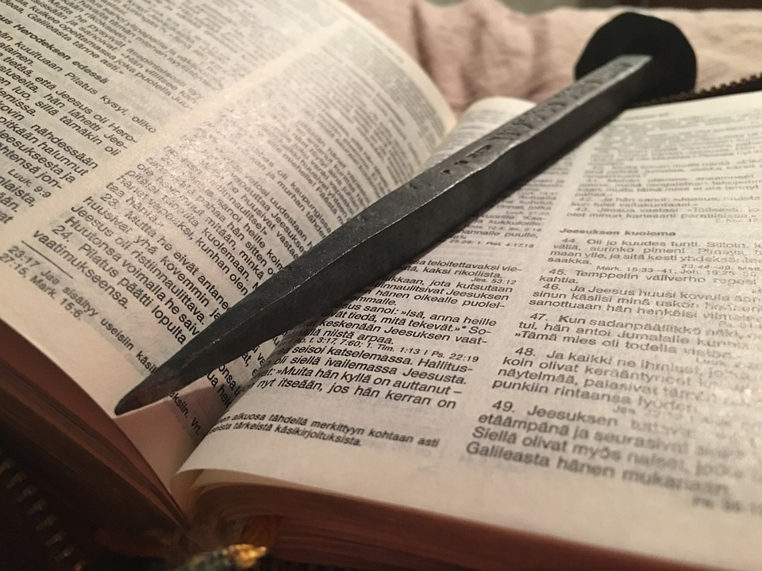
Why we shouldn’t worry
Causes us to loose perspectives
Causes us to forget our worth
Robs us of our strength

Slide 12
Matthew 6:25
Causes us to loose perspectives
²⁵ “Therefore I tell you, do not worry about your life, what you will eat or drink; or about your body, what you will wear. Is not life more than food, and the body more than clothes?

Slide 13

Matthew 6:26
Causes us to forget our worth
²⁶ Look at the birds of the air; they do not sow or reap or store away in barns, and yet your heavenly Father feeds them. Are you not much more valuable than they?

Slide 14
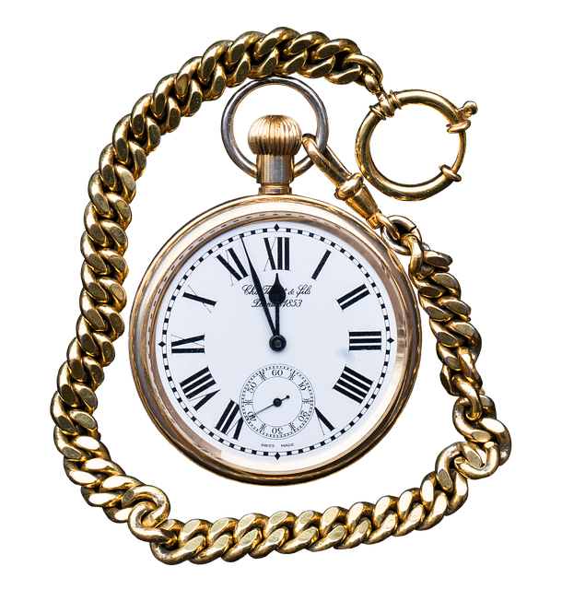
Matthew 6:27
Robs us of strength
²⁷ Can any one of you by worrying add a single hour to your life?

Slide 15

Other
Reasons…
Your thoughts

Slide 16
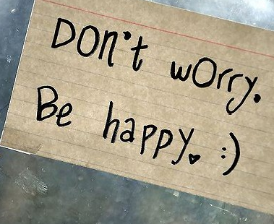
Let’s examine…
How To Wipe Out worry.

Slide 17

How to Wipe out Worry
Examine your priorities
Live in the present
Pray about everything

Slide 18

Matthew 6:33
Examine your priorities
³³ But seek first his kingdom and his righteousness, and all these things will be given to you as well.

Slide 19

Deuteronomy 33:25
Live in the present
Today!
²⁵ The bolts of your gates will be iron and bronze, and your strength will equal your days.

Slide 20
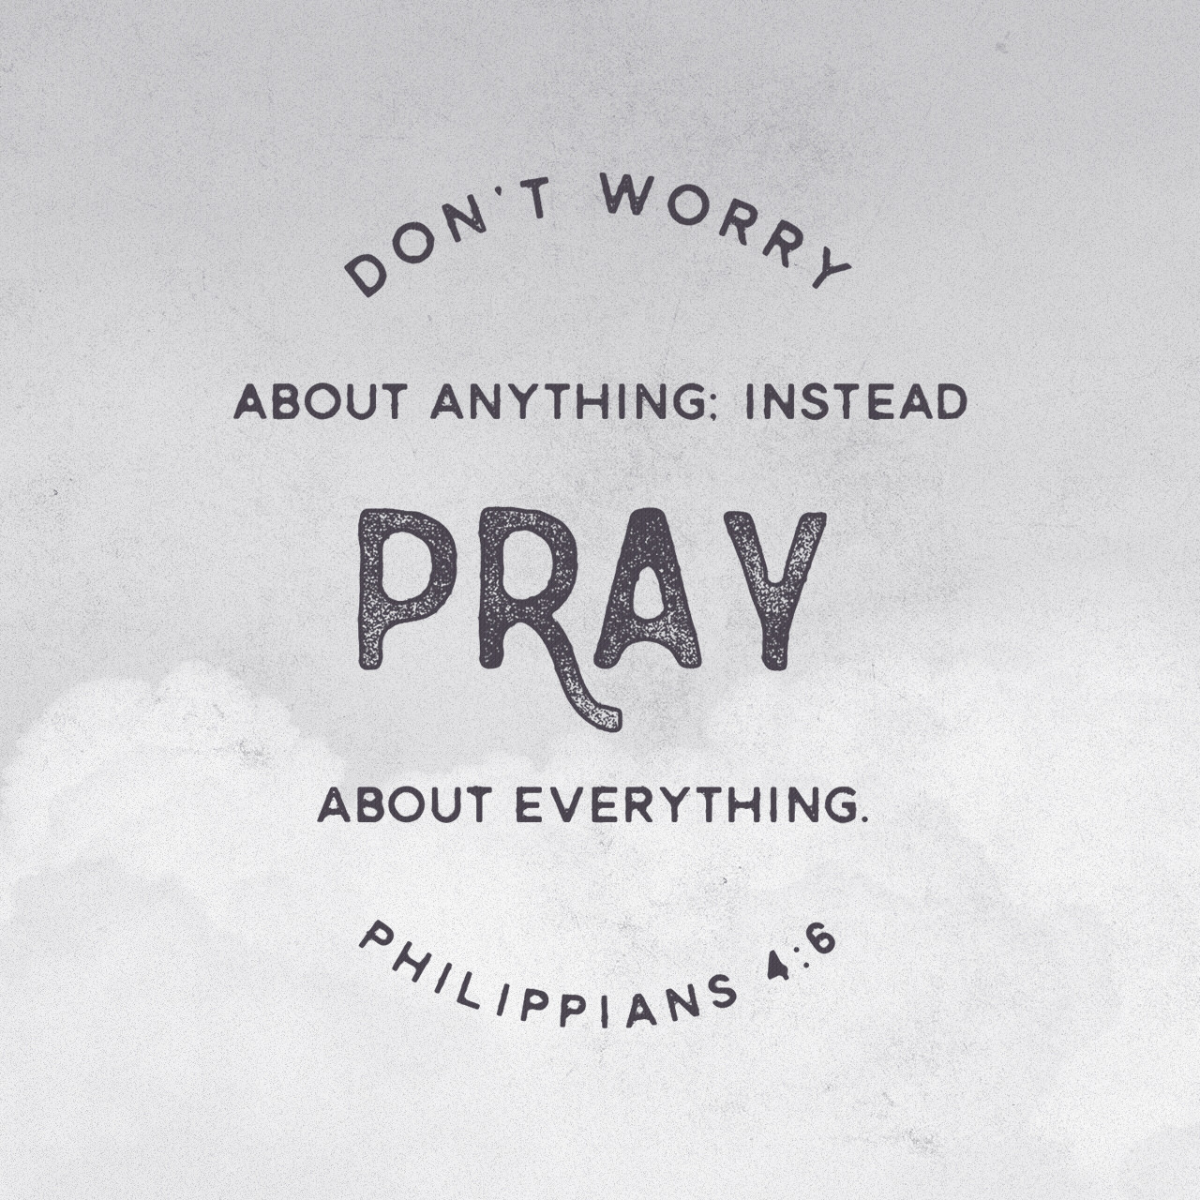
Philippians 4:6
Pray about everything
Today!
⁶ Do not be anxious about anything, but in every situation, by prayer and petition, with thanksgiving, present your requests to God.

Slide 21

Keep Praying
Psalm 55:22
1 Peter 5:7
Cast your cares on the Lord and he will sustain you; he will never let the righteous be shaken.
Cast all your anxiety on him because he cares for you

Slide 22
Other ways
To wipe out worry…
Your thoughts

Slide 23

Q

