Slide 1

Bible Study
With Pastor Benjamin E.V. Lett

Slide 2

Prepare for our time of study by finding and reading:
^{September 13, 2023}
Ephesians 4:31
Proverbs 29:11

Slide 3


Bible Study with Hill Chapel Athens
New Zoom Location
https://us02web.zoom.us/j/88909951335
Meeting ID: 889 0995 1335
One tap mobile
+13126266799,,88909951335# US
Meeting ID: 889 0995 1335

Slide 4
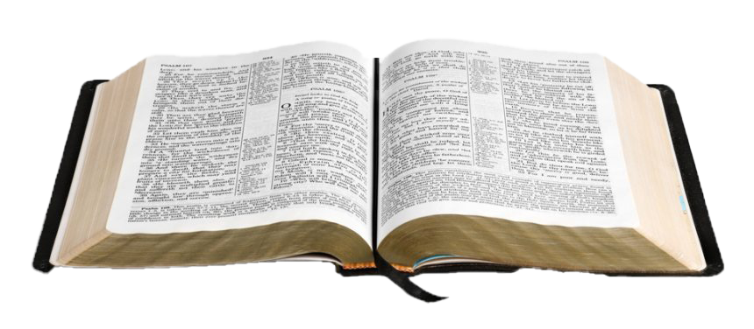
Bible Study with Hill Chapel Athens
Fall 2023 Study Topic
On the Road to becoming an Overcomer
On Line Only until further notice

Slide 5
On the road to becoming an overcomer
Why God permits Problems
Chasing Out Worry
Getting rid of Guilt
Putting away People Hurt
Taking on Your Anger
When You're Afraid
Turning Down Temptation
done with Loneliness
done with Discouragement
Done with feeling like a Failure
Strangling Stress
Finding Financial Freedom
Burnout be gone

Slide 6

Two things we must do to be able to forgive the person who hurt us
Free the person Bless and pray for the offender
Focus on the purpose of pain

Slide 7
living as an Overcomer by Taking on your anger
^{Lesson 5}
Ephesians 4:31
Proverbs 29:11

Slide 8
Anger

Slide 9



Anger
What is it?
How can it look?
What can it do?

Slide 10

What you should know to have victory over anger
The Categories of Anger
The Causes of Anger
The Cure for Anger

Slide 11
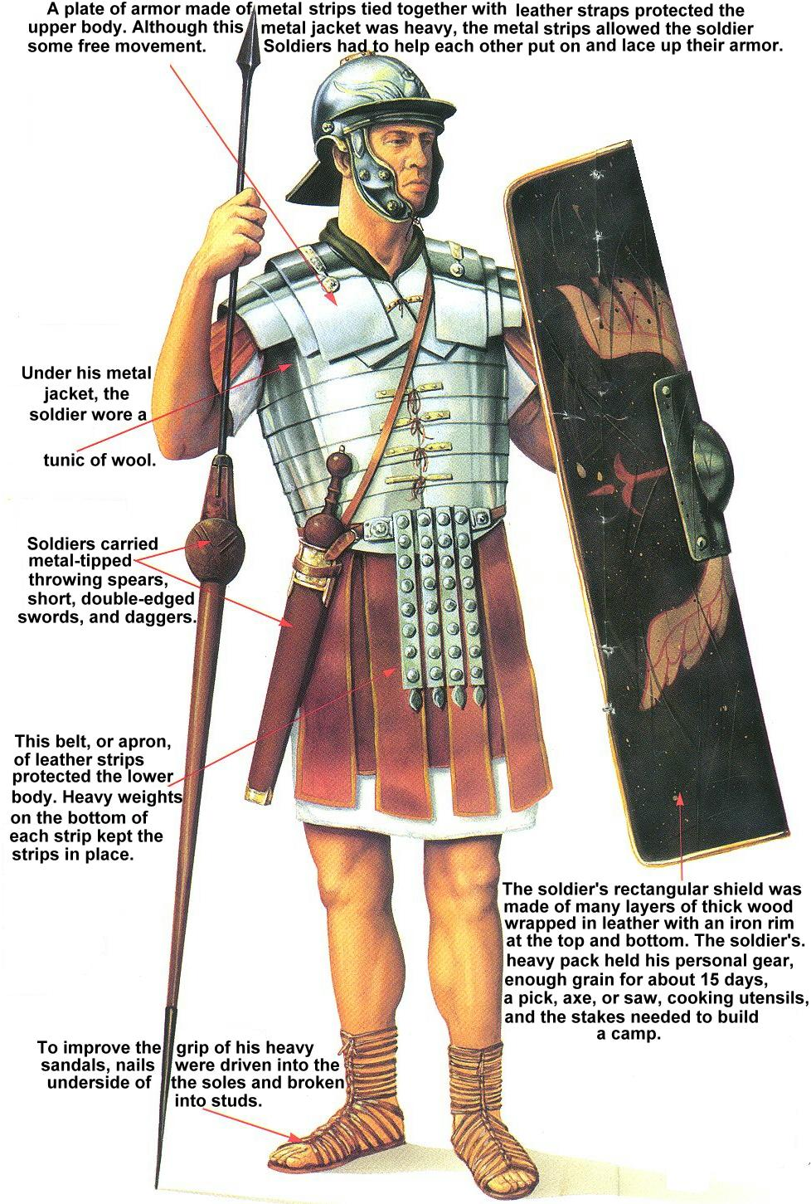
In order to defeat the enemy you must know the enemy
Put on the full armor of God, so that you can take your stand against the devil’s schemes. For our struggle is not against flesh and blood, but against the rulers, against the authorities, against the powers of this dark world and against the spiritual forces of evil in the heavenly realms. Ephesians 6:11-12

Slide 12
Know the categories of anger
Rage
An angry person stirs up conflict, and a hot-tempered person commits many sins. Provers 29:22
Simple anger
“In your anger do not sin”: Do not let the sun go down while you are still angry, Ephesians ns 4:26
Rage (THUMOS) – “wrath” , hot anger or anger let loose
Anger (ORGE) – suggest a more controlled anger

Slide 13
Know the Causes of anger
1. Hurt
Emotional and Physical
2. Insecurity
Do not pay attention to every word people say, or you may hear your servant cursing you— Ecclesiastes 7:21
3. Frustration
Whoever is patient has great understanding, but one who is quick-tempered displays folly. Proverbs 14:29
Hurt
Insecurity
Frustration

Slide 14
Know the Cure for Anger We can control our anger if we do three things:
Constrain our words
The words of the reckless pierce like swords, but the tongue of the wise brings healing Proverbs 12:18
Consider the consequences
Refrain from anger and turn from wrath; do not fret—it leads only to evil. Psalm 37:8
Control our responses
My dear brothers and sisters, take note of this: Everyone should be quick to listen, slow to speak and slow to become angry, James 1:19
Constrain our words
Consider the consequences
Control Our responses

Slide 15
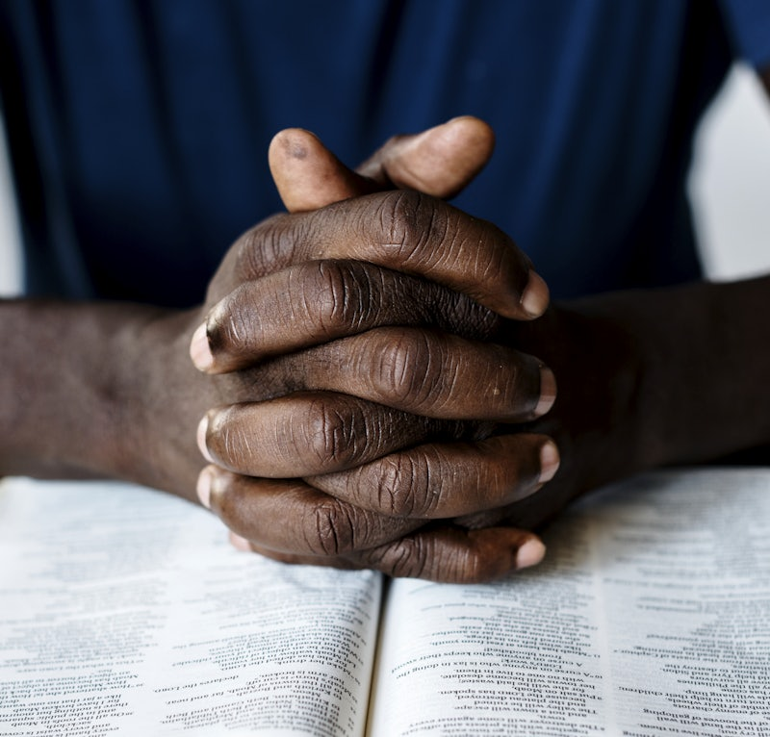
^{Pray}
^{Meditate}
^{Study}
^{Therapy}

