Slide 1


Bible Study with Hill Chapel Athens
New Zoom Location
https://us02web.zoom.us/j/88909951335
Meeting ID: 889 0995 1335
One tap mobile
+13126266799,,88909951335# US
Meeting ID: 889 0995 1335

Slide 2

Bible Study
With Pastor Benjamin E.V. Lett

Slide 3

Prepare for our time of study by finding and reading:
^{September 27, 2023}
Genesis 2 & 3

Slide 4
living as an Overcomer by Turning Down Temptation
^{Lesson 7}
Genesis 2 & 3

Slide 5
Temptation

Slide 6

Temptation
Is temptation something we should be concerned about?
Why?
Why not?

Slide 7
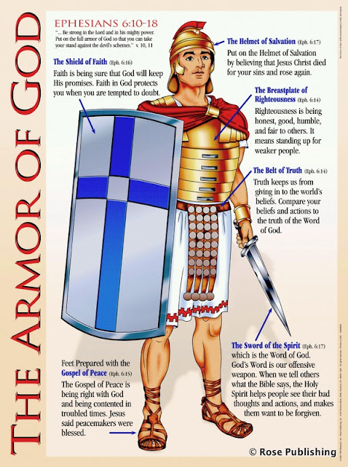
In order to defeat the enemy you must know the enemy Temptation
Put on the full armor of God, so that you can take your stand against the devil’s schemes. For our struggle is not against flesh and blood, but against the rulers, against the authorities, against the powers of this dark world and against the spiritual forces of evil in the heavenly realms. Ephesians 6:11-12

Slide 8

Temptation started with Adam and Eve
To turn down temptation, we must understand two things:
The strategy of Satan
The steps for resisting

Slide 9

The Strategy of Satan
Think negatively about God’s word
Think lightly about God’s warnings
Think exclusively about pleasure

Slide 10
Think negatively about God’s word
¹⁶ And the Lord God commanded the man, saying, Of every tree of the garden thou mayest freely eat: ¹⁷ But of the tree of the knowledge of good and evil, thou shalt not eat of it: for in the day that thou eatest thereof thou shalt surely die. Gen. 2:16-17
Now the serpent was more subtil than any beast of the field which the Lord God had made. And he said unto the woman, Yea, hath God said, Ye shall not eat of every tree of the garden? Genesis 3:1

Slide 11
Think negatively about God’s warnings
About Satan
⁴⁴ He was a murderer from the beginning, and abode not in the truth, because there is no truth in him. When he speaketh a lie, he speaketh of his own: for he is a liar, and the father of it. John 8:44
⁴ And the serpent said unto the woman, Ye shall not surely die:
Genesis 3:4

Slide 12
Think exclusively about pleasure
Move with wisdom
It is as sport to a fool to do mischief: but a man of understanding hath wisdom.
Proverbs 10:23
⁴ And the serpent said unto the woman, Ye shall not surely die:
Genesis 3:4

Slide 13

The Steps for Resisting
Refocus your thoughts
Reflect on the consequences
Request God’s help
Repent of past failures

Slide 14
Refocus your thoughts
God’s desires
⁶ And when the woman saw that the tree was good for food, and that it was pleasant to the eyes, and a tree to be desired to make one wise, she took of the fruit thereof, and did eat, and gave also unto her husband with her; and he did eat.
Genesis 3:6
⁸ The statutes of the Lord are right, rejoicing the heart: the commandment of the Lord is pure, enlightening the eyes. Psalm 19:8

Slide 15
Reflect on the Consequences
The Bible says:
⁶ And when the woman saw that the tree was good for food, and that it was pleasant to the eyes, and a tree to be desired to make one wise, she took of the fruit thereof, and did eat, and gave also unto her husband with her; and he did eat.
Genesis 3:6
¹¹ Because sentence against an evil work is not executed speedily, therefore the heart of the sons of men is fully set in them to do evil.
Ecclesiastes 8:11

Slide 16
Request God’s Help
Be reminded:
Jesus teaches us to pray … lead us not into temptation Matthew 6:13
¹³ There hath no temptation taken you but such as is common to man: but God is faithful, who will not suffer you to be tempted above that ye are able; but will with the temptation also make a way to escape, that ye may be able to bear it. 1 Corinthians 10:13
Jesus teaches … Watch and pray so that you will not fall into temptation. Matthew 26:41

Slide 17

Repent of past failures
Jesus gives us an example with the woman at the well
¹¹ She said, No man, Lord. And Jesus said unto her, Neither do I condemn thee: go, and sin no more. John 8:11

Slide 18


