Slide 1
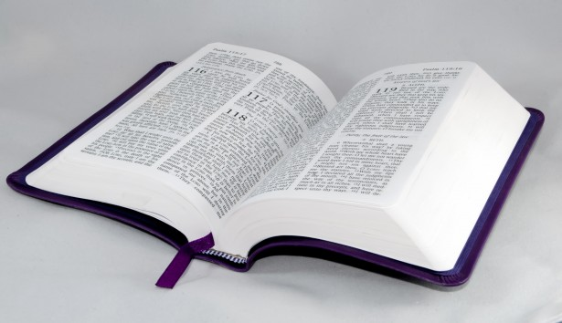
Bible Study
Hill Chapel
Baptist Church Athens

Slide 2

Bible Study
With Pastor Benjamin E.V. Lett

Slide 3

Prepare for our time of study by finding and reading:
^{November 8, 2023}
Matthew 6:19-34

Slide 4


Bible Study with Hill Chapel Athens
New Zoom Location
https://us02web.zoom.us/j/88909951335
Meeting ID: 889 0995 1335
One tap mobile
+13126266799,,88909951335# US
Meeting ID: 889 0995 1335

Slide 5
living as an Overcomer by Finding Financial Freedom – Part 2
^{Lesson 14}
Matthew 6:19-34

Slide 6

Financial Debt

Slide 7
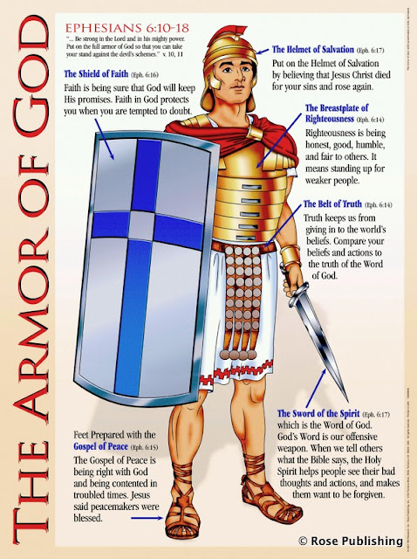
In order to defeat the enemy you must know the enemy Debt
Put on the full armor of God, so that you can take your stand against the devil’s schemes. For our struggle is not against flesh and blood, but against the rulers, against the authorities, against the powers of this dark world and against the spiritual forces of evil in the heavenly realms. Ephesians 6:11-12

Slide 8
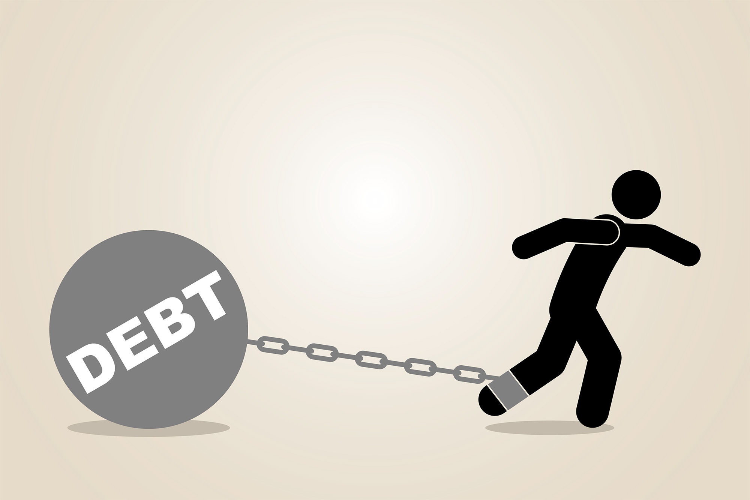
You do not have to be poor, or even in debt, to be in financial bondage.

Slide 9


^{Sign of financial Bondage}
1. Being discontent with financial status.
2. Having overdue bills of accumulating debt on credit cards.
3. Worrying about investments and possessions.
4. Having less than 3 month’s income in savings.
If two or more of these are true in your life, you are probably in financial bondage and need to take five steps to financial freedom.

Slide 10

5 Steps
to Financial Freedom

Slide 11

^{Steps to financial freedom}
1. Find out where your money is going.
Be sure you know the condition of your flocks, give careful attention to your herds. Proverbs 27:23
^{Keep good records.}

Slide 12
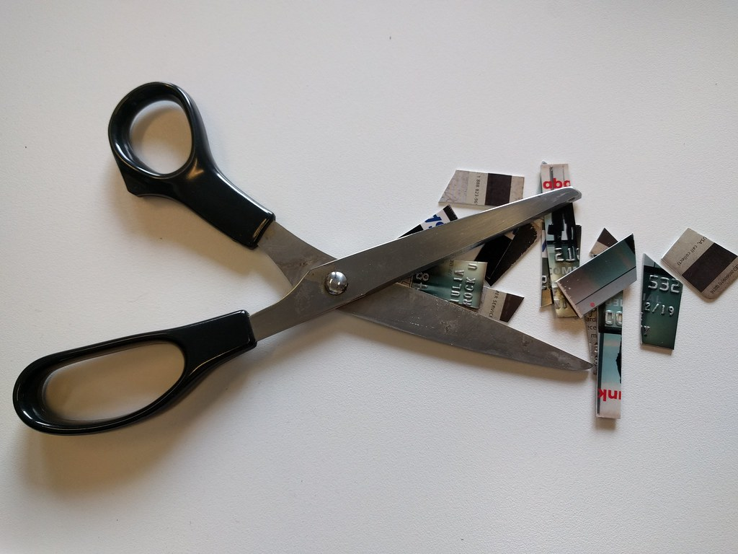

^{Steps to financial freedom}
2. Get rid of all your credit cards.
Lazy hands make for poverty, but diligent hands bring wealth. Proverb 10:4
Impulse spending will get you in trouble!
Wait Sales
Watch For a blessing
Save Look forward to it
Trust Ask God for it
Did anyone get hurt? lol

Slide 13
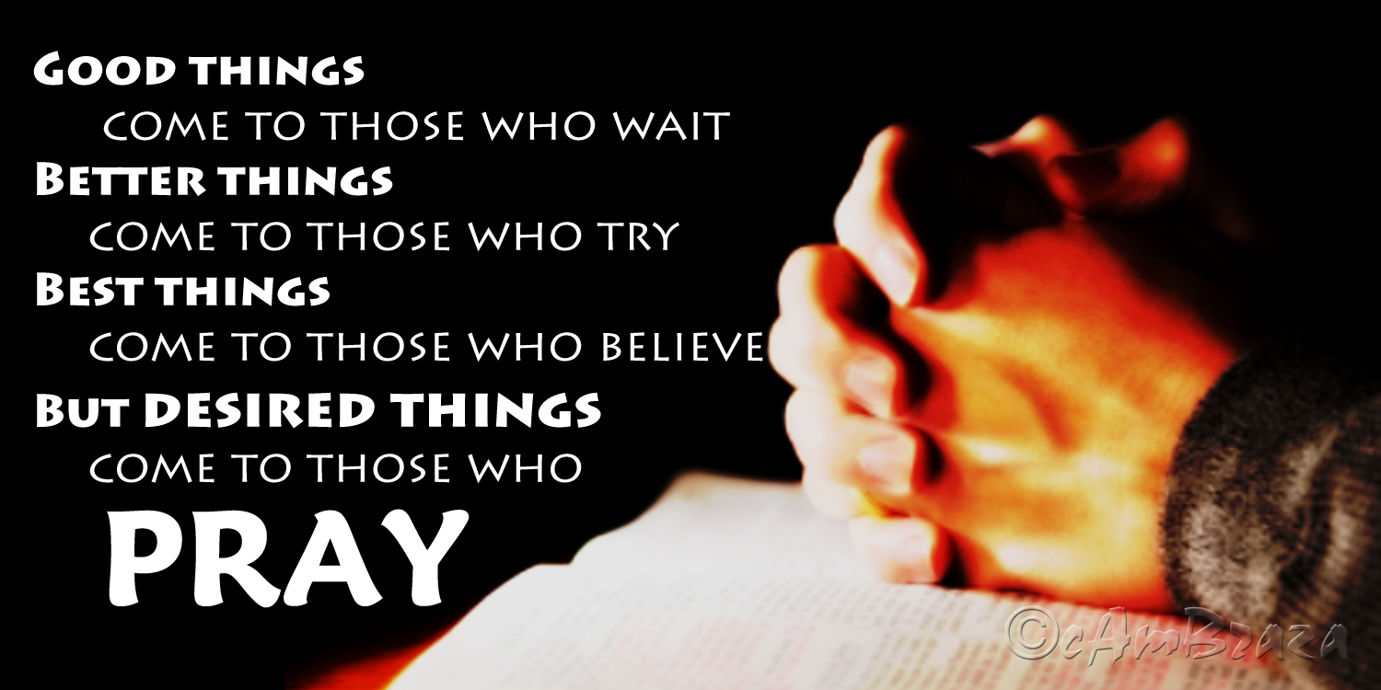
^{Steps to financial freedom}
3. Pray before you pay.
You desire but do not have, so you kill. You covet but you cannot get what you want, so you quarrel and fight. You do not have because you do not ask God. James 4:2
Cuts down on impulse buying and capitalizes your dependence on God.

Slide 14

^{Steps to financial freedom}
4. Enjoy what you have.
Moreover, when God gives someone wealth and possessions, and the ability to enjoy them, to accept their lot and be happy in their toil – this is a gift of God. Ecclesiastes 5:10
You don’t find happiness at the end of the road; you find it (or you make it, or permit it) along the way.

Slide 15

^{Steps to financial freedom}
5. Give 10% back to the work of the Lord.
Honor the Lord with your wealth, with the firstfruits of all your crops; ¹⁰ then your barns will be filled to overflowing, and your vats will brim over with new wine.. Proverbs 3:9, 10
Fewer things reveal our faith in God and His word like the practice of tithing.
Biblical money management.
Practiced because we love God

Slide 16
Giving the Tithe
Giving in Joy
Give what you have decided in your heart to give, not reluctantly or under compulsion, for God loves a cheerful giver. 2 Corinthians 9:7
Giving in Faith
“For my thoughts are not your thoughts, neither are your ways my ways,” declares the Lord. Isaiah 55:8
Giving to Demonstrate
For where your treasure is, there your heart will be also. Mathew 6:21
Giving to Expect
Whoever sows sparingly will also reap sparingly, and whoever sows generously will also reap generously. 2 Corinthians 9:6

Slide 17
5 Steps to Financial Freedom
1. Find out where your money is going.
2. Get rid of all your credit cards.
3. Pray before you pay.
4. Enjoy what you have.
5. Give 10% back to God.

Slide 18


