Slide 1

Bible Study
With Pastor Benjamin E.V. Lett

Slide 2

living as an Overcomer by Done with Feeling like a failure
^{Lesson 10}
Psalm 103

Slide 3
Feeling like a failure

Slide 4
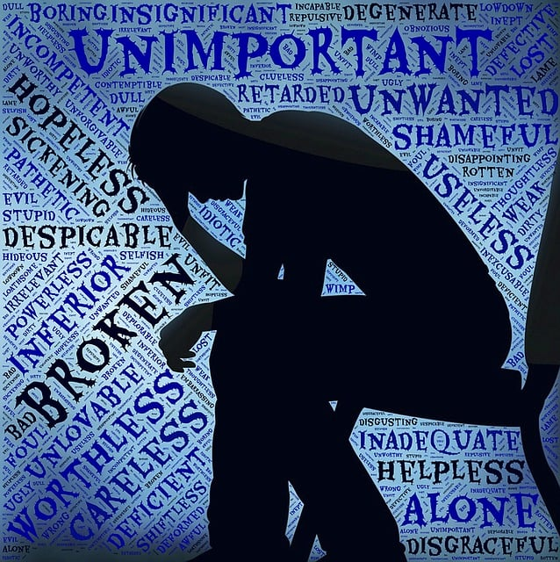
failure
What are actions that may cause the feeling of failure
Who / what determines that you are a failure.
What actions result in you feeling like a failure.

Slide 5
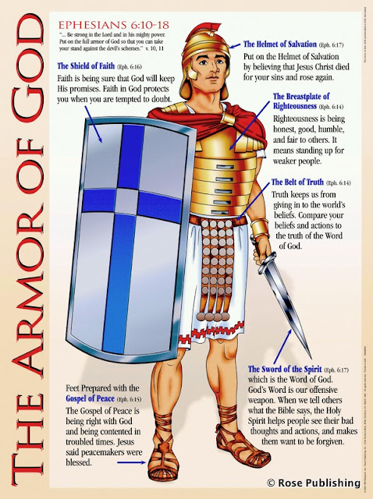
In order to defeat the enemy you must know the enemy
Put on the full armor of God, so that you can take your stand against the devil’s schemes. For our struggle is not against flesh and blood, but against the rulers, against the authorities, against the powers of this dark world and against the spiritual forces of evil in the heavenly realms. Ephesians 6:11-12

Slide 6
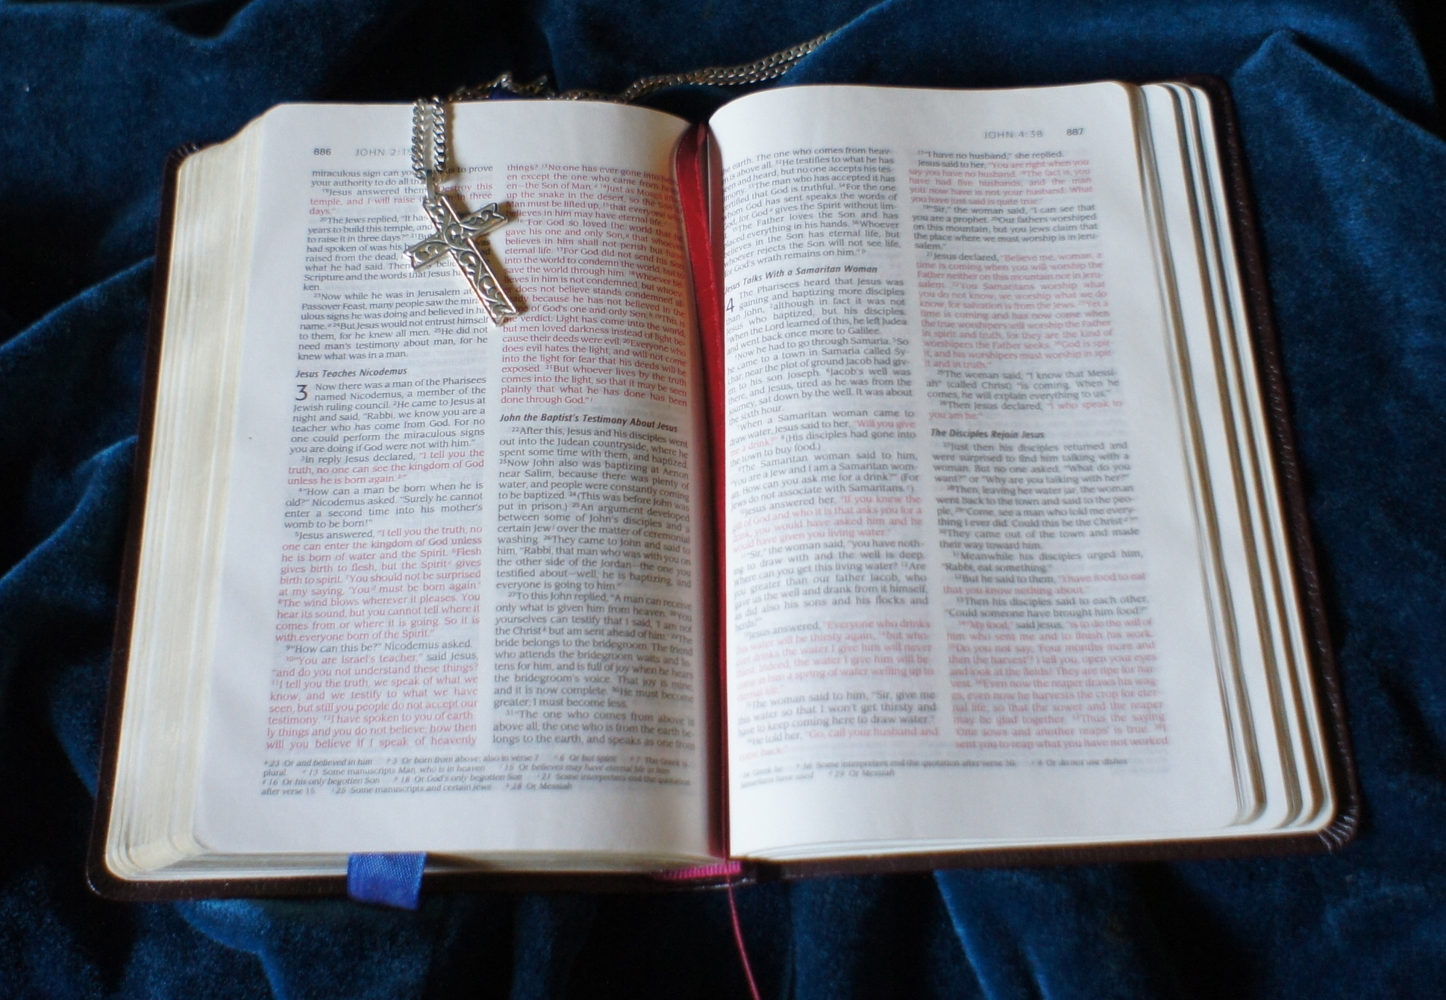
The Bible
A series of stories about human failures
The story of how God loves and forgives

Slide 7


When you feel like a Failure
The Results of Failure
Recovering From Failure

Slide 8

Results of failure #1- Failure reminds us that we are human
What should we do with this knowledge?
¹⁴ for God knows how we are formed, he remembers that we are dust. Psalm 103:14

Slide 9
Results of failure #2- Failure Keeps us humble
⁹ To some who were confident of their own righteousness and looked down on everyone else, Jesus told this parable: ¹⁰ “Two men went up to the temple to pray, one a Pharisee and the other a tax collector. ¹¹ The Pharisee stood by himself and prayed: ‘God, I thank you that I am not like other people—robbers, evildoers, adulterers—or even like this tax collector. ¹² I fast twice a week and give a tenth of all I get.’ ¹³ “But the tax collector stood at a distance. He would not even look up to heaven, but beat his breast and said, ‘God, have mercy on me, a sinner.’ ¹⁴ “I tell you that this man, rather than the other, went home justified before God. For all those who exalt themselves will be humbled, and those who humble themselves will be exalted.” Luke 18:9-14

Slide 10

Results of failure #3- Failure draws us closer to God
What actions toward God may failure bring about in our lives?
⁴ In his pride the wicked man does not seek him; in all his thoughts there is no room for God. Psalm 10:4

Slide 11

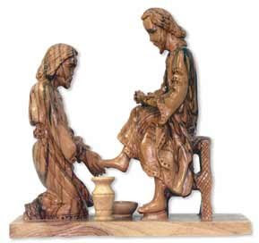
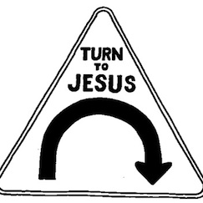
Results of failure
Humanness
Humility
Redirection

Slide 12

Recovering from failure #1- Admit the failure
¹³ Whoever conceals their sins does not prosper, but the one who confesses and renounces them finds mercy. Proverbs 28:13 4:10
Who do we admit our failures to?

Slide 13
Recovering from Failure #2- Accept God’s forgiveness
¹⁰ he does not treat us as our sins deserve or repay us according to our iniquities. Psalm 103:10
God deals with us on the basis of his Grace.

Slide 14

Give me one word for grace

Slide 15
Let us then approach God’s throne of grace with confidence, so that we may receive mercy and find grace to help us in our time of need. Hebrews 4:16

Slide 16
Recovering from failure #3- Apply the lessons of failure
⁷¹ It was good for me to be afflicted so that I might learn your decrees. Psalm 119:71
What does this
look like?

Slide 17
Recovering from failure #4 – Acknowledge failure isn’t final
⁸ The Lord is compassionate and gracious, slow to anger, abounding in love. ⁹ He will not always accuse, nor will he harbor his anger forever; ¹⁰ he does not treat us as our sins deserve or repay us according to our iniquities. ¹¹ For as high as the heavens are above the earth, so great is his love for those who fear him; ¹² as far as the east is from the west, so far has he removed our transgressions from us. ¹³ As a father has compassion on his children, so the Lord has compassion on those who fear him; ¹⁴ for he knows how we are formed, he remembers that we are dust. Psalm 103:8-14

Slide 18


