Slide 1

Bible Study
With Pastor Benjamin E.V. Lett

Slide 2

Add a funny Quote
“QUOTES…

Slide 3

Weekly Prayer Meeting
Mondays at 5:30 pm
via teleconference
Dial: 1-267-807-9495
Access code: 505-087-623

Slide 4
Hill Chapel Baptist Church Athens Wednesday Bible Study from the Hill and Lett's Talk
6:00PM Eastern Time, every week on Wednesday
Join Zoom Meeting
https://us02web.zoom.us/j/84908875086?pwd=OUtSOVROZmdwS3g2czZJR3BmcGVsUT09
Meeting ID: 849 0887 5086 Passcode: 715262
One tap mobile:
+13017158592,,84908875086#,,,,*715262# US or
+13052241968,,84908875086#,,,,*715262# US

Slide 5
Colossians
Journey Into Becoming All God Wants You To Be

Slide 6

series Introduction
The main goal of every Christian should be to become all God wants them to be
The book of Colossians is about becoming all God wants you to be.
Some of us have further to go in this spiritual journey than others
but all of us must have the required pilers of characteristics Paul writes about in Colossians 1:1-8.

Slide 7
Colossians
Who?
Paul, the author (1:1,23; 4:18)
Colossians, the recipients (1:1,21,27)
Epaphras, the minister (1:7-8)
Tychicus, the letter carrier (4:7-8)

Slide 8
Colossians
Paul wrote this letter during his first imprisonment in Rome (A.D. 60-62; Acts 28:16),
At this time, he also wrote his other prison epistles: Philippians, Ephesians, and Philemon.

Slide 9
Colossians
Why?
To warn against human philosophy (2:8)
To tell the Colossians about Paul (4:7-8)

Slide 10
Colossians
Why?
He wrote Colossians to confront the attempts of some believers to combine elements of paganism and secular philosophy with Christian doctrine.
He presents Jesus Christ as the absolute authority and the complete sufficiency for becoming all God wants us to be.

Slide 11

LESSON 1
The Three pilers for Spiritual Growth (Colossians 1:1-8)

Slide 12
Colossians 1:1-4
Paul, an apostle of Jesus Christ by the will of God, and Timotheus our brother, ² To the saints and faithful brethren in Christ which are at Colosse: Grace be unto you, and peace, from God our Father and the Lord Jesus Christ. ³ We give thanks to God and the Father of our Lord Jesus Christ, praying always for you, ⁴ Since we heard of your faith in Christ Jesus, and of the love which ye have to all the saints,

Slide 13
Colossians 1:5-8
⁵ For the hope which is laid up for you in heaven, whereof ye heard before in the word of the truth of the gospel; ⁶ Which is come unto you, as it is in all the world; and bringeth forth fruit, as it doth also in you, since the day ye heard of it, and knew the grace of God in truth: ⁷ As ye also learned of Epaphras our dear fellow servant, who is for you a faithful minister of Christ; ⁸ Who also declared unto us your love in the Spirit.

Slide 14


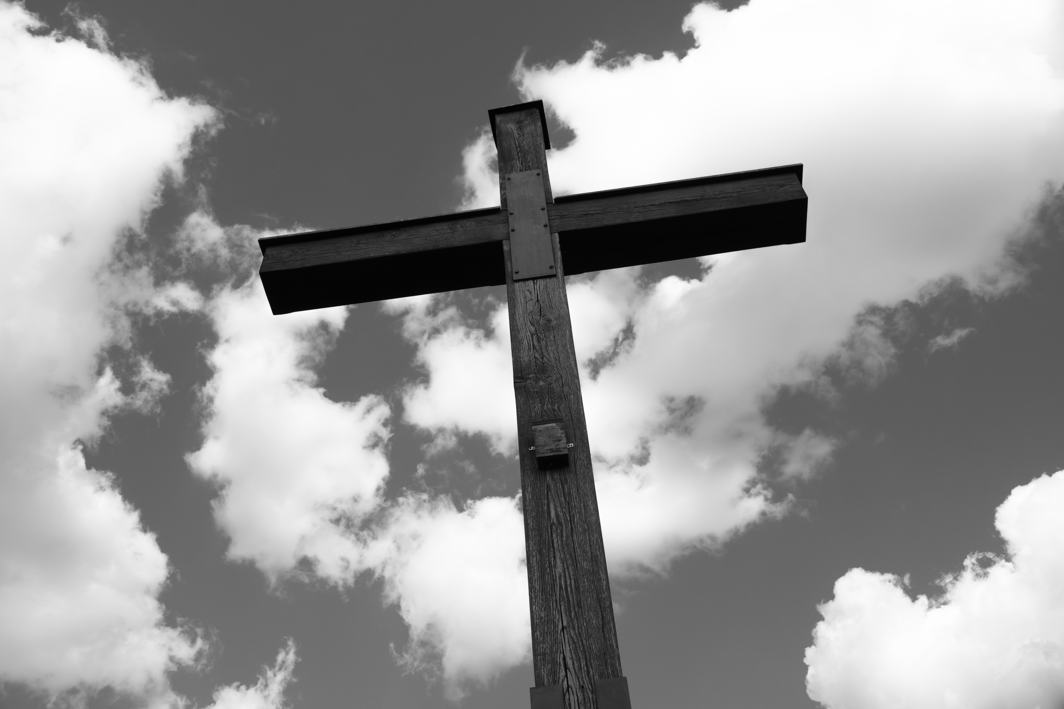
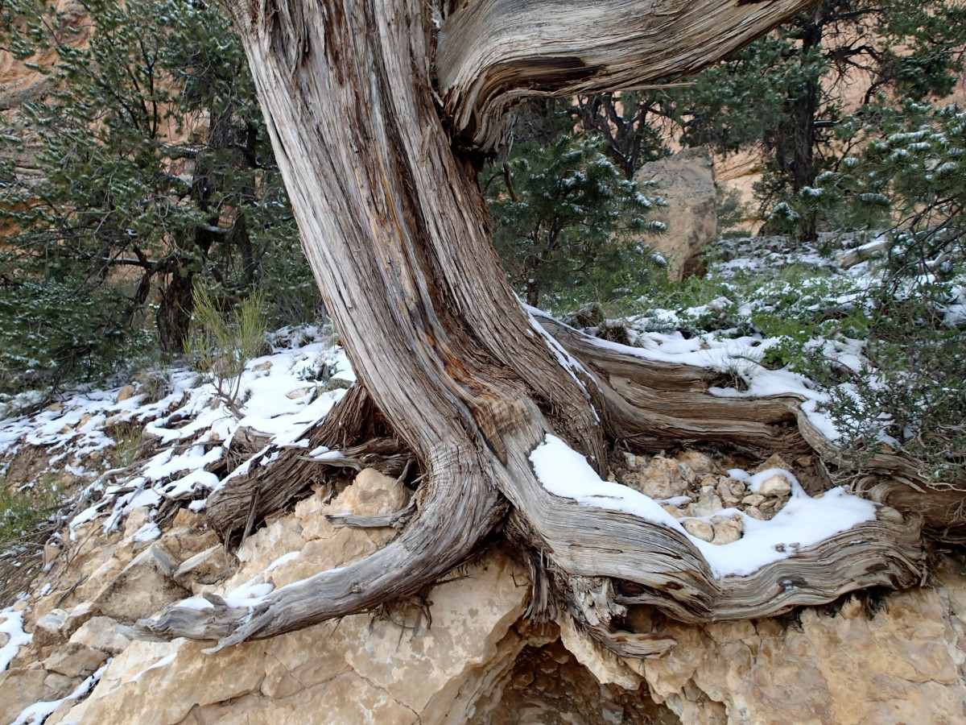
Brainstorm Group(s)
Saving Faith
Steadfast Hope
Supernatural Love

Slide 15

Saving Faith
This letter is written to the saints . . . at Colossae (1:2a).
saints (HAGIOS, hag´-ee-os) means “set apart,” or consecrated,” to God.
All Christians are saints who should daily experience Paul’s prayer for the Colossians—that God will give them His continuing grace and peace (1:2b).
Grace refers to God’s unmerited favor and supernatural empowerment (Acts 4:33).
Experiencing God’s grace results in peace from God.

Slide 16
Saving Faith
We are responsible for maintaining our peace from God.
If we don’t have peace from God—inner tranquility—even during life’s storms, we’re not all God wants us to be—and it’s not God’s fault.
The key to sustaining peace from God is found in Isaiah 26:3.
³ Thou wilt keep him in perfect peace, whose mind is stayed on thee: because he trusteth in thee.

Slide 17
Saving Faith
Paul compliments them for their faith in Christ Jesus (1:4a).
This refers to the saving faith they demonstrated when they accepted Jesus as Lord and Savior.
The word translated faith (PISTIS, pis´-tis) in the Bible is not a blind leap into the dark.
Biblical faith is being persuaded something is true to the point it changes your life.

Slide 18
Saving Faith
Saving faith always reveals itself by what Paul mentions in verse 4…
⁴ Since we heard of your faith in Christ Jesus, and of the love which ye have to all the saints,

