Slide 1
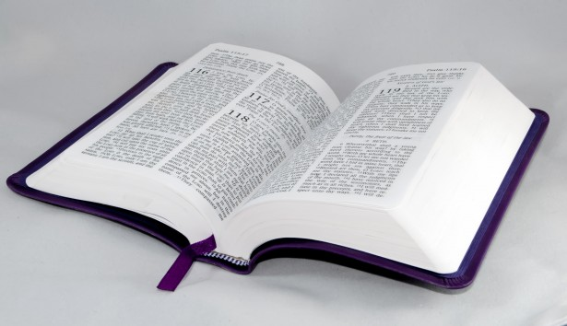
Bible Study
Hill Chapel
Baptist Church Athens

Slide 2

Bible Study
With Pastor Benjamin E.V. Lett

Slide 3

LESSON 4
Having Your Own Successful Ministry
(Colossians 1:24-29)

Slide 4
Hill Chapel Baptist Church Athens
Wednesday Bible Study from the Hill and Lett's Talk
6:00PM Eastern Time, every week on Wednesday
Join Zoom Meeting
https://us02web.zoom.us/j/84908875086?pwd=OUtSOVROZmdwS3g2czZJR3BmcGVsUT09
Meeting ID: 849 0887 5086 Passcode: 715262
One tap mobile:
+13017158592,,84908875086#,,,,*715262# +13052241968,,84908875086#,,,,*715262#

Slide 5
Discipleship 103
What you need to know

Slide 6
Bible Study Series
January –March 2024
Becoming All God Wants You to Be

Slide 7
LESSON 4
Having Your Own Successful Ministry
(Colossians 1:24-29)

Slide 8
Colossians 1:24-27
²⁴ Now I rejoice in what I am suffering for you, and I fill up in my flesh what is still lacking in regard to Christ’s afflictions, for the sake of his body, which is the church. ²⁵ I have become its minister / servant by the commission God gave me to present to you the word of God in its fullness—

Slide 9
Colossians 1:28-29
²⁸ He is the one we proclaim, admonishing and teaching everyone with all wisdom, so that we may present everyone fully mature in Christ. ²⁹ To this end I strenuously contend with all the energy Christ so powerfully works in me.

Slide 10

What does it look like?
What does success look like?
What is a minister?
What does a minister look like?

Slide 11
Have you thought about these questions?
Wha are the saints?
Are you a saint?
Should all saints be in ministry?
¹¹ And He Himself gave some to be apostles, some prophets, some evangelists, and some pastors and teachers, ¹² for the equipping of the saints for the work of ministry, for the edifying of the body of Christ, (Ephesians 4:11-12)

Slide 12
There are at least four prerequisites for having a successful ministry
An Attitude of Ministry
An Area of Ministry
An Assignment for ministry
An Aim for Your Ministry

Slide 13
1. An Attitude of Ministry
²⁴ Now I rejoice in what I am suffering for you, and I fill up in my flesh what is still lacking in regard to Christ’s afflictions, for the sake of his body, which is the church. ²⁵ I have become its servant by the commission God gave me to present to you the word of God in its fullness— (Colossians 1:24-25a).
Paul writes that he can “rejoice in what I am suffering”.
Why do you suppose he can rejoice?
What does your suffering say about you and who you are?

Slide 14
1. An Attitude of Ministry
²⁴ Now I rejoice in what I am suffering for you, and I fill up in my flesh what is still lacking in regard to Christ’s afflictions, for the sake of his body, which is the church. ²⁵ I have become its minister/ servant by the commission God gave me to present to you the word of God in its fullness— (Colossians 1:24-25a).
This means that he is participating in Christ’s sufferings as they continue in His body, the church.
  Is the church suffering now?
  If the church is suffering tell us how?

Slide 15

1. An Attitude of Ministry
²⁴ Now I rejoice in what I am suffering for you, and I fill up in my flesh what is still lacking in regard to Christ’s afflictions, for the sake of his body, which is the church. ²⁵ I have become its minister/ servant by the commission God gave me to present to you the word of God in its fullness— (Colossians 1:24-25a).
What makes the best servant?

Slide 16
2. An Area of Ministry
²⁵ I have “become its servant” by the commission God gave me to present to you the word of God in its fullness— (Colossians 1:25b-c).
Paul writes that he “became its servant”.
“I am its administrator – steward.”
Why do you suppose he chose the phrase servant?

Slide 17
3. An assignment for Ministry
²⁶ the mystery that has been kept hidden for ages and generations, but is now disclosed to the Lord’s people. ²⁷ To them God has chosen to make known among the Gentiles the glorious riches of this mystery, which is Christ in you, the hope of glory (Colossians 1:26-27).
His assignment was to announce the truths behind the mysteries.
  Salvation is offered to all
  All are equal under God
  God through Christ makes us all one

Slide 18
3. An assignment for Ministry
²⁶ the mystery that has been kept hidden for ages and generations, but is now disclosed to the Lord’s people. ²⁷ To them God has chosen to make known among the Gentiles the glorious riches of this mystery, which is Christ in you, the hope of glory (Colossians 1:26-27).
Christ in you!!!
¹⁶ The Spirit Himself bears witness with our spirit that we are children of God, (Romans 8:16).

Slide 19

4. An Aim for Your Ministry
²⁸ He is the one we proclaim, admonishing and teaching everyone with all wisdom, so that we may present everyone fully mature in Christ. ²⁹ To this end I strenuously contend with all the energy Christ so powerfully works in me.
There should be a twofold aim, or goal, in every ministry
Warn everyone
Teach everyone
Mature Christians

Slide 20


