Slide 1
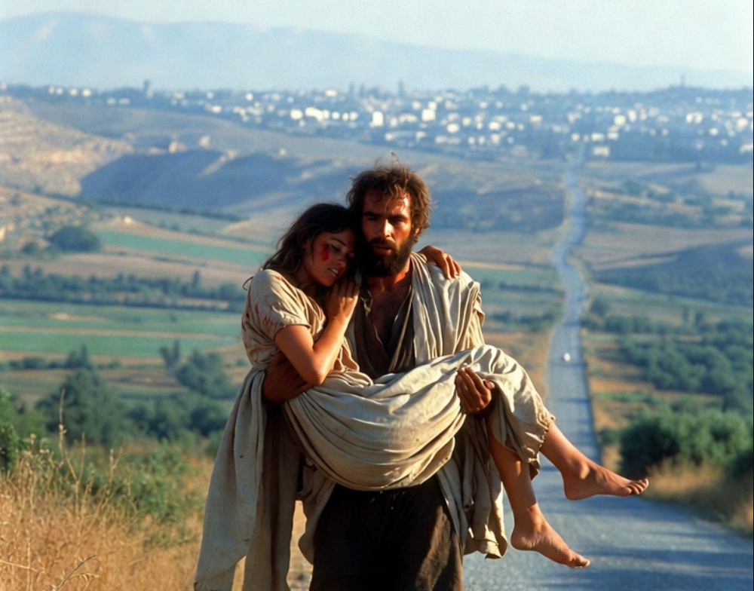

.
The Harm Of Not Knowing God
THE BOOK OF
HOSEA
CHAPTERS 8-10

Slide 2
.
Without Knowing The Lord…
We selfishly choose a form of godliness
We blindly walk toward destruction
We abundantly trust our own ways

Slide 3
.
“But know this, that in the last days difficult times will come. For men will be [a whole list of evil deeds] holding to a form of godliness, but having denied its power. Keep away from such men as these.”
II Timothy 3:1-5

Slide 4
.
Without Knowing The Lord…
We selfishly choose a form of godliness
We blindly walk toward destruction

Slide 5
.
“But not one has done so, even one who has a remnant of the Spirit. And what did that one do while he was seeking a godly seed? Be careful then to keep your spirit, and let no one deal treacherously against the wife of your youth.”
Malachi 2:15

Slide 6
.
Without Knowing The Lord…
We selfishly choose a form of godliness
We blindly walk toward destruction
We abundantly trust our own ways

