Slide 1
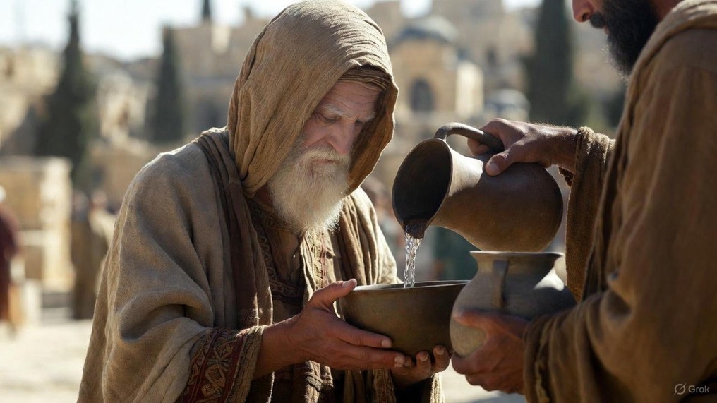

.
Success During The Decline
J
THE
BOOK
of
OHN
Chapter 3:22-36

Slide 2
.
“From that time Jesus began to preach and say, ‘Repent, for the kingdom of heaven is at hand.’”
Matthew 4:17

Slide 3
.
Success During The Decline
J
THE
BOOK
of
OHN
Chapter 3:22-36

Slide 4
.
Success During Time Of Decline
Seek unity & focus on what God’s given you, not what God’s given another person

Slide 5
.
“For you are still fleshly. For since there is jealousy & strife among you, are you not fleshly, & are you not walking like mere men? For when one says, “I am of Paul,” & another, “I am of Apollos,” are you not mere men? What then is Apollos? What is Paul? Servants through whom you believed, even as the Lord gave to each one… (cont)
I Corinthians 3:3-8

Slide 6
.
(cont) …I planted, Apollos watered, but God was causing the growth. So then neither the one who plants nor the one who waters is anything, but God who causes the growth. Now he who plants & he who waters are one, but each will receive his own reward according to his own labor.”
I Corinthians 3:3-8

Slide 7
.
“Who are you to judge the servant of another? To his own master he stands or falls; & he will stand, for the Lord is able to make him stand.”
Romans 14:4

Slide 8
.
“But when Cephas came to Antioch, I opposed him to his face, because he stood condemned. For prior to the coming of certain men from James, he used to eat with the Gentiles, but when they came, he began to shrink back & separate himself, fearing the party of the circumcision… (cont)
Galatians 2:11-14

Slide 9
.
(cont) …& the rest of the Jews joined him in hypocrisy, with the result that even Barnabas was carried away by their hypocrisy. But when I saw that they were not straightforward about the truth of the gospel, I said to Cephas before everyone, ‘If you, being a Jew, live like the Gentiles & not like the Jews, how is it that you compel the Gentiles to live like Jews?’”
Galatians 2:11-14

Slide 10
.
“Now I exhort you, brothers, by the name of our Lord Jesus Christ, that you all agree & that there be no divisions among you, but that you be made complete in the same mind & in the same judgment… (cont)
I Corinthians 1:10-13

Slide 11
.
(cont) …For I have been informed concerning you, my brothers, by Chloe’s people, that there are quarrels among you. Now I mean this, that each one of you is saying, ‘I am of Paul,’ & ‘I of Apollos,’ & ‘I of Cephas,’ & ‘I of Christ.’ Has Christ been divided? Was Paul crucified for you? Or were you baptized in the name of Paul?”
I Corinthians 1:10-13

Slide 12
.
Success During Time Of Decline
Seek unity & focus on what God’s given you, not what God’s given another person
Seek truth & focus on God’s Words, not earthly things

Slide 13
.
“For I did not speak from Myself, but the Father Himself who sent Me has given Me a commandment—what to say & what to speak.”
John 12:49

Slide 14
.
Success During Time Of Decline
Seek unity & focus on what God’s given you, not what God’s given another person
Seek truth & focus on God’s Words, not earthly things

Slide 15
.
“Enter through the narrow gate; for the gate is wide & the way is broad that leads to destruction, & there are many who enter through it. For the gate is narrow & the way is constricted that leads to life, & there are few who find it.”
Matthew 7:13-14

Slide 16
.
Success During Time Of Decline
Seek unity & focus on what God’s given you, not what God’s given another person
Seek truth & focus on God’s Words, not earthly things
Walk in the Spirit & focus on deliverance from wrath into eternal life

Slide 17
.
“Therefore, consider the members of your earthly body as dead to sexual immorality, impurity, passion, evil desire, & greed, which is idolatry. On account of these things, the wrath of God is coming upon the sons of disobedience, & in them you also once walked, when you were living in them… (cont)
Colossians 3:5-10

Slide 18
.
(cont) …But now you also, lay them all aside: wrath, anger, malice, slander, & abusive speech from your mouth. Do not lie to one another, since you put off the old man with its evil practices, & have put on the new man who is being renewed to a full knowledge according to the image of the One who created him.”
Colossians 3:5-10

Slide 19
.
“Jesus cried out & said, ‘He who believes in Me, does not believe in Me but in Him who sent Me. And he who sees Me sees the One who sent Me. I have come as Light into the world, so that everyone who believes in Me will not remain in darkness. And if anyone hears My words & does not keep them, I do not judge him; for I did not come to judge the world, but to save the world… (cont)
John 12:44-50

Slide 20
.
(cont) …He who rejects Me & does not receive My words, has one who judges him; the word I spoke is what will judge him on the last day. For I did not speak from Myself, but the Father Himself who sent Me has given Me a commandment - what to say & what to speak. I know that His commandment is eternal life; therefore the things I speak, I speak just as the Father has told Me.”
John 12:44-50

Slide 21
.
Success During Time Of Decline
Seek unity & focus on what God’s given you, not what God’s given another person
Seek truth & focus on God’s Words, not earthly things
Walk in the Spirit & focus on deliverance from wrath into eternal life

