Slide 1
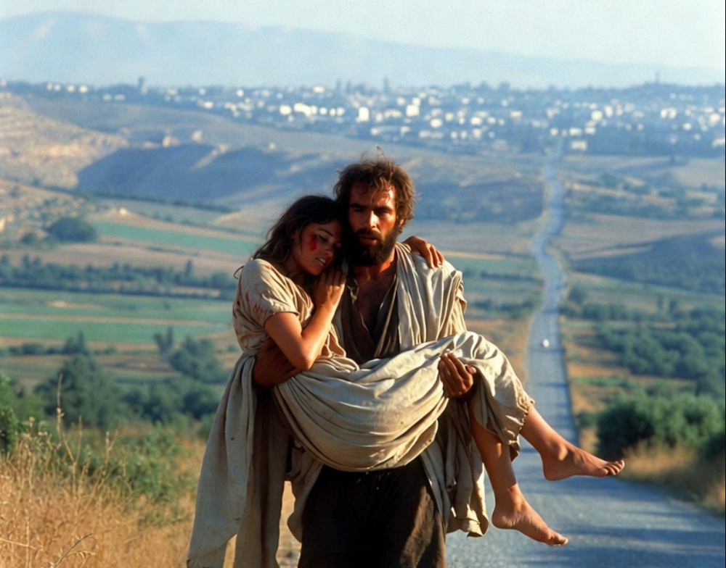

.
Return
To Me
THE BOOK OF
HOSEA
CHAPTERS 11-14

Slide 2
.
Returning To The Lord
Receive God’s love, so we don’t receive of our lusts
Reap God’s provision, so we don’t remain in poverty
Recognize God’s reign, so we don’t rely on our own reasoning

Slide 3
.
“Trust in Yahweh with all your heart & do not lean on your own understanding. In all your ways acknowledge Him, & He will make your paths straight.”
Proverbs 3:5-6

Slide 4
.
“For the report of your obedience has reached to all. Therefore I am rejoicing over you, but I want you to be wise in what is good & innocent in what is evil.”
Romans 16:19

Slide 5
.
“Then Yahweh said to Samuel, ‘Listen to the voice of the people in regard to all that they say to you, for they have not rejected you, but they have rejected Me from being king over them.’”
I Samuel 8:7

Slide 6
.
“I have come in My Father’s name, & you do not receive Me; if another comes in his own name, you will receive him.”
John 5:43

Slide 7
.
“But when this corruptible puts on the incorruptible, & this mortal puts on immortality, then will come about the word that is written, ‘death is swallowed up in victory. O death, where is your victory? O death, where is your sting?... (cont)
I Corinthians 15:54-57

Slide 8
.
(cont) …Now the sting of death is sin, & the power of sin is the law; but thanks be to God, who gives us the victory through our Lord Jesus Christ!”
I Corinthians 15:54-57

Slide 9
.
Returning To The Lord
Receive God’s love, so we don’t receive of our lusts
Reap God’s provision, so we don’t remain in poverty
Recognize God’s reign, so we don’t rely on our own reasoning
Render our confession of sin, so we may be converted

