Slide 1
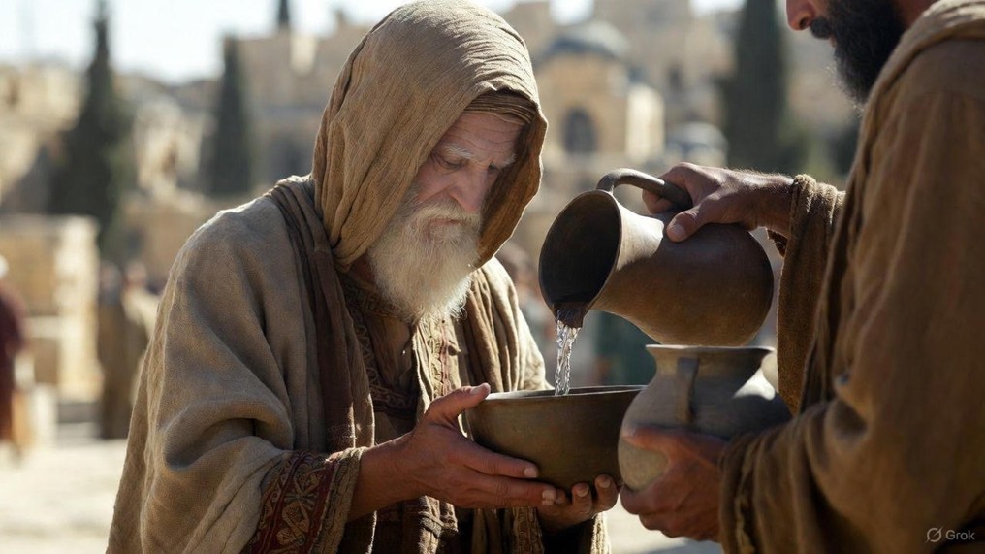

.
Why Are You Talking To Me?
J
THE
BOOK
of
OHN
Chapter 4:1-30

Slide 2
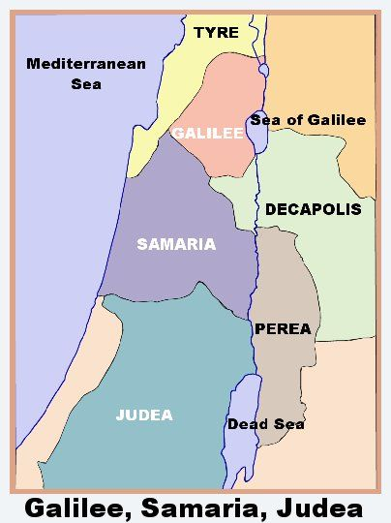
Standard Jewish Route of Travel
Shechem
Jesus’ Route of Travel

Slide 3
.
Why Are You Talking To Me?
J
THE
BOOK
of
OHN
Chapter 4:1-30

Slide 4
.
S.H.A.R.E. Jesus Christ
Start with standard conversation
Highlight the heavenly
Articulate the axis (decision point)

Slide 5
.
“For what does it profit a man to gain the whole world, and forfeit his soul?”
Mark 8:36

Slide 6
.
S.H.A.R.E. Jesus Christ
Start with standard conversation
Highlight the heavenly
Articulate the axis (decision point)
Rouse repentance from dissatisfaction
Exalt Jesus

