Slide 1
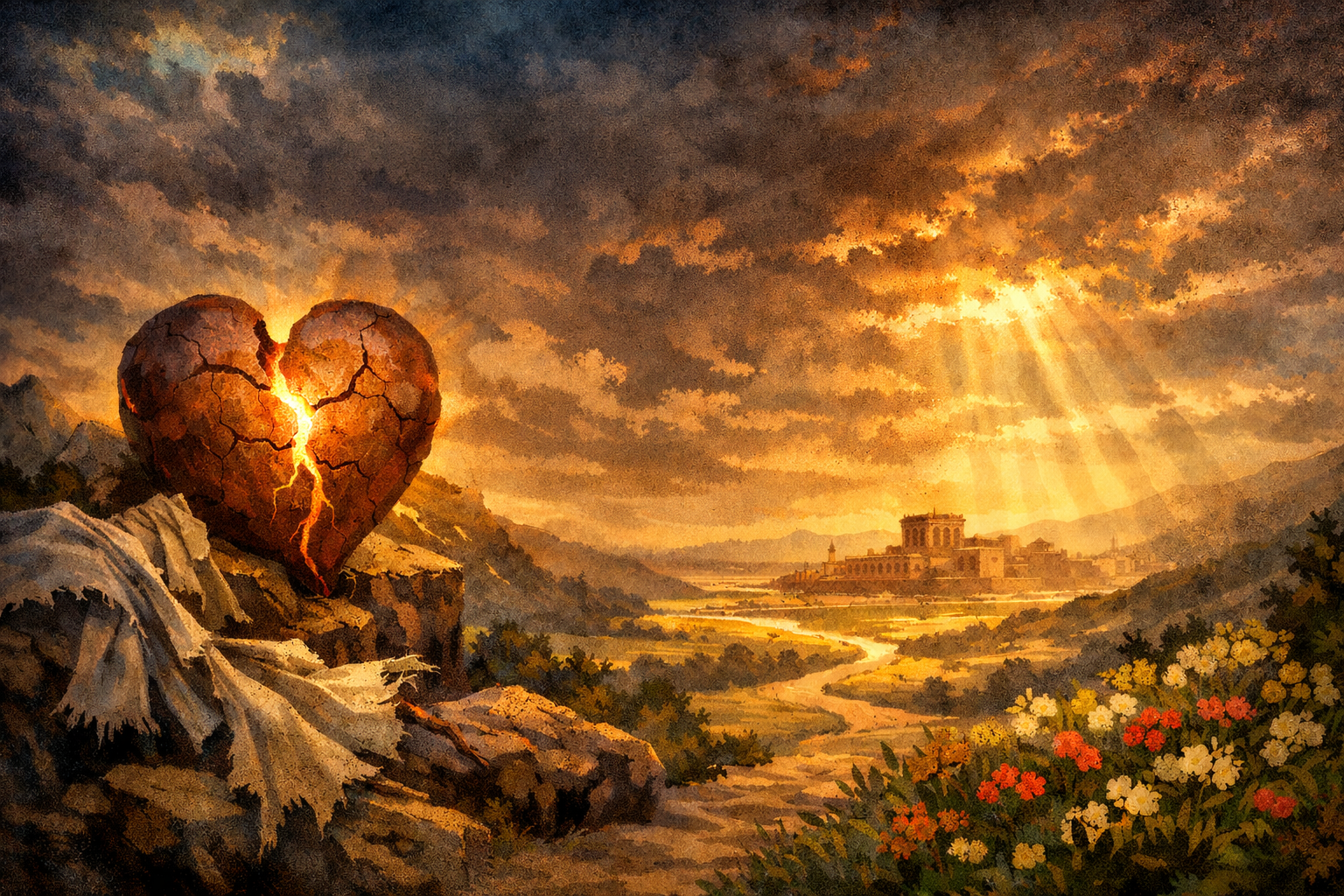


.
J .
.
oel .
.
The Day That Changes Everything .

Slide 2
.
The Day of the Lord .
It’s foreshadowed: Natural destruction causes us to awaken, mourn & turn to God

Slide 3
.
The Day of the Lord .
It’s foreshadowed: Natural destruction causes us to awaken, mourn & turn to God
It’s forewarned: Spiritual destruction is coming unless they return in heart allowing God to restore & give His Spirit

Slide 4
.
Matthew 24:29.
“But immediately after the tribulation of those days the sun will be darkened, & the moon will not give its light, & the stars will fall from the sky, & the powers of the heavens will be shaken.”

Slide 5
.
The Day of the Lord .
It’s foreshadowed: Natural destruction causes us to awaken, mourn & turn to God
It’s forewarned: Spiritual destruction is coming unless they return in heart allowing God to restore & give His Spirit
It’s foreknown: God judges the nations when all decisions are behind & complete

