Slide 1
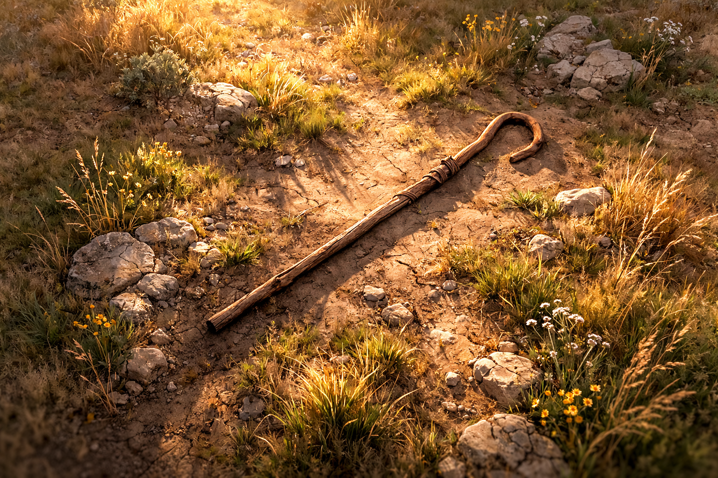

Amos .
Chapters 1-2
Even A Shepherd Knows

Slide 2
Even a shepherd knows what deserves judgement
Cruelty for God’s people

Slide 3
Jeremiah 12:14a
“Thus says Yahweh concerning all My evil neighbors who beat at the inheritance with which I have caused My people Israel to inherit, ‘Behold, I am about to uproot them from their land…’”

Slide 4
Even a shepherd knows what deserves judgement
Cruelty for God’s people
Enslavement of anyone
Betrayal of friends
Betrayal of brothers
Savagery toward Israeli innocents
Desecrating their past heritage
Disrespecting God’s truth
Despising the spiritual for the earthly

