Slide 1
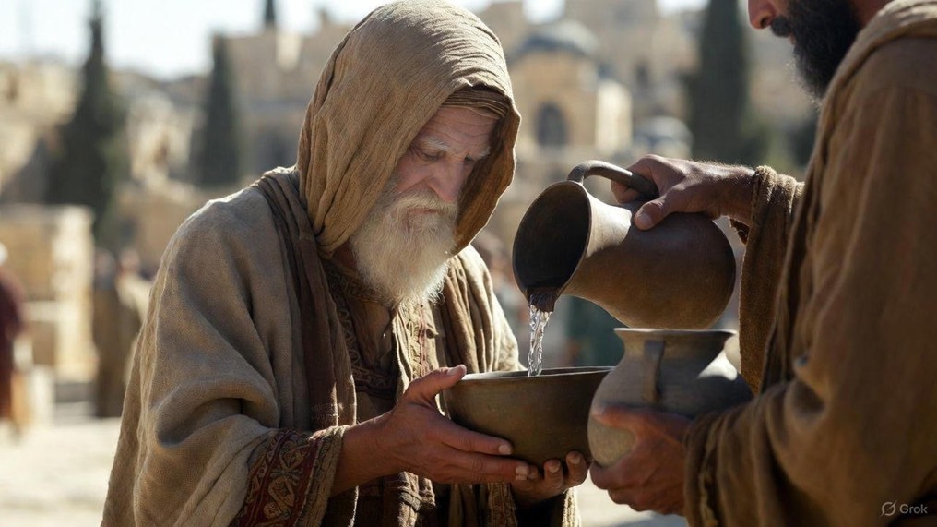

.
Lift Your Eyes: Beyond The Earthly
J
THE
BOOK
of
OHN
Chapter 4:31-54

Slide 2
.
Lift Your Eyes Beyond The Earthly
Don’t focus on diet but on the dying

Slide 3
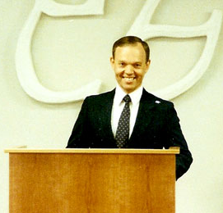
.
“You can only be earthly good to the extent that you are heavenly minded”
Bob Hoekstra

Slide 4
.
“For I [Jesus] have come down from heaven, not to do My own will, but the will of Him who sent Me. Now this is the will of Him who sent Me, that of all that He has given Me I lose nothing, but raise it up on the last day. For this is the will of My Father, that everyone who sees the Son & believes in Him will have eternal life, & I Myself will raise him up on the last day.”
John 6:38-40

Slide 5
.
“And Jesus said to him, Today salvation has come to this house, because he [Zaccheus], too, is a son of Abraham. For the Son of Man has come to seek and to save the lost.”
Luke 19:9-10

Slide 6
.
Lift Your Eyes Beyond The Earthly
Don’t focus on diet but on the dying
Don’t focus on men’s words but on Christ’s words

Slide 7
.
“Now these were more noble-minded than those in Thessalonica, for they received the word with great eagerness, examining the Scriptures daily to see whether these things were so. Therefore many of them believed, along with not a few prominent Greek women and men.”
Acts 17:11-12

Slide 8
.
“I [Paul] planted, Apollos watered, but God was causing the growth. So then neither the one who plants nor the one who waters is anything, but God who causes the growth.”
I Corinthians 3:6-7

Slide 9
.
“Now it happened that when Jesus had finished these parables, He departed from there. And He came to His hometown & began teaching them in their synagogue, so that they were astonished, & said, Where did this man get this wisdom & these miraculous powers?... (cont)
Matthew 13:53-58

Slide 10
.
(cont) …Is not this the carpenter’s son? Is not His mother called Mary, and His brothers, James and Joseph and Simon and Judas? And His sisters, are they not all with us? Where then did this man get all these things?” … (cont)
Matthew 13:53-58

Slide 11
.
(cont) …and they were taking offense at Him. But Jesus said to them, A prophet is not without honor except in his hometown and in his own household. And He did not do many miracles there because of their unbelief.”
Matthew 13:53-58

Slide 12
.
“Jesus answered them & said, Truly, truly, I say to you, you seek Me, not because you saw signs, but because you ate of the loaves and were filled. Do not work for the food which perishes, but for the food which endures to eternal life, which the Son of Man will give to you, for on Him the Father, God, set His seal.”
John 6:26-27

Slide 13
.
Lift Your Eyes Beyond The Earthly
Don’t focus on diet but on the dying
Don’t focus on men’s words but on Christ’s words
Don’t focus on healings but on the Healer

Slide 14
.
If one gets saved
Whole family gets saved
A Child
3%
Mom
17%
Dad
>90%
Promise Keepers Study

Slide 15
.
Lift Your Eyes Beyond The Earthly
Don’t focus on diet but on the dying
Don’t focus on men’s words but on Christ’s words
Don’t focus on healings but on the Healer

