Slide 1
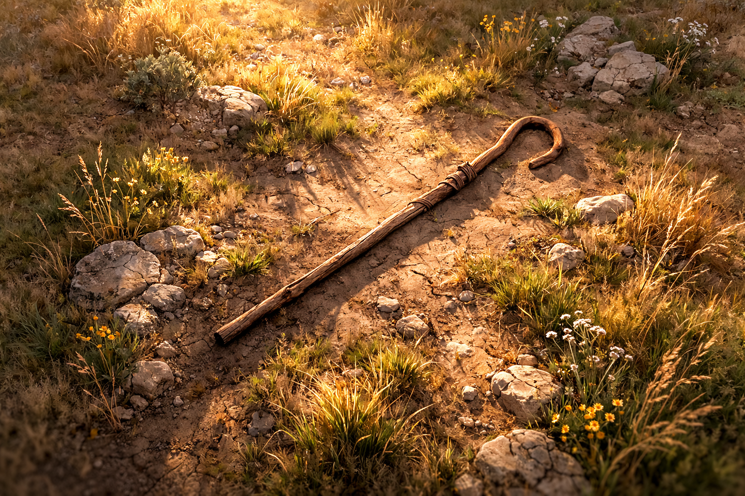

Amos .
Chapters 3-4
The Responsibility Of Privilege

Slide 2
We’ve Have The Responsibility Of Privilege
We have the privilege…
To be identified with God

Slide 3
Luke 12:47-48
“The slave who knew his master’s will & did not get ready or act in accord with his will, will receive many beatings, but the one who did not know it, & committed deeds worthy of a beating, will receive but a few. From everyone who has been given much, much will be required, & to whom they entrusted much, of him they will ask all the more.”

Slide 4
We’ve Have The Responsibility Of Privilege
We have the privilege…
To be identified with God
To receive communication from God
To not be ended because of our sin

Slide 5
Exodus 22:13
“Now if it is all torn to pieces, let him bring it as evidence; he shall not make restitution for what has been torn to pieces.”

Slide 6
We’ve Have The Responsibility Of Privilege
We have the privilege…
To be identified with God
To receive communication from God
To not be ended because of our sin
To have wealth and resources
To be progressively disciplined

Slide 7
Janes 5:17-18
“Elijah was a man with a nature like ours, & he prayed earnestly that it would not rain, & it did not rain on the earth for three and a half years. Then he prayed again, & the sky gave rain & the earth produced its fruit.”

Slide 8
Revelation 2:4
“But I have this against you, that you have left your first love.”

Slide 9
We’ve Have The Responsibility Of Privilege
We have the privilege…
To be identified with God
To receive communication from God
To not be ended because of our sin
To have wealth and resources
To be progressively disciplined

