Slide 1
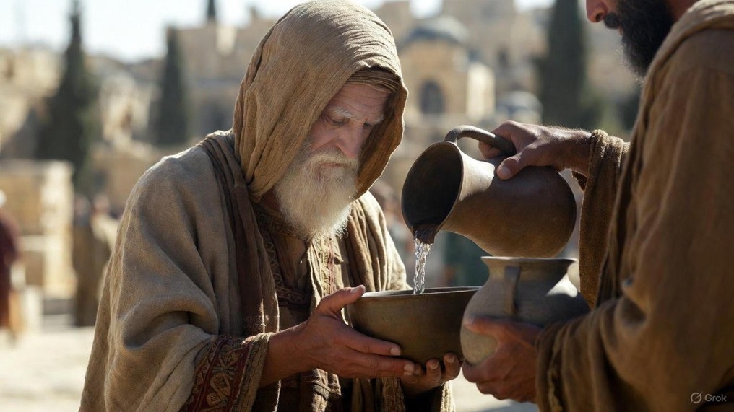

.
You’re The One
J
THE
BOOK
of
OHN
Chapter 5:1-17

Slide 2
.
You’re the O.N.E.
One Person: One person is sought by Jesus

Slide 3
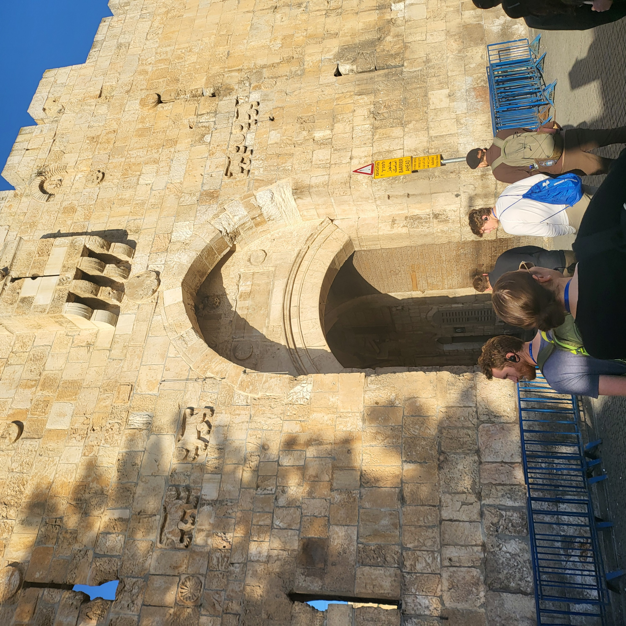
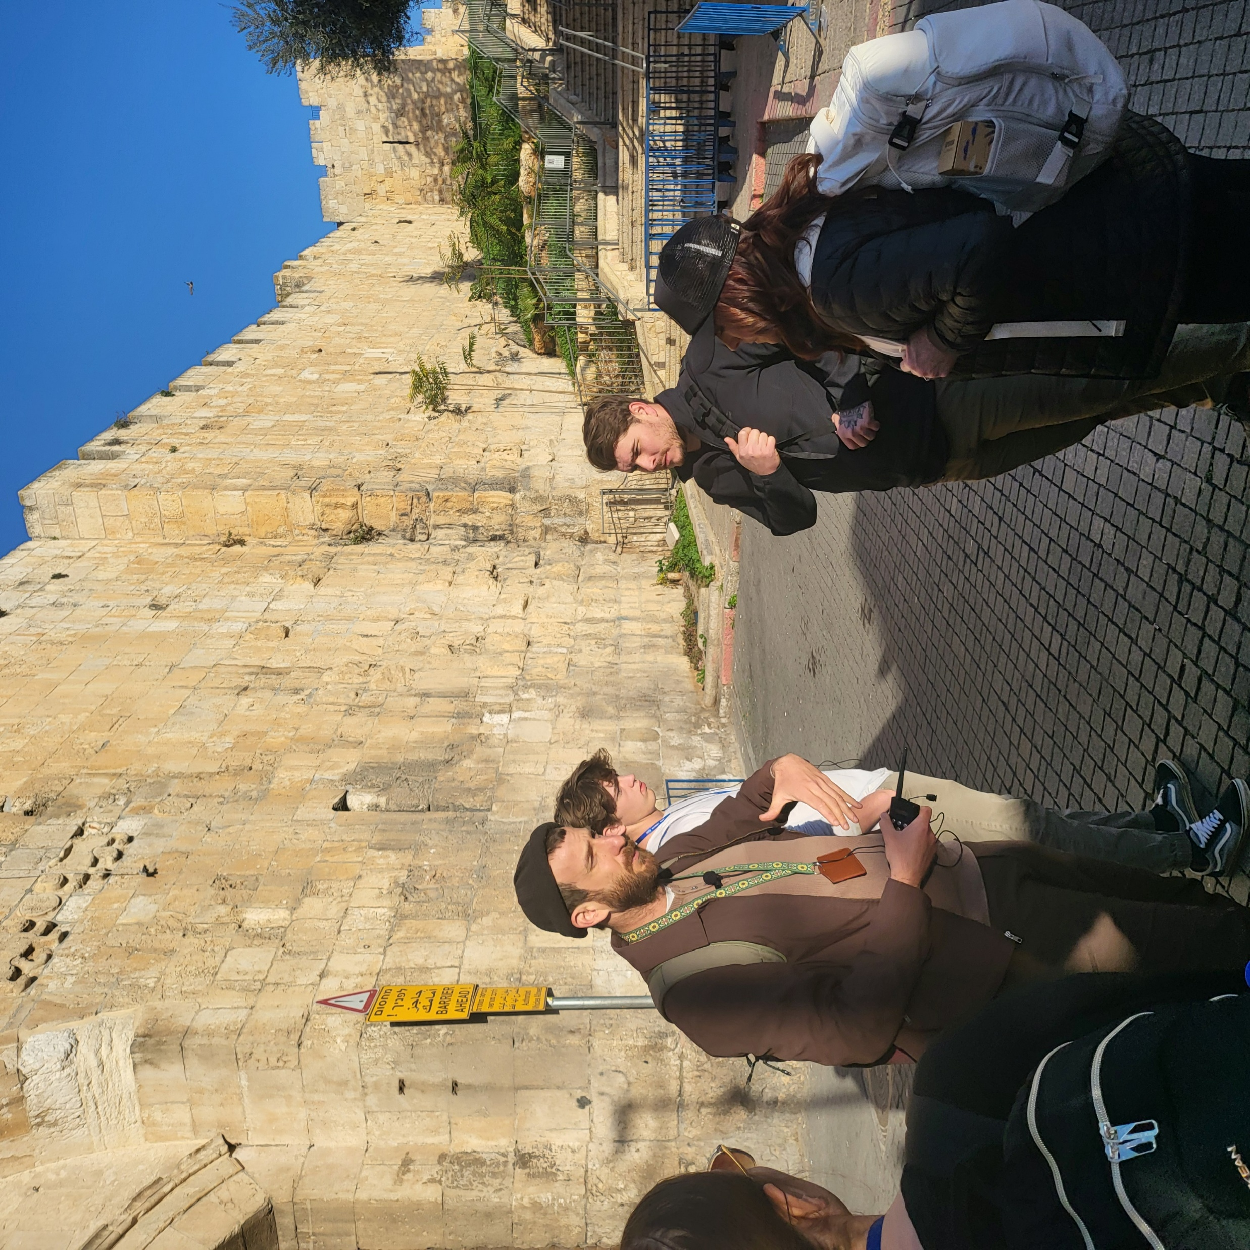
.
The Sheep Gate or Lion’s Gate

Slide 4
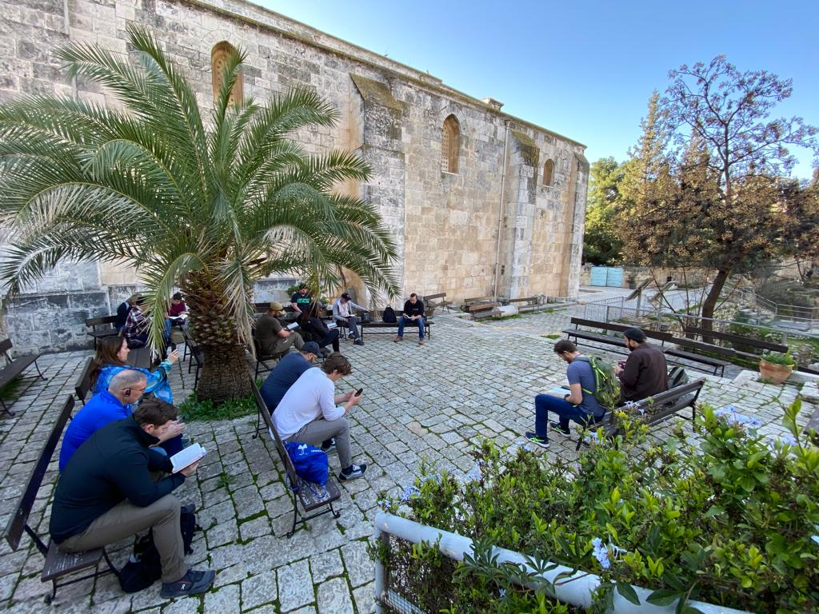
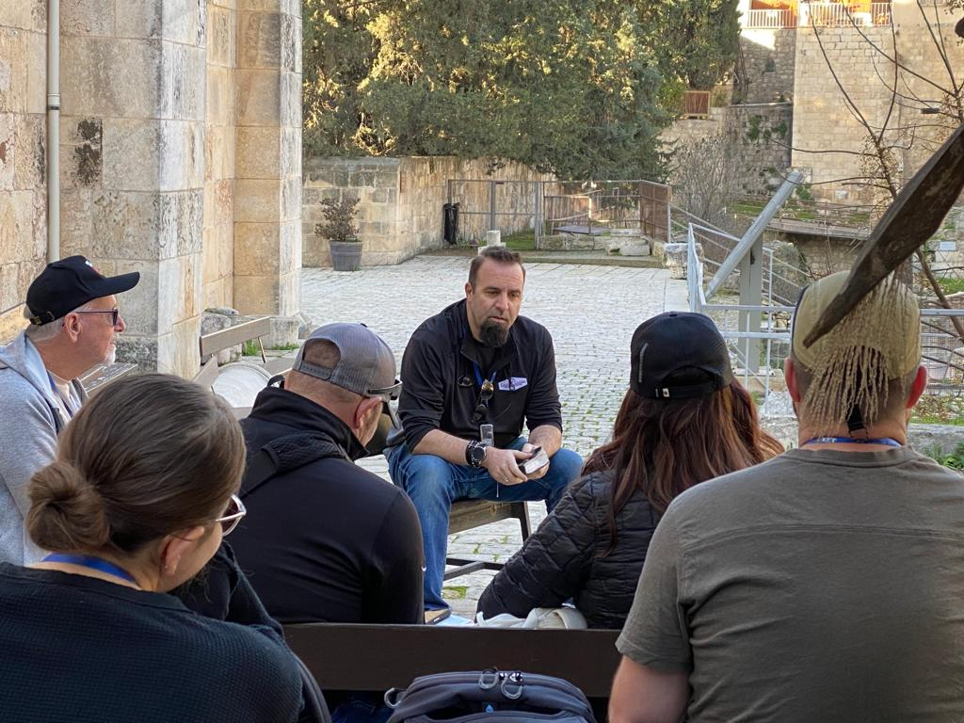
.
The Sheep Gate or Lion’s Gate

Slide 5

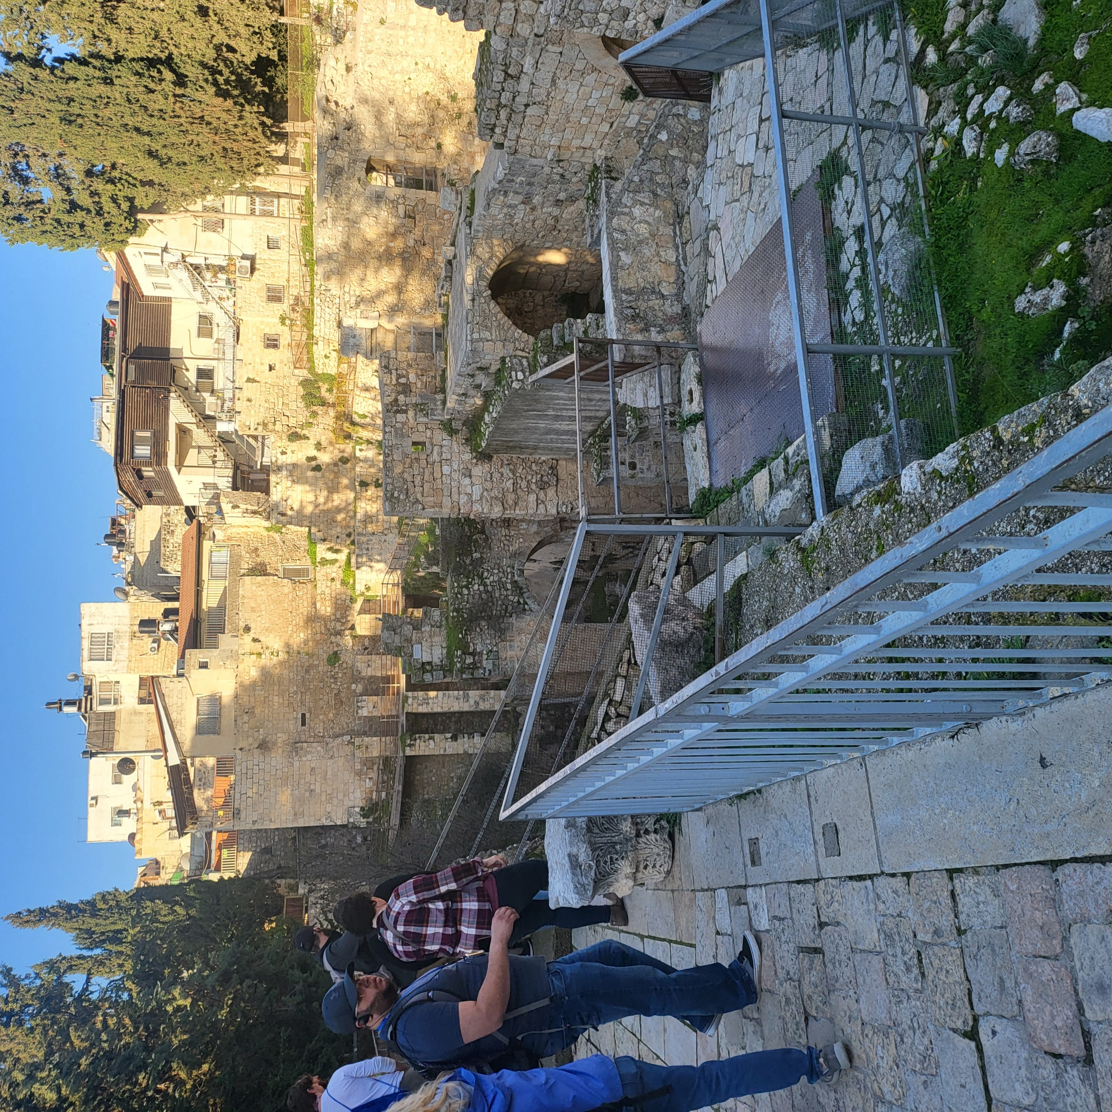
.
Pool of Bethesda

Slide 6
.
You’re the O.N.E.
One Person: One person is sought by Jesus
One Way: Never mind the work of God in others

Slide 7
.
“Peter, turning around, saw the disciple whom Jesus loved following them; the one who also had leaned back on His bosom at the supper & said, ‘Lord, who is the one who betrays You?’ So Peter seeing him said to Jesus, ‘Lord, & what about this man?’… (cont)
John 21:20-23

Slide 8
.
(cont) …Jesus said to him, ‘If I want him to remain until I come, what is that to you? You follow Me!’ Therefore this saying went out among the brothers that this disciple would not die; yet Jesus did not say to him that he would not die, but only, ‘If I want him to remain until I come, what is that to you?’”
John 21:20-23

Slide 9
.
You’re the O.N.E.
One Person: One person is sought by Jesus
One Way: Never mind the work of God in others
One Lord: Exalt Jesus above tradition

Slide 10
.
“His disciples asked Him, saying, ‘Rabbi, who sinned, this man or his parents, that he would be born blind?’ Jesus answered, ‘Neither this man nor his parents sinned, but this was so that the works of God might be manifested in him.’”
John 9:2-3

Slide 11
.
You’re the O.N.E.
One Person: One person is sought by Jesus
One Way: Never mind the work of God in others
One Lord: Exalt Jesus above tradition

Slide 12
.
“Then some Pharisees & scribes came to Jesus from Jerusalem & said, ’Why do Your disciples break the tradition of the elders? For they do not wash their hands when they eat bread… (cont)
Matthew 15:1-3, 7-9

Slide 13
.
(cont) …And He answered & said to them, ‘Why do you yourselves transgress the commandment of God for the sake of your tradition?... You hypocrites, rightly did Isaiah prophesy of you… (cont)
Matthew 15:1-3, 7-9

Slide 14
.
(cont) ‘This people honors Me with their lips, but their heart is far away from Me. ‘But in vain do they worship Me, teaching as doctrines the commands of men.’”
Matthew 15:1-3, 7-9

Slide 15
.
You’re the O.N.E.
One Person: One person is sought by Jesus
One Way: Never mind the work of God in others
One Lord: Exalt Jesus above tradition

