Slide 1
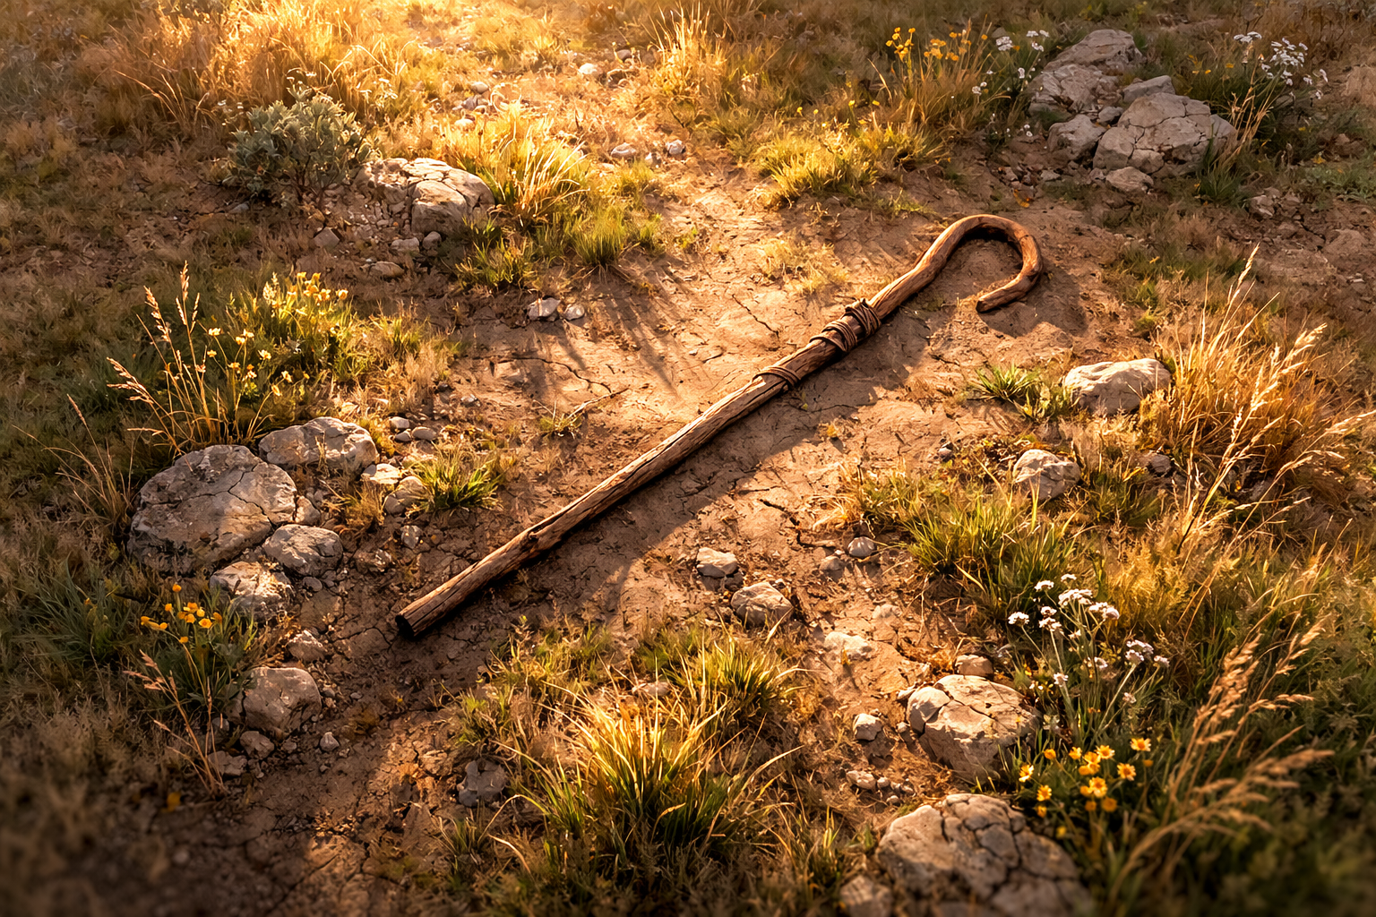

Amos .
Chapters 5-6
The Call To Leave & Cleave

Slide 2
The Call To Leave & Cleave
What to do: Change direction
How to do it: Make specific good actions
Where to do it: At work, home & church
Why to do it: Because our pride and ease lead to judgment

