Slide 1
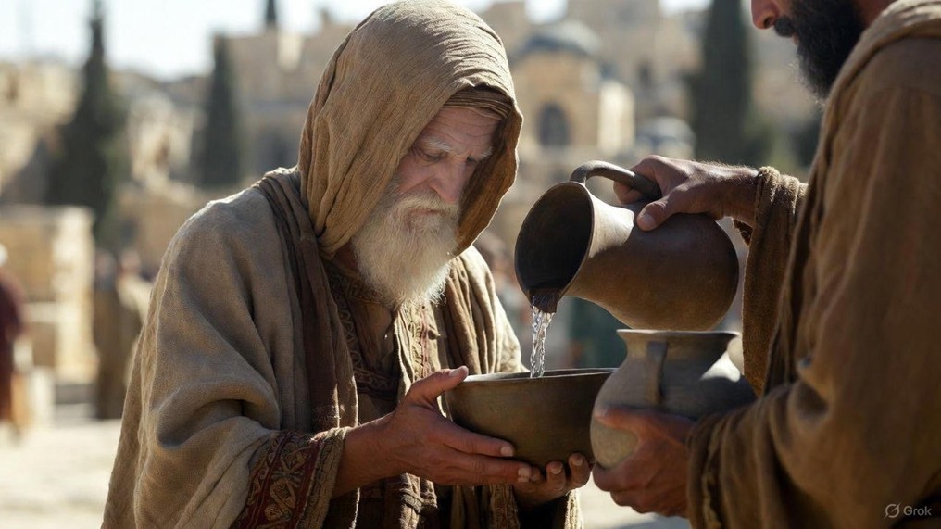

.
G.E.T. Jesus
J
THE
BOOK
of
OHN
Chapter 5:18-47

Slide 2
.
G.E.T. Jesus: Qualifications for Messiah
His Character: Jesus is God

Slide 3
.
“The Jews answered Him, ‘For a good work we do not stone You, but for blasphemy; and because You, being a man, make Yourself God.’”
John 10:33

Slide 4
.
G.E.T. Jesus: Qualifications for Messiah
His Character: Jesus is God

Slide 5
.
“The thief comes only to steal and kill and destroy; I came that they may have life, and have it abundantly. I am the good shepherd; the good shepherd lays down His life for the sheep.”
John 10:10-11

Slide 6
.
“He who believes in Him is not judged; he who does not believe has been judged already, because he has not believed in the name of the only begotten Son of God.”
John 3:18

Slide 7
.
G.E.T. Jesus: Qualifications for Messiah
His Character: Jesus is God
His Calling: Jesus offers eternal life

Slide 8
.
“For the Lord Himself will descend from heaven w/ a shout, w/ the voice of the archangel & w/ the trumpet of God, & the dead in Christ will rise first. Then we who are alive & remain will be caught up together w/ them in the clouds to meet the Lord in the air, & so we shall always be w/ the Lord.”
I Thessalonians 4:16-17

Slide 9
.
G.E.T. Jesus: Qualifications for Messiah
His Character: Jesus is God
His Calling: Jesus offers eternal life

Slide 10
.
“Do not think that I came to bring peace on the earth; I did not come to bring peace, but a sword…He who has found his life will lose it, & he who has lost his life for My sake will find it.”
Matthew 10:34 & 39

Slide 11
.
“Behold, someone came to Him & said, ‘Teacher, what good thing shall I do that I may have eternal life?’ Jesus said, ‘but if you wish to enter into life, keep the commandments… (cont)
Matthew 19:16, 17b, 20-22, 26

Slide 12
.
(cont) …The young man said to Him, ‘All these things I have kept; what am I still lacking?” Jesus said to him, ‘If you wish to be complete, go & sell your possessions & give to the poor, & you will have treasure in heaven; & come, follow Me… (cont)
Matthew 19:16, 17b, 20-22, 26

Slide 13
.
(cont) …But when the young man heard this statement, he went away grieving; for he was one who owned much property…& looking at them Jesus said to them, ‘with people this is impossible, but with God all things are possible.’”
Matthew 19:16, 17b, 20-22, 26

Slide 14
.
“Therefore they said to Him, ‘What should we do, so that we may work the works of God?’ Jesus answered and said to them, ‘This is the work of God, that you believe in Him whom He has sent.’”
John 6:28-29

Slide 15
.
G.E.T. Jesus: Qualifications for Messiah
His Character: Jesus is God
His Calling: Jesus offers eternal life
His Confirmation: Jesus is trustworthy

Slide 16
.
“A single witness shall not rise up against a man on account of any iniquity or any sin which he has committed; at the mouth of two or three witnesses a matter shall be established.”
Deuteronomy 19:15

Slide 17
.
G.E.T. Jesus: Qualifications for Messiah
His Character: Jesus is God
His Calling: Jesus offers eternal life
His Confirmation: Jesus is trustworthy

Slide 18
.
“Then the eyes of the blind will be opened, and the ears of the deaf will be unstopped. Then the lame will leap like a deer, and the tongue of the mute will shout for joy.”
Isaiah 35:5-6a

Slide 19
.
“And said to Him, ‘Are You the One who is to come, or shall we look for someone else?’ Jesus answered & said to them, ‘Go & report to John what you hear & see: the blind receive sight & the lame walk, the lepers are cleansed & the deaf hear, the dead are raised up, & the poor have the gospel preached to them.”
Matthew 11:3-5

Slide 20
.
G.E.T. Jesus: Qualifications for Messiah
His Character: Jesus is God
His Calling: Jesus offers eternal life
His Confirmation: Jesus is trustworthy

Slide 21
.
“And with all the deception of unrighteousness for those who perish, because they did not receive the love of the truth so as to be saved.”
II Thessalonians 2:10

Slide 22
.
“Then beginning with Moses and with all the prophets, He interpreted to them the things concerning Himself in all the Scriptures.”
Luke 24:27

Slide 23
.
G.E.T. Jesus: Qualifications for Messiah
His Character: Jesus is God
His Calling: Jesus offers eternal life
His Confirmation: Jesus is trustworthy

