Slide 1
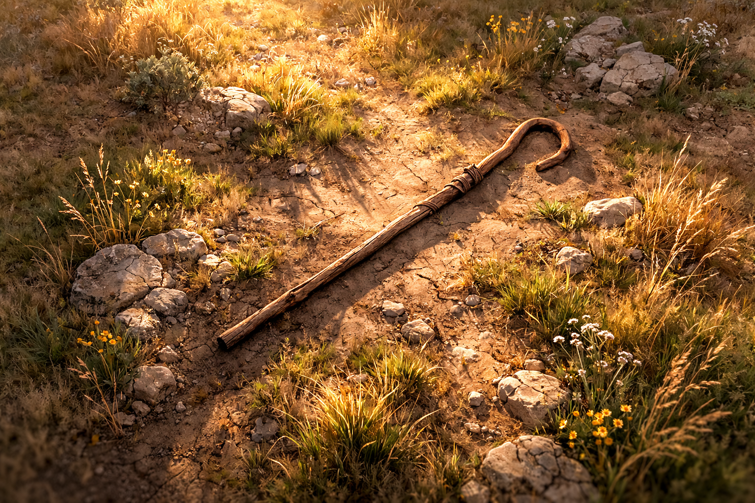

Amos .
Chapters 7-9
A Sinner’s Paradox

Slide 2
A Sinner’s Paradox
Paradox of Love:
They hate God’s people even though we

Slide 3
Acts 4:18-20
“And when they had summoned them, they commanded them not to speak or teach at all in the name of Jesus. But Peter & John answered & said to them, ‘Whether it is right in the sight of God to hear you rather than God, you be the judge; for we cannot stop speaking about what we have seen & heard.’”

Slide 4
Jeremiah 20:9
“But if I say, ‘I will not remember Him or speak anymore in His name,’ then in my heart it becomes like a burning fire shut up in my bones; & I am weary of holding it in, & I cannot prevail.”

Slide 5
A Sinner’s Paradox
Paradox of Love:
Paradox of Truth:
Paradox of Destiny:
They hate God’s people even though we seek their best
They know much of God, yet don’t apply it, so it will be taken from them
They deserve judgment, yet God wants to bless them w/ grace

Slide 6
A Sinner’s Paradox
Paradox of Love:
Paradox of Truth:
Paradox of Destiny:
We continue to love them despite their hatred
We offer them truth, whether they use it or not
We warn them of judgment & offer them the grace of Jesus’ death on the cross

