Slide 1
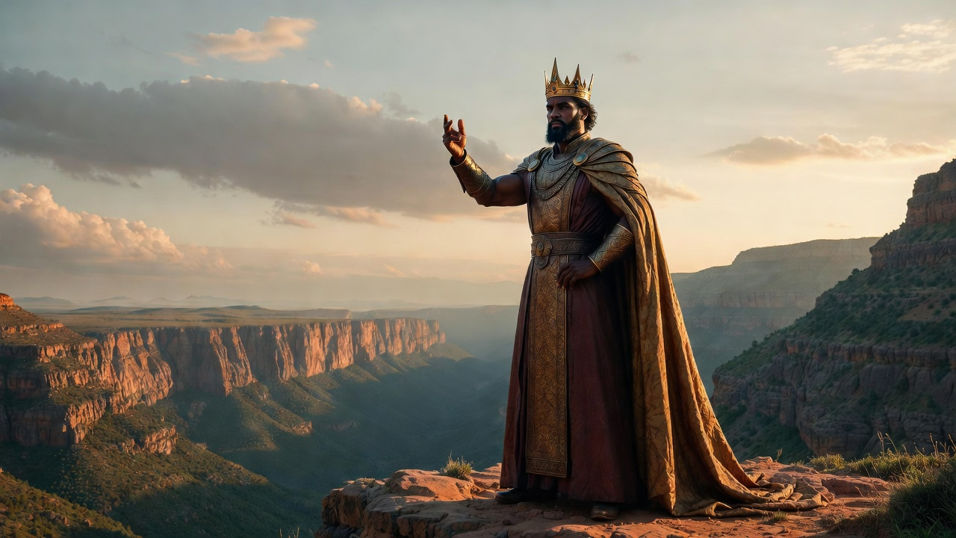

The Pride That Divides
Obadiah

Slide 2
The Pride That Divides
Separated from Faith: Edom’s pride in trusting themselves

Slide 3
“Pride goes before destruction, and a haughty spirit before stumbling. It is better to be humble in spirit with the lowly than to divide the spoil with the proud.”
Proverbs 16:18-19

Slide 4
“Only by pride cometh contention: but with the well advised is wisdom.”
Proverbs 13:10 KJV

Slide 5
“Also Edom shall be a desolation: every one that goeth by it shall be astonished, & shall hiss at all the plagues thereof. As in the overthrow of Sodom & Gomorrah & the neighbour cities thereof, saith the LORD, no man shall abide there, neither shall a son of man dwell in it.”
Jeremiah 49:17-18

Slide 6
The Pride That Divides
Separated from Faith: Edom’s pride in trusting themselves

Slide 7
“Concerning Edom, thus saith the LORD of hosts; Is wisdom no more in Teman? Is counsel perished from the prudent? Is their wisdom vanished?”
Jeremiah 49:7

Slide 8
The Pride That Divides
Separated from Faith: Edom’s pride in trusting themselves
Separated from Fellowship: Edom’s hatred of Israel

Slide 9
“But I have stripped Esau bare; I have uncovered his hiding places, so that he will not be able to conceal himself; his seed has been destroyed along with his relatives & his neighbors, & he is no more. Leave your orphans behind, I will keep them alive; & let your widows trust in Me.”
Jeremiah 49:10-11

Slide 10
The Pride That Divides
Separated from Faith: Edom’s pride in trusting themselves
Separated from Fellowship: Edom’s hatred of Israel
Separated from Forever: The Day of the Lord Divides

Slide 11
“Do not be deceived, God is not mocked, for whatever a man sows, this he will also reap.”
Galatians 6:7

Slide 12
“Do not be deceived, God is not mocked, for whatever a man sows, this he will also reap.”
Galatians 6:7

Slide 13
“But I have stripped Esau bare; I have uncovered his hiding places, so that he will not be able to conceal himself; his seed has been destroyed along with his relatives & his neighbors, & he is no more. Leave your orphans behind, I will keep them alive; & let your widows trust in Me.”
Jeremiah 49:10-11

Slide 14
The Pride That Divides
Separated from Faith: Edom’s pride in trusting themselves
Separated from Fellowship: Edom’s hatred of Israel
Separated from Forever: The Day of the Lord Divides

Slide 15
“For His anger is but for a moment, His favor is for a lifetime; Weeping may last for the night, But a shout of joy comes in the morning.”
Psalm 30:5

Slide 16
The Pride That Divides
Separated from Faith: Edom’s pride in trusting themselves
Separated from Fellowship: Edom’s hatred of Israel
Separated from Forever: The Day of the Lord Divides

