Slide 1
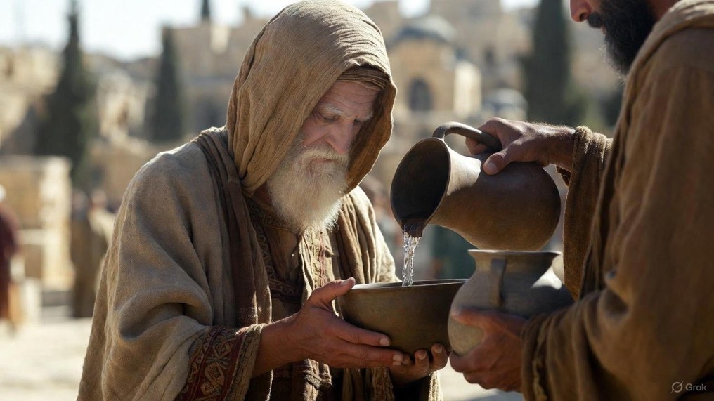

.
Adjusting Our Focus Back To Jesus
J
THE
BOOK
of
OHN
Chapter 6:1-40

Slide 2
.
Refocusing Our Christianity On Jesus
Full Provision doesn’t come from our resources but from Jesus

Slide 3
.
“When Jesus went ashore, He saw a large crowd, & He felt compassion for them because they were like sheep without a shepherd; & He began to teach them many things.”
Mark 6:34

Slide 4
.
Refocusing Our Christianity On Jesus
Full Provision doesn’t come from our resources but from Jesus
Faithful Protection doesn’t come from our effort but from Jesus

Slide 5
.
“Seeing them straining at the oars, for the wind was against them, at about the fourth watch of the night He came to them, walking on the sea; & He was intending to pass by them.”
Mark 6:48

Slide 6
.
Refocusing Our Christianity On Jesus
Full Provision doesn’t come from our resources but from Jesus
Faithful Protection doesn’t come from our effort but from Jesus
Fulfilled Promises don’t come from any man but from Jesus

Slide 7
.
“Faithful is He who calls you, who also will do it.”
I Thessalonians 5:24

Slide 8
.
Refocusing Our Christianity On Jesus
Full Provision doesn’t come from our resources but from Jesus
Faithful Protection doesn’t come from our effort but from Jesus
Fulfilled Promises don’t come from any man but from Jesus

Slide 9
.
“He who rejects Me & does not receive My words, has one who judges him; the word I spoke is what will judge him on the last day.”
John 12:48

Slide 10
.
Refocusing Our Christianity On Jesus
Full Provision doesn’t come from our resources but from Jesus
Faithful Protection doesn’t come from our effort but from Jesus
Fulfilled Promises don’t come from any man but from Jesus

