Slide 1
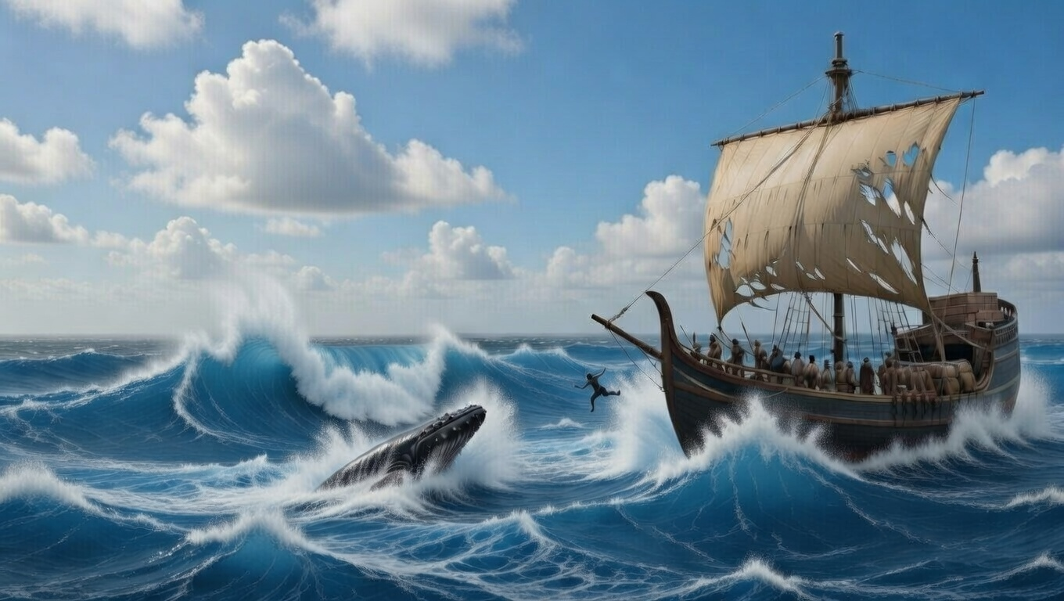


. Jonah
. Chapter 1-2 .
Reacting To God’s Acting

Slide 2
. Reacting To God’s Acting
The rebellious want to run away
The God-fearing want to respond

Slide 3
“But He answered & said to them, An evil & adulterous generation eagerly seeks for a sign; & yet no sign will be given to it but the sign of Jonah the prophet; for just as Jonah was three days & three nights in the belly of the sea monster, so will the Son of Man be three days & three nights in the heart of the earth.”
. Matthew 12:39-40

Slide 4
. Reacting To God’s Acting
The rebellious want to run away
The God-fearing want to respond
The desperate want to repent

Slide 5
“For the eyes of Yahweh move to and fro throughout the earth that He may strongly support those whose heart is wholly devoted to Him.”
. II Chronicles 16:9a

Slide 6
. Reacting To God’s Acting
The rebellious want to run away
The God-fearing want to respond
The desperate want to repent

