Slide 1
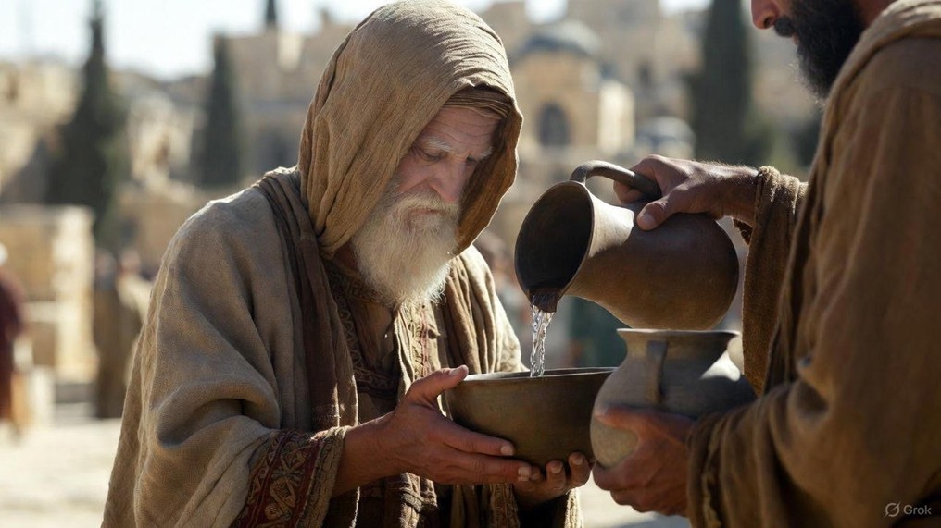

.
Spirit Life Or Dead Flesh
J
THE
BOOK
of
OHN
Chapter 6:41-71

Slide 2
.
Reactions To Jesus’ Spiritual Talk
Denial: The Jews don’t believe, therefore they don’t follow Jesus

Slide 3
.
“For a child will be born to us, a son will be given to us; & the government will rest on His shoulders; & His name will be called Wonderful Counselor, Mighty God, Eternal Father, Prince of Peace.”
Isaiah 9:6

Slide 4
.
Reactions To Jesus’ Spiritual Talk
Denial: The Jews don’t believe, therefore they don’t follow Jesus

Slide 5
.
“For indeed we have had good news proclaimed to us, just as they also; but the word that was heard did not profit those who were not united with faith among those who heard.
Hebrews 4:2

Slide 6
.
Reactions To Jesus’ Spiritual Talk
Denial: The Jews don’t believe, therefore they don’t follow Jesus
Doubting: The Disciples struggle to believe, therefore some stop following

Slide 7
.
“But now I am going to Him who sent Me; & none of you asks Me, ‘Where are You going?’ But b/c I have said these things to you, sorrow has filled your heart. But I tell you the truth, it is to your advantage that I go away; for if I do not go away, the Advocate will not come to you; but if I go, I will send Him to you.”
John 16:5-7

Slide 8
.
“Who [God] also made us sufficient as ministers of a new covenant, not of the letter but of the Spirit; for the letter kills, but the Spirit gives life.”
II Corinthians 3:6

Slide 9
.
Reactions To Jesus’ Spiritual Talk
Denial: The Jews don’t believe, therefore they don’t follow Jesus
Doubting: The Disciples struggle to believe, therefore some stop following
Confessing: Peter believes, therefore he’ll follow Jesus forever

