Slide 1
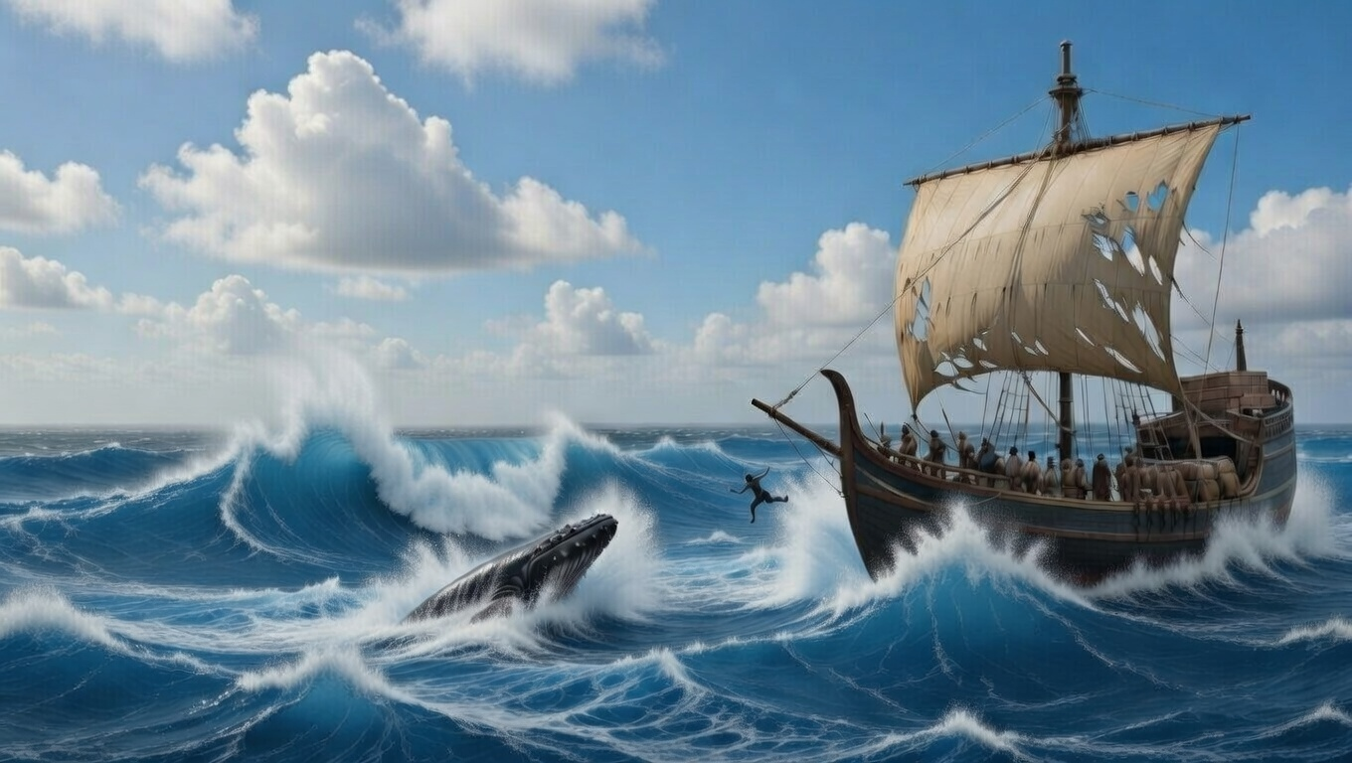


. Jonah
. Chapter 3-4 .
Targeting Repentance

Slide 2
. Targeting Repentance
The Target: When God confronts your sin, publicly change your life

Slide 3
“If a brother or sister is without clothing & in need of daily food, & one of you says to them, ‘Go in peace, be warmed and be filled,’ & yet you do not give them what is necessary for their body, what use is that? Even so faith, if it has no works, is dead by itself. But someone will say, ‘You have faith; & I have works.’ Show me your faith without the works, & I will show you my faith by my works.”
. James 2:15-18

Slide 4
. Targeting Repentance
The Target: When God confronts your sin, publicly change your life
The Audience: When others receive grace, support them in joy & love

Slide 5
“Do not marvel, brothers, if the world hates you. We know that we have passed out of death into life, because we love the brothers. The one who does not love abides in death… (con’t)
. I John 3:13-16

Slide 6
(con’t) …Everyone who hates his brother is a murderer, & you know that no murderer has eternal life abiding in him. By this we have known love, that He laid down His life for us; & we ought to lay down our lives for the brothers.”
. I John 3:13-16

Slide 7
. Targeting Repentance
The Target: When God confronts your sin, publicly change your life
The Audience: When others receive grace, support them in joy & love
The Giver: When rebels resist grace for others, God reasons with them thru hard & easy situations

