Slide 1
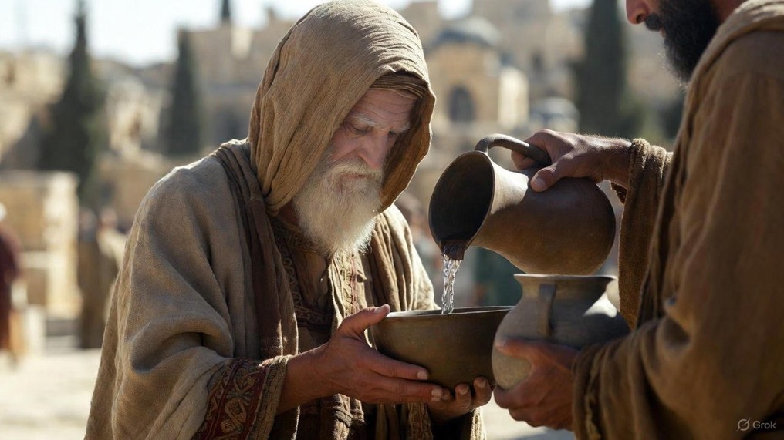

.
Empowerment Of The Word
J
THE
BOOK
of
OHN
Chapter 7

Slide 2
.
The Word Of God Empowers Us
To endure mockery
To speak boldly with authority
To stir debate about Jesus’ identity

Slide 3
.
“But there will be no more gloom for her who was in anguish; in earlier times He treated the land of Zebulun & the land of Naphtali with contempt, but later on He shall make it glorious, by the way of the sea, on the other side of Jordan, Galilee of the Gentiles. The people who walk in darkness will see a great light; those who live in the land of the shadow of death, the light will shine on them.”
Isaiah 9:1-2

Slide 4
.
The Word Of God Empowers Us
To endure mockery
To speak boldly with authority
To stir debate about Jesus’ identity

Slide 5
.
“And He said, ‘To you it has been granted to know the mysteries of the kingdom of God, but to the rest it is in parables, so that seeing they may not see, and hearing they may not understand.’”
Luke 8:10

Slide 6
.
The Word Of God Empowers Us
To endure mockery
To speak boldly with authority
To stir debate about Jesus’ identity
To offer something greater than tradition

Slide 7
.
“Moreover, I will give you a new heart & put a new spirit within you; & I will remove the heart of stone from your flesh & give you a heart of flesh.”
Ezekiel 36:26

Slide 8
.
The Word Of God Empowers Us
To endure mockery
To speak boldly with authority
To stir debate about Jesus’ identity
To offer something greater than tradition
To reason with people from the Word

Slide 9
.
“But Jesus answered & said to them, ‘You are mistaken, not understanding the Scriptures nor the power of God.’”
Matthew 22:29

Slide 10
.
The Word Of God Empowers Us
To endure mockery
To speak boldly with authority
To stir debate about Jesus’ identity
To offer something greater than tradition
To reason with people from the Word

