Slide 1
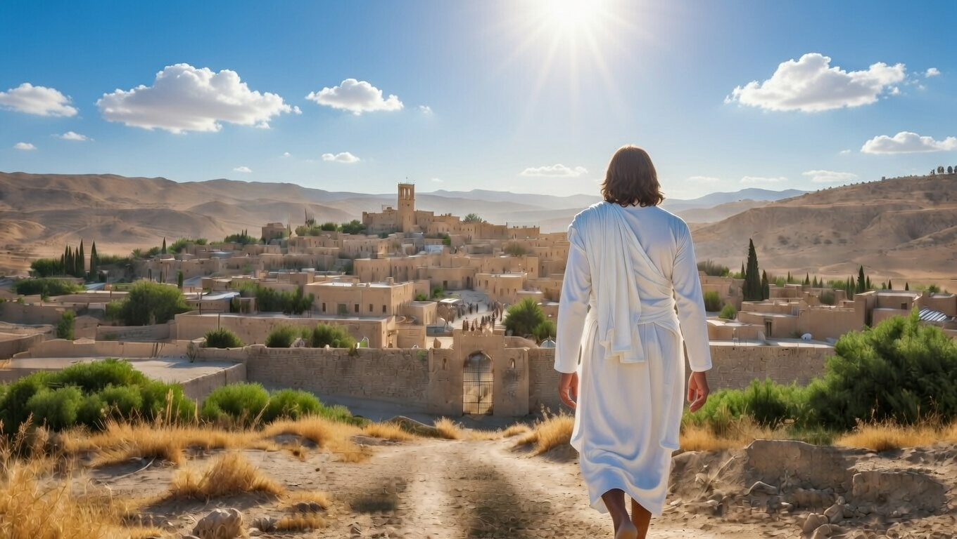

What Shall It Profit?
Micah
Chapter 1-2

Slide 2
What Are We Living For?
Are we trying to gain eternal life?
Believe God’s Word to the extent that it moves you

Slide 3
“For what does it profit a man to gain the whole world, and forfeit his soul?”
Mark 8:36

Slide 4
“If anyone wishes to come after Me, he must deny himself, & take up his cross & follow Me. For whoever wishes to save his life will lose it, but whoever loses his life for My sake & the gospel’s will save it.”
Mark 8:34b-35

Slide 5
What Are We Living For?
Are we trying to gain eternal life?
Believe God’s Word to the extent that it moves you
Are we trying to gain the world?
Sinful gain leads to losing even our natural lot in life

Slide 6
“For what does it profit a man to gain the whole world, and forfeit his soul?”
Mark 8:36

Slide 7
What Are We Living For?
Are we trying to gain eternal life?
Believe God’s Word to the extent that it moves you
Are we trying to gain the world?
Sinful gain leads to losing even our natural lot in life

