Slide 1
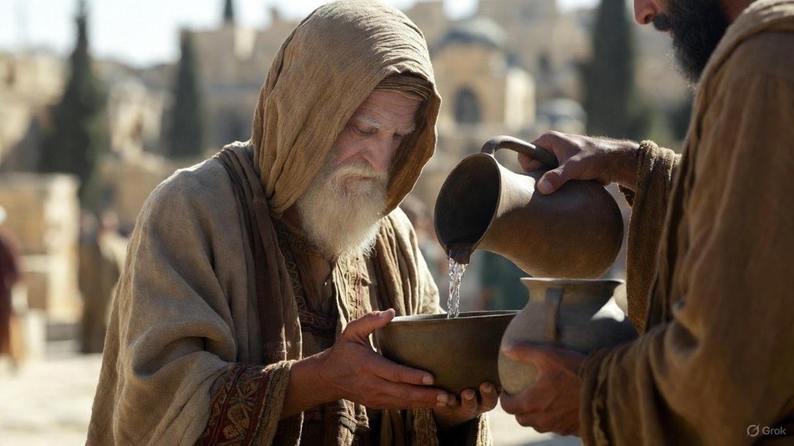

.
Exposing The Truth
J
THE
BOOK
of
OHN
Chapter 8:1-30

Slide 2
.
Exposing The Truth
Don’t Get Diverted: We offer grace & warn of judgement to come

Slide 3
.
The Main Thing to Jesus
50% - He began to teach
35% - He entered to heal
10% - He came to confront
5% - Other reasons

Slide 4
.
“If there is a man who commits adultery with another man’s wife, one who commits adultery with his friend’s wife, the adulterer and the adulteress shall surely be put to death.”
Leviticus 20:10

Slide 5
.
Exposing The Truth
Don’t Get Diverted: We offer grace & warn of judgement to come

Slide 6
.
“Do not judge, so that you will not be judged. For w/ what judgment you judge, you will be judged; & with what measure you measure, it will be measured to you. Why do you look at the speck that is in your brother’s eye, but do not notice the log that is in your own eye? Or how can you say to your brother, Let me take the speck out of your eye, & behold, the log is in your own eye? You hypocrite, first take the log out of your own eye, & then you will see clearly to take the speck out of your brother’s eye.”
Matthew 7:1-5

Slide 7
.
“Do not judge according to appearance, but judge with righteous judgment.”
John 7:24

Slide 8
.
Exposing The Truth
Don’t Get Diverted: We offer grace & warn of judgement to come
Live in the Light: We offer truth by knowing God in His Word
Give the Gospel: We offer life from the dead through Jesus

Slide 9
.
“And as Moses lifted up the serpent in the wilderness, even so must the Son of Man be lifted up; so that whoever believes will in Him have eternal life.”
John 3:14

Slide 10
.
“Being found in appearance as a man, He humbled Himself by becoming obedient to the point of death, even death on a cross. Therefore, God also highly exalted Him, and bestowed on Him the name which is above every name.”
Philippians 2:8-9

Slide 11
.
Exposing The Truth
Don’t Get Diverted: We offer grace & warn of judgement to come
Live in the Light: We offer truth by knowing God in His Word
Give the Gospel: We offer life from the dead through Jesus

