Slide 1
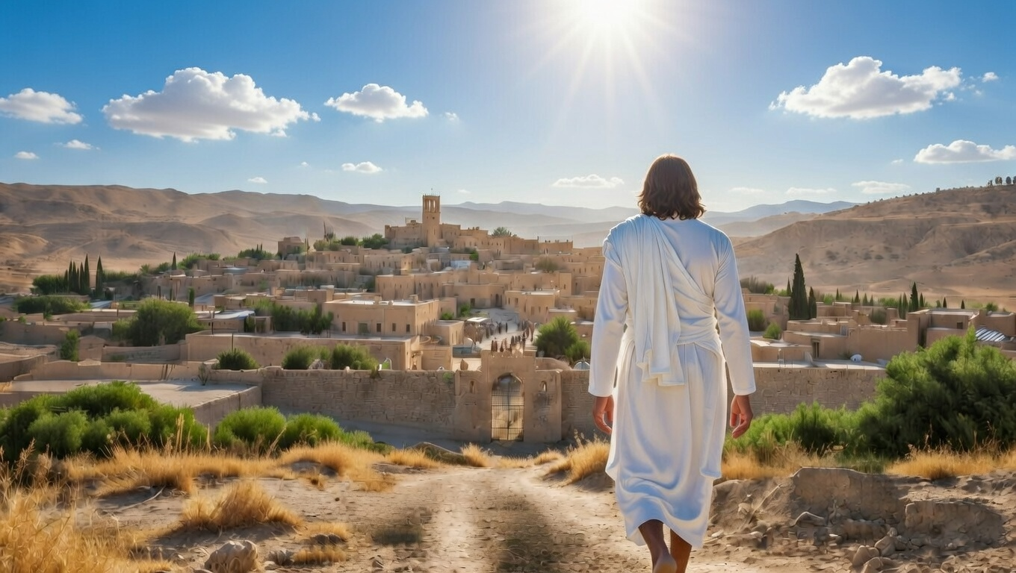

The Leaders We Need
Micah
Chapter 3-5

Slide 2
The Leaders We Need
Ones that give out justice – serve others

Slide 3
“By this we have known love, that He laid down His life for us; and we ought to lay down our lives for the brothers.”
I John 3:16

Slide 4
“But your iniquities have made a separation between you and your God, And your sins have hidden His face from you so that He does not hear.”
Isaiah 59:2

Slide 5
The Leaders We Need
Ones that give out justice – serve others

Slide 6
“Holding to a form of godliness, but having denied its power. Keep away from such men as these.”
II Timothy 3:5

Slide 7
The Leaders We Need
Ones that give out justice – serve others
Ones that promise a restored life – believe in salvation

Slide 8
“But it will be in that day, that I will make Jerusalem a heavy stone for all the peoples; all who heave it up will be severely injured. And all the nations of the earth will be gathered against it… (cont)
Zechariah 12:3,6

Slide 9
(cont) …In that day I will make the clans of Judah like a fiery laver among pieces of wood & a fiery torch among sheaves, so they will consume on the right hand & on the left all the surrounding peoples, while Jerusalem will again be inhabited in its own place—in Jerusalem.”
Zechariah 12:3,6

Slide 10
The Leaders We Need
Ones that give out justice – serve others
Ones that promise a restored life – believe in salvation
Ones that point to Jesus – seek His reign

Slide 11
“For a child will be born to us, a son will be given to us; And the government will rest on His shoulders; And His name will be called Wonderful Counselor, Mighty God, Eternal Father, Prince of Peace.”
Isaiah 9:6

Slide 12
The Leaders We Need
Ones that give out justice – serve others
Ones that promise a restored life – believe in salvation
Ones that point to Jesus – seek His reign

