Slide 1
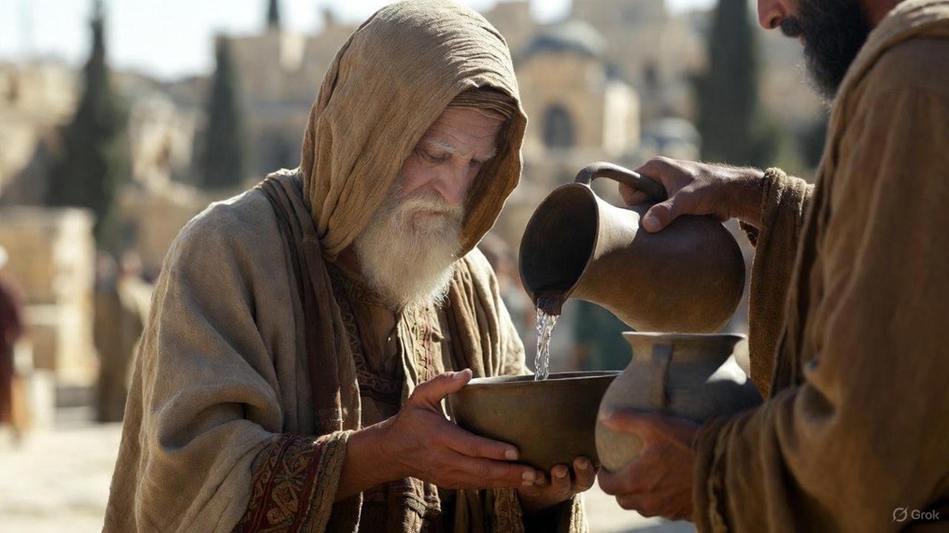

.
True Sons Of Abraham
J
THE
BOOK
of
OHN
Chapter 8:31-59

Slide 2
.
Live The Truth Abraham Believed
You’ll be set free from sin

Slide 3
.
“Sanctify them by the truth; Your word is truth.”
John 17:17

Slide 4
.
Live The Truth Abraham Believed
You’ll be set free from sin

Slide 5
.
“Do you not know that when you go on presenting yourselves to someone as slaves for obedience, you are slaves of the one whom you obey, either of sin leading to death, or of obedience leading to righteousness?”
Romans 6:16

Slide 6
.
“But thanks be to God that though you were slaves of sin, you obeyed from the heart that pattern of teaching to which you were given over, & having been freed from sin, you became slaves of righteousness.”
Romans 6:17-18

Slide 7
.
Live The Truth Abraham Believed
You’ll be set free from sin
You’ll become children of God

Slide 8
.
“Then he believed in Yahweh; and He counted it to him as righteousness.”
Genesis 15:6

Slide 9
.
Live The Truth Abraham Believed
You’ll be set free from sin
You’ll become children of God

Slide 10
.
“For as many as are being led by the Spirit of God, these are sons of God. For you have not received a spirit of slavery leading to fear again, but you have received the Spirit of adoption as sons by whom we cry out, “Abba! Father!”
Romans 8:14-15

Slide 11
.
“I know your tribulation and your poverty (but you are rich), and the blasphemy by those who say they are Jews and are not, but are a synagogue of Satan.”
Revelation 2:9

Slide 12
.
“Behold, I am giving up those of the synagogue of Satan, those who say that they are Jews & are not, but lie. Behold, I will make them come & bow down before your feet, & make them know that I have loved you.”
Revelation 3:9

Slide 13
.
“For he is not a Jew who is one outwardly, nor is circumcision that which is outward in the flesh. But he is a Jew who is one inwardly; & circumcision is that which is of the heart, by the Spirit, not by the letter; & his praise is not from men, but from God.”
Romans 2:28-29

Slide 14
.
Live The Truth Abraham Believed
You’ll be set free from sin
You’ll become children of God
You’ll be granted life from the dead

Slide 15
.
“There is neither Jew nor Greek, there is neither slave nor free man, there is no male & female, for you are all one in Christ Jesus. And if you belong to Christ, then you are Abraham’s seed, heirs according to promise.”
Galatians 3:28

Slide 16
.
Live The Truth Abraham Believed
You’ll be set free from sin
You’ll become children of God
You’ll be granted life from the dead

