Slide 1
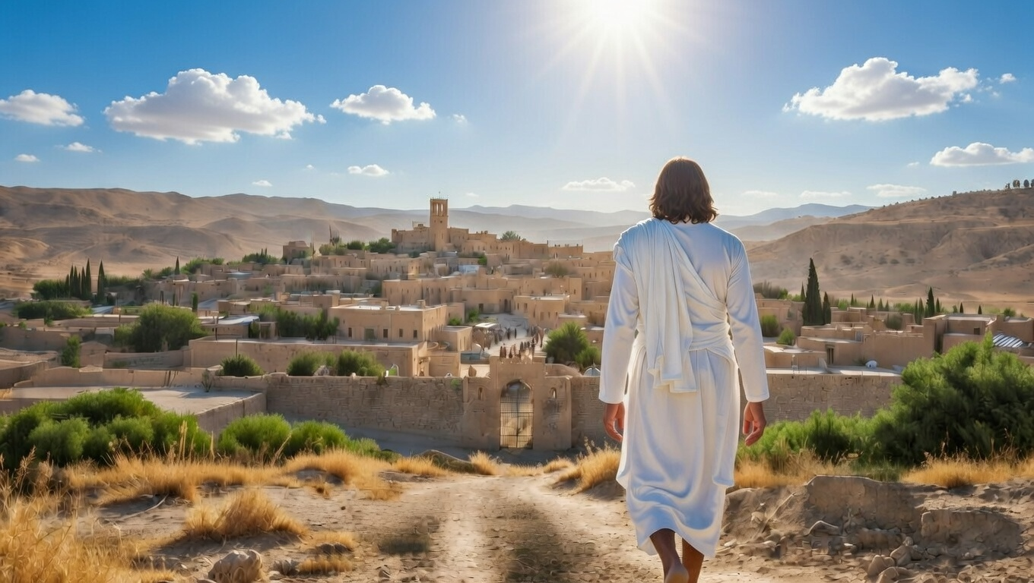

Israel’s Timeline Of Grace
Micah
Chapter 6-7

Slide 2
Israel’s Timeline Of Grace
They’re loosed from under evil leaders
They’re expected to forsake their own efforts

Slide 3
“Samuel said, “Has Yahweh as much delight in burnt offerings and sacrifices as in obeying the voice of Yahweh? Behold, to obey is better than sacrifice, and to heed than the fat of rams.”
I Samuel 15:22

Slide 4
Israel’s Timeline Of Grace
They’re loosed from under evil leaders
They’re expected to forsake their own efforts
They’re released into rebellion
They’re discontent and distrusting

Slide 5
“May it never be! Rather, let God be true and every man a liar.”
Romans 3:4a

Slide 6
Israel’s Timeline Of Grace
They’re loosed from under evil leaders
They’re expected to forsake their own efforts
They’re released into rebellion
They’re discontent and distrusting
They’re gifted life by God’s grace

