Slide 1

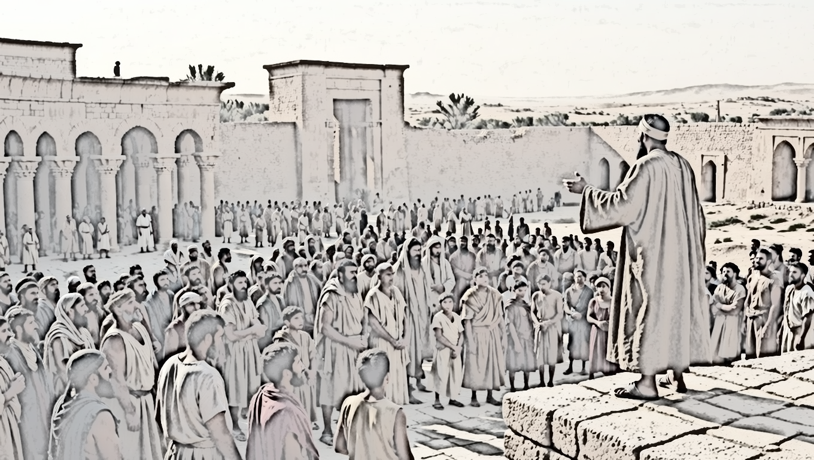

When Justice Prevails

Slide 2
When Justice Prevails
God will be seen in strength and control
Our enemies will understand their lack of control
We will learn not to trust ourselves

Slide 3
Proverbs 14:12
“There is a way which seems right to a man, But its end is the way of death.”

Slide 4
When Justice Prevails
God will be seen in strength and control
Our enemies will understand their lack of control
We will learn not to trust ourselves

Slide 5
Luke 13:1-5
“Now at that same time there were some present who were reporting to Him about the Galileans whose blood Pilate had mixed with their sacrifices. Jesus answered & said to them, ‘Do you think that these Galileans were greater sinners than all other Galileans because they suffered these things?’… (con’t)

Slide 6
Luke 13:1-5
(con’t) …‘I tell you, no, but unless you repent, you will all likewise perish. Or do you think that those eighteen on whom the tower in Siloam fell & killed them were worse offenders than all the men who live in Jerusalem? I tell you, no, but unless you repent, you will all likewise perish.’”

Slide 7
When Justice Prevails
God will be seen in strength and control
Our enemies will understand their lack of control
We will learn not to trust ourselves

Slide 8
Psalm 20:7
“Some boast in chariots and some in horses, But we will boast in the name of Yahweh, our God.”

Slide 9
When Justice Prevails
God will be seen in strength and control
Our enemies will understand their lack of control
We will learn not to trust ourselves

