Slide 1
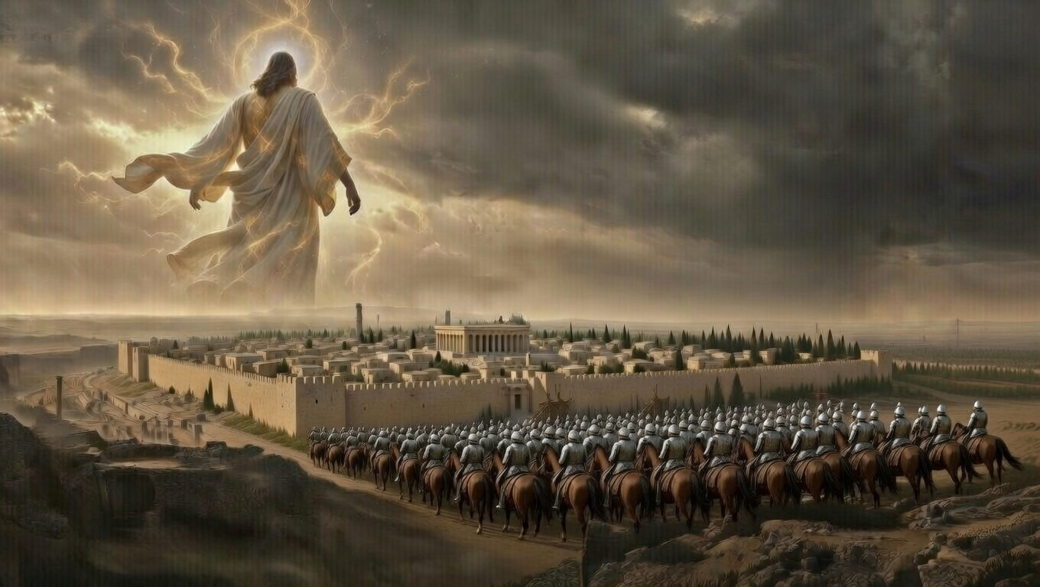


. Habakkuk .
God Handles Evil Perfectlyrf.

Slide 2
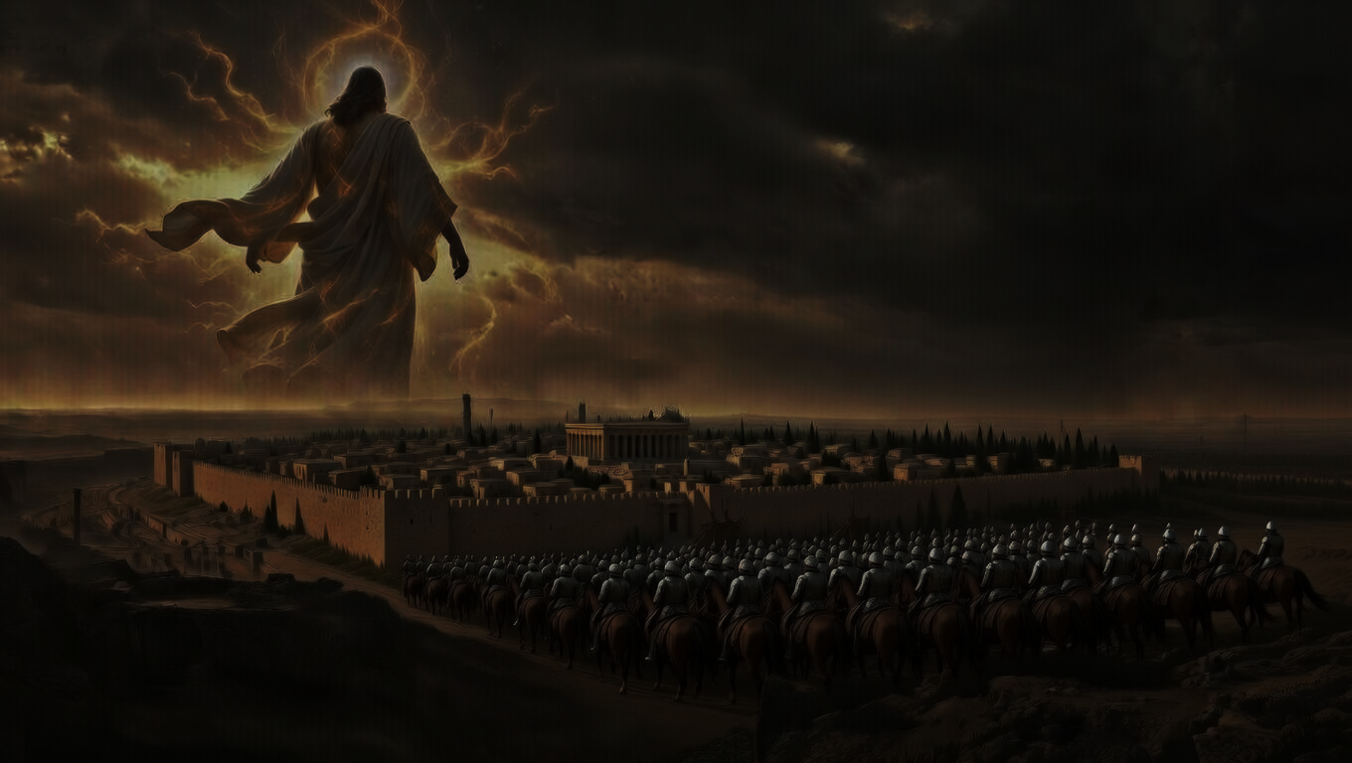
God Handles Evil Perfectly .
Why does God allow wickedness?
    God will bring it to an end
Why does God use wicked people?
    Be concerned with which side of judgement we’re on
Rise above with praise.

Slide 3
“These things I have spoken to you, so that in Me you may have peace. In the world you have tribulation, but take courage; I have overcome the world.” .
John 16:33 .

Slide 4
God Handles Evil Perfectly .
Why does God allow wickedness?
    God will bring it to an end
Why does God use wicked people?
    Be concerned with which side of judgement we’re on
Rise above with praise.

Slide 5
Examples of .
God Handles Evil Perfectly .
Joseph attacked by the evil world
    Rose above to save all Israel
The Blind Man attacked by evil flesh
    Rose above to condemn unbelievers
Job attacked by the evil devil
    Rose above to glorify God.

