Slide 1
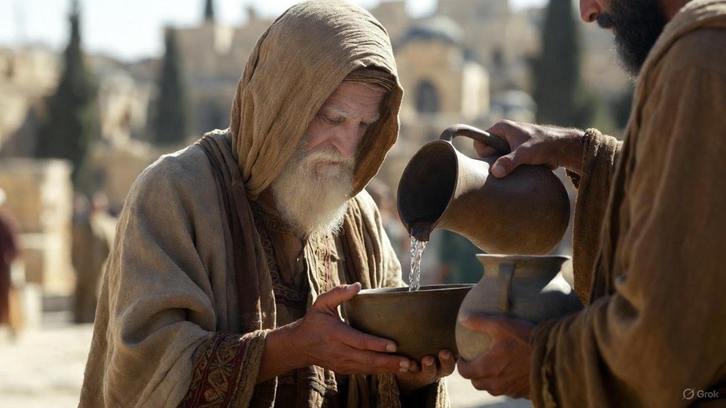

.
Are You Truly In The Kingdom?
J
THE
BOOK
of
OHN
Chapter 10

Slide 2
.
Are You Truly In The Kingdom?
We believe Jesus is the only method for entrance into the Kingdom

Slide 3
.
“Strive to enter through the narrow door, for many, I tell you, will seek to enter & will not be able. Once the head of the house gets up & shuts the door, & you begin to stand outside & knock on the door, saying, ‘Lord, open up to us!’ then He will answer & say to you, ‘I do not know where you are from.’ Then you will begin to say, ‘We ate & drank in Your presence, & You taught in our streets… (cont)
Luke 13:24-29

Slide 4
.
(cont) …And He will say, ‘I tell you, I do not know where you are from; depart from Me, all you workers of unrighteousness.’ “In that place there will be weeping & gnashing of teeth when you see Abraham & Isaac & Jacob & all the prophets in the kingdom of God, but yourselves being cast out. “And they will come from east & west & from north & south, & will recline at the table in the kingdom of God.”
Luke 13:24-29

Slide 5
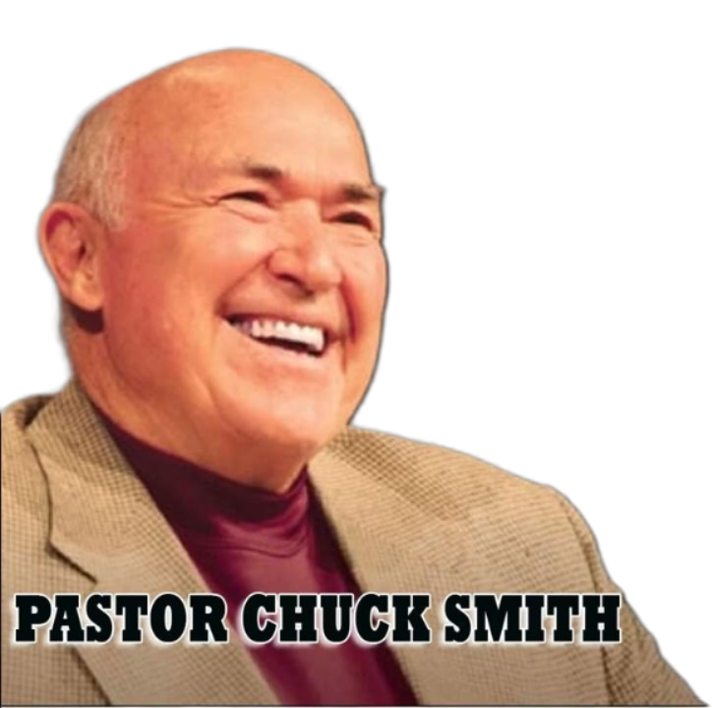
.
“Healthy sheep reproduce”
Pastor Chuck

Slide 6
.
Are You Truly In The Kingdom?
We believe Jesus is the only method for entrance into the Kingdom
We believe Jesus sacrificed for and shepherds over us

Slide 7
.
“And this is eternal life, that they may know You, the only true God, and Jesus Christ whom You have sent.”
John 17:3

Slide 8
.
Are You Truly In The Kingdom?
We believe Jesus is the only method for entrance into the Kingdom
We believe Jesus sacrificed for and shepherds over us

Slide 9
.
“He says, ‘It is too small a thing that You should be My Servant To raise up the tribes of Jacob & to cause the preserved ones of Israel to return; I will also give You as a light of the nations so that My salvation may reach to the end of the earth.”
Isaiah 49:6

Slide 10
.
“Remember that you [Gentiles] were at that time without Christ, alienated from the citizenship of Israel, & strangers to the covenants of promise, having no hope & without God in the world. But now in Christ Jesus you who formerly were far off have been brought near by the blood of Christ. For He Himself is our peace, who made both groups one & broke down the dividing wall of the partition by abolishing in His flesh the enmity, the Law of commandments contained in ordinances, so that in Himself He might create the two into one new man, making peace.”
Ephesians 2:12-15

Slide 11
.
“All of us like sheep have gone astray, Each of us has turned to his own way; But Yahweh has caused the iniquity of us all To fall on Him.”
Isaiah 53:6

Slide 12
.
Are You Truly In The Kingdom?
We believe Jesus is the only method for entrance into the Kingdom
We believe Jesus sacrificed for and shepherds over us
We hear Jesus’ voice & know Him
We’re made into more than sheep, but also sons & daughters of God

