Slide 1
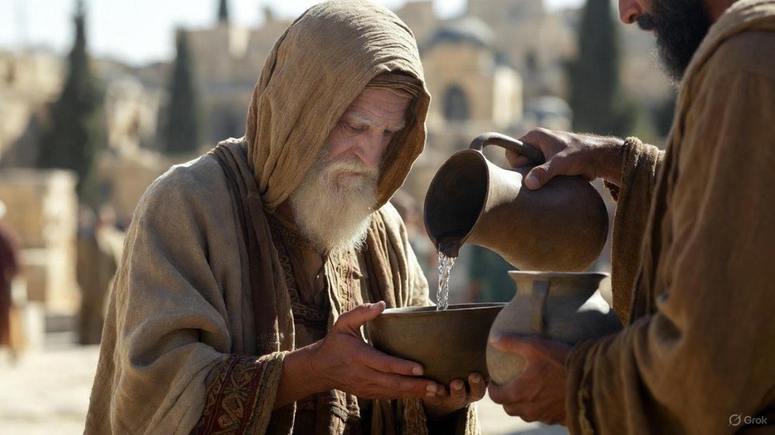

.
Growing Through The Impossible
J
THE
BOOK
of
OHN
Chapter 11:1-46

Slide 2
.
Aristotle’s Ten Categories
Substance (What?) – Turned water to wine
Quantity (How much?) – Fed 5,000
Quality (What kind?) – Blind man receives sight
Place (Where?) – Healed from a distance
Time (When?) – Healed a lame man of 38 years
Position (On what?) – Walked on water
Action (What it does?) – His willing death
Passion (What is done to it?) – His resurrection
State (What it has?) – Caught an abundance of fish
Relation (To what?) – Raised Lazarus to the living

Slide 3
.
Growing Through The Impossible
J
THE
BOOK
of
OHN
Chapter 11:1-46

Slide 4
.
Growing Thru Impossible Situations
Let love for God & others propel us to endure

Slide 5
.
“So faith comes from hearing, and hearing by the word of Christ.”
Romans 10:17

Slide 6
.
Growing Thru Impossible Situations
Let love for God & others propel us to endure
Don’t limit God’s power & personal purpose
Act rightly even when struggling to believe

Slide 7
.
“And He [Jesus] did not do many miracles there because of their unbelief.”
Matthew 13:58

Slide 8
.
Growing Thru Impossible Situations
Let love for God & others propel us to endure
Don’t limit God’s power & personal purpose
Act rightly even when struggling to believe

