Slide 1
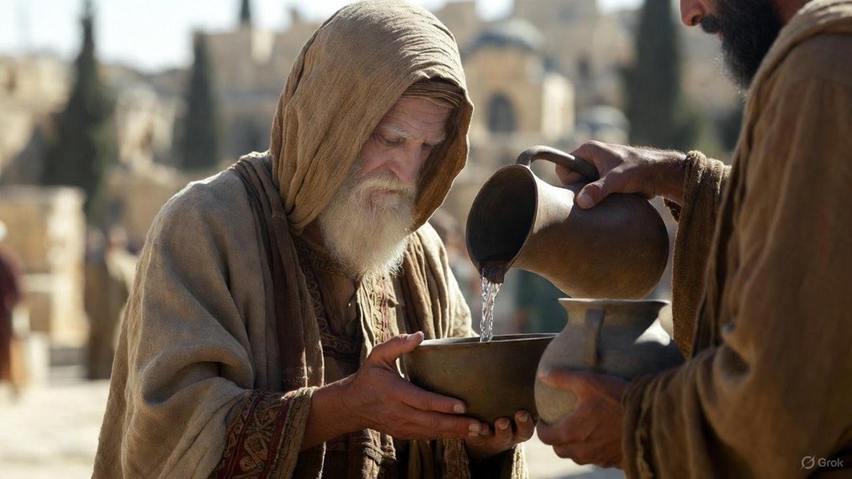

.
Authenticity
J
THE
BOOK
of
OHN
Chapter 11:47-12:19

Slide 2
.
Are We Truly Being Authentic?
Are we truly concerned about truth or just self-preservation?

Slide 3
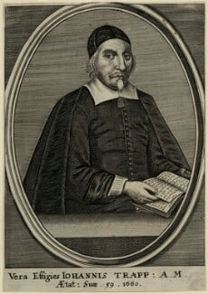
.
“Wholesome sugar may be found in a poisoned cane, a precious stone in a toad’s head, a flaming torch in a blind man’s hand”
John Trapp

Slide 4
.
Are We Truly Being Authentic?
Are we truly concerned about truth or just self-preservation?
Are we truly worshippers or do we see it as a waste?
Is out devotion skin-deep or can we persevere thru troubles?

