Slide 1
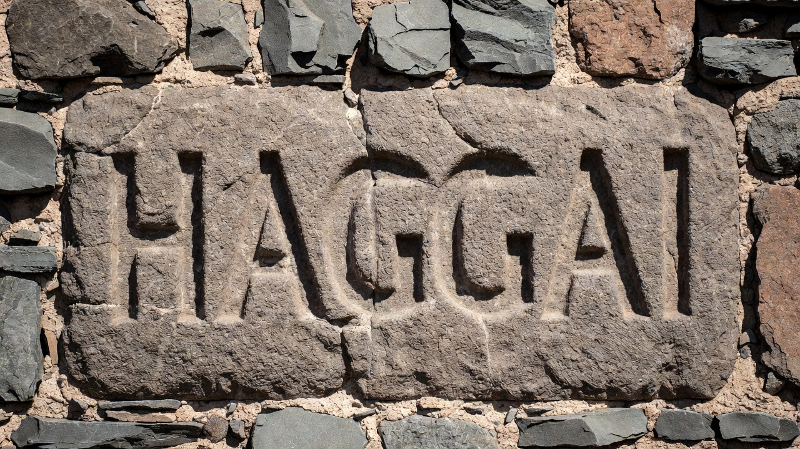


A Fruitful Fresh Start

Slide 2
A Fruitful Fresh Start
Called to Construct: Prioritize the Spiritual over the earthly, we have God’s counsel
Called to Courage: Don’t despise a small start, we have God’s covenant, Spirit & promise
Called to Cleanliness: Set our hearts on fearing God, then we’ll have His blessing
Called to Confidence: He’s coming back, we have God’s promise

Slide 3
I John 3:2-3
“Beloved, now we are children of God, & it has not been manifested as yet what we will be. We know that when He is manifested, we will be like Him, because we will see Him just as He is. Everyone who has this hope fixed on Him purifies himself, just as He is pure.”

Slide 4
Jeremiah 22:24-30
“As I live, declares Yahweh, even though Coniah the son of Jehoiakim king of Judah were a signet ring on My right hand, yet I would pull you off; & I will give you over into the hand of…Nebuchadnezzar king of Babylon…. (cont)

Slide 5
Jeremiah 22:24-30
(cont) …I will hurl you and your mother who bore you into another land—there you were not born, but there you will die. But as for the land to which their soul desires to return, they will not return to it… (cont)

Slide 6
Jeremiah 22:24-30
(cont) …Is this man Coniah a despised, shattered jar? Or is he an undesirable vessel? Why have he & his seed been hurled out & cast into a land that they had not known? O land, land, land, Hear the word of Yahweh… (cont)

Slide 7
Jeremiah 22:24-30
(cont) …Thus says Yahweh, Write this man down childless, A man who will not succeed in his days; For no man of his seed will succeed sitting on the throne of David or ruling again in Judah.”

Slide 8
A Fruitful Fresh Start
Called to Construct: Prioritize the Spiritual over the earthly, we have God’s counsel
Called to Courage: Don’t despise a small start, we have God’s covenant, Spirit & promise
Called to Cleanliness: Set our hearts on fearing God, then we’ll have His blessing
Called to Confidence: He’s coming back, we have God’s promise

Slide 9
Ezra 5:1-2
“And the prophets, Haggai the prophet and Zechariah the son of Iddo, prophesied to the Jews who were in Judah and Jerusalem in the name of the God of Israel, who was over them…. (cont)

Slide 10
Ezra 5:1-2
(cont) …then Zerubbabel the son of Shealtiel and Jeshua the son of Jozadak arose and began to rebuild the house of God which is in Jerusalem; and the prophets of God were with them supporting them.”

Slide 11
A Fruitful Fresh Start
Called to Construct: Prioritize the Spiritual over the earthly, we have God’s counsel
Called to Courage: Don’t despise a small start, we have God’s covenant, Spirit & promise
Called to Cleanliness: Set our hearts on fearing God, then we’ll have His blessing
Called to Confidence: He’s coming back, we have God’s promise

